Slide 1
The history of chemistry

Slide 2
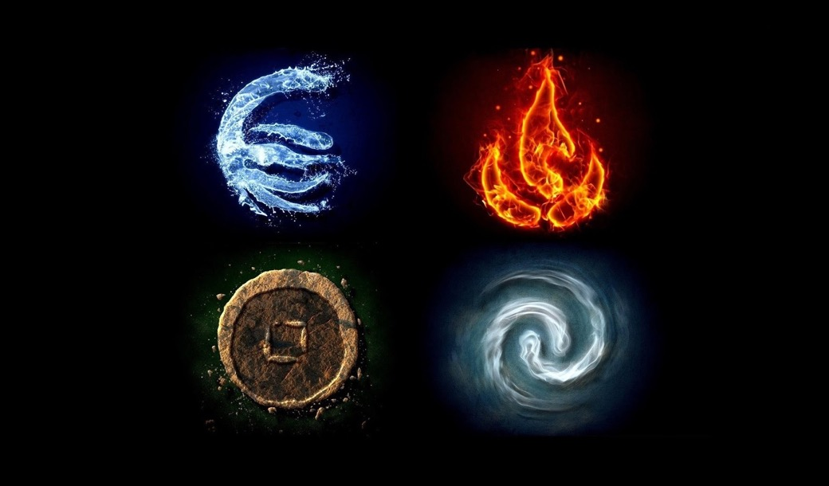
What is matter? What are the fundamental varieties of matter?
The ancient greeks thought there were four of these elements

Slide 3
Today we know there are over 100
These are Nature’s building blocks

Slide 4
How did we discover all these different elements?
By studying the gases produced during chemical reactions

Slide 5
Phlogiston theory

Slide 6
Early chemists antoine laurant de Lavoisier and joseph priestly figured out what was really going on
Heating substances like ore did not make them gain phlogiston.
It made them LOSE a gas.
Lavoisier called it oxygen!

Slide 7
What are the fundamental forces of the universe?
Gravity – attractive
Electromagnetism – attractive/repulsive
Strong nuclear interactions
Weak nuclear interactions

Slide 8
We can demonstrate this with scotch tape!

Slide 9
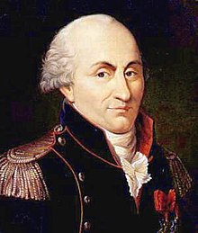
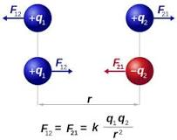
Coulomb’s law
Charles-Augustin de Coulomb
1736-1806
$$F=k\left|\frac{q_{1}∗q_{2}}{r^{2}}\right|$$

Slide 10
He proved it with his torsion balance

Slide 11
But it wasn’t until alessandro volta invented the first battery that we could have a sustained flow of charge
1745-1827

