Slide 1
Fake Reality
A Choose your own adventure story by: brynli donovan :]

Slide 2
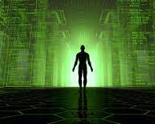
Intro
You wake up in your bed. The world loading in before your eyes. You feel refreshed and eccentric to get your life started. As you get up you walk outside, your hunger is nonexistent. You can't remember the last time you tasted real food, but the thought doesn't last long. All you know is, your life is perfect. As you walk outside your steps seem slower than normal. You look down and see a strange sight. It turns out your legs are wrapped in wires. What do you do?
You call for help.
You tug the wires.

Slide 3
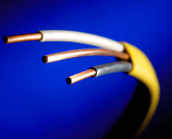
You tug the wires
You tug the wires, and they rip very easily. They're old and rusty. Next thing you know your vision flickers and your head feels extremely heavy. You reach your hands up and feel a strange device. You take it off and what you see is horrifying. You see your apartment which you've lived in your whole life. But it's empty and torn up. There are holes everywhere and the windows are busted. You see the door wide open. You begin to walk towards it and for the first time in your life you see the real outdoors. It is nothing like you've seen in your world, everything is dead and more apartments stack on each other in rows. You look to your right and see robots coming towards you with red lasers scanning the ground and walls. What do you do?
Hide.
Ask for help.

Slide 4
You call for help
As you call for help the police come towards you, asking what is wrong. You tell them your legs aren't yours and they're wrapped in wires. To the police, your legs are normal, but they decide to take you to the Mayor. Do you follow?
Go with the police.
Run away.

Slide 5
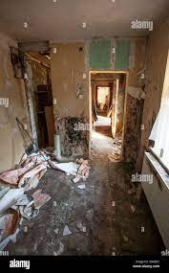
Hide
You duck back into the room scrambling to find somewhere to take cover. You decide to hide behind and old bookcase. You quickly settle yourself but the sudden force from moving the bookcase to squeeze behind it caused the books on the top to fall. They clatter to the floor; the noise is very loud, and you hear the robots coming toward you. You stay put even though your insides are screaming for you to run. The robots burst in through the door and start scanning the room. Before you know it, you're floating in the air and the robots are grabbing you. You've been caught. Return to slide 1.

Slide 6
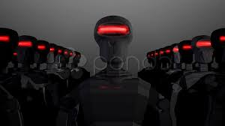
Ask for help.
You step out of the run-down building and wave your arms. You have no idea what they're going to do but you decide to trust them. The robots slowly walk towards you their red scanners covering every inch of your body. You ask them where you are, but they don't respond. They simply pick you up and begin to carry you. You thrash around but their grip is tight. You've been caught. Return to slide 1.

Slide 7
Go with the police.
You follow the police to their car. They take you to the mansion where the Mayor lives. You head inside, escorted by the two officers. He's sitting in his office, staring at you like you are not worthy of wasting his time. You tell him what happened and you see a flicker of panic across his face. It lasted for a second, but you know something is wrong. He's quiet for a moment then says, "Take this... anomaly to the brig." You start to panic, what do you do?
Run
Follow the police.

Slide 8
Both run options
You turn and run away from the police. They reach out to grab you but you're too quick. You manage to run out of their sight and you turn down and alleyway. It's not safe to return to your apartment. You're lost and you have no idea what to do. But you remember about the wires around your legs, what do you do?
Tear the wires
Leave them alone.

Slide 9
2nd follow the police
The police grab you by the arms roughly. You beg them to be gentle and start asking questions, how could you possibly be an anomaly? You try to escape but they hold you tight. They drag you down stone step, the air getting colder and dense. You feel like you're suffocating. The police unlock the door and throw you inside. You've been caught. Return to slide 1.

Slide 10
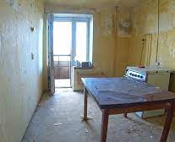
Tear the wires after running
You yank the wires off your legs and your vision flickers. Next thing you know, you're in your apartment but holes fill the walls, and the windows are shattered. Everything is dilapidated and you can hardly recognize it. You wander towards the door, you peek outside and see large robots with red scanners are coming your way. What do you do?
Run
Ask for help.

Slide 11
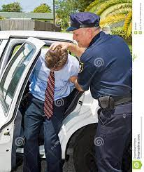
Leave the wires alone
You shake your head and decide to leave the wires alone. You don't know enough about them to be messing around and the police are on your tail. Next thing you know you’re cornered. Policemen step out in front of you and start gripping your arms and dragging you to their car. They shut you inside roughly and start driving towards the Mayor’s mansion. You’ve been caught. Return to slide 1.

Slide 12
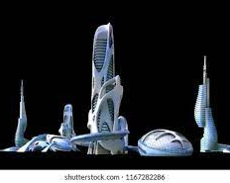
Run from robots.
You bust through one of the holes in the wall. The robots sense you present and bust through behind you. You sprint for cover in an old car patch with mounds of compressed metals. You hide in an old truck and duck into the seat, compressed low against the rusty floor. The red scanners float by you, and you escape, for now. You wait longer and finally crawl out of the car. You cast a cautious glance around and see a tall building. It's shaped like a diamond, and it glows a bright blue. You see a load of robots marching toward the building. You decide to go towards it.

Slide 13
Go towards the building.
You start at a fast jog as you head towards the glowing building. The robots pay no mind to you as you approach. You stay ducked behind a rise in the ground. The last of the robots go into the building and the doors begin to close. You run after them and slip into the door before it bangs shut. You see rows of robots lined up staring at the same spot. A glowing orb, it seems to be the source of power, for all the robots seemed to be charging with long plugs. What do you do?
Leave.
Destroy the orb.

Slide 14
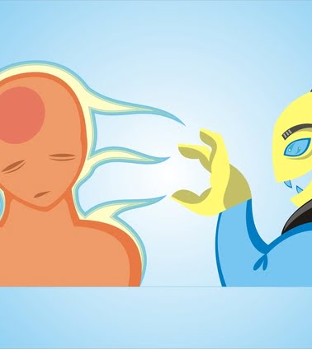
Leave
You turn and run away. The sudden noise seems to jerk the robots from their slumber. They turn towards you, their long legs sprinting at you much faster than your own legs can carry you. They grab you roughly, their metallic hands cutting into your skin. They start to chant a word that makes your blood run cold. “Sacrifice. Sacrifice.” They take you to the orb and you feel the life force being drained out of you. Unfortunately, you’re dead. Game over.

Slide 15
Destroy the orb.
You start to sprint towards the orb. The robots seem startled, in their own creepy way. They start to chase after you, but you manage to get there before them. You grab the orb, it's warm in your hands and you can sense the energy trying to take over you. It's nice and pleasant, you can feel it offering you everlasting happiness. You face one last decision. What do you do?
Let the orb take over.
Destroy the orb.

Slide 16
Let the orb take over.
The orb seeps into your skin. Your vision darkens and the robots cheer. They finally managed to find a human body to take over and use as a host to infiltrate the virtual world. Mankind’s fate was rested on your shoulders, but now it's over. The robots will be able to take over the world, again. Mankind's paradise will soon be a robot factory. You’ve ended up destroying the world. Game over.

Slide 17
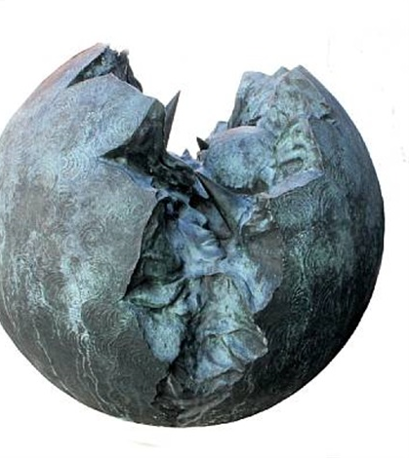
Destroy the orb.
You throw the orb to the ground. Watching it shatter before you. You fought the urge to let it take over you and now it’s gone. The robots collapse and you’ve defeated them. Congratulations. You won. You’ve saved mankind.

