Slide 1
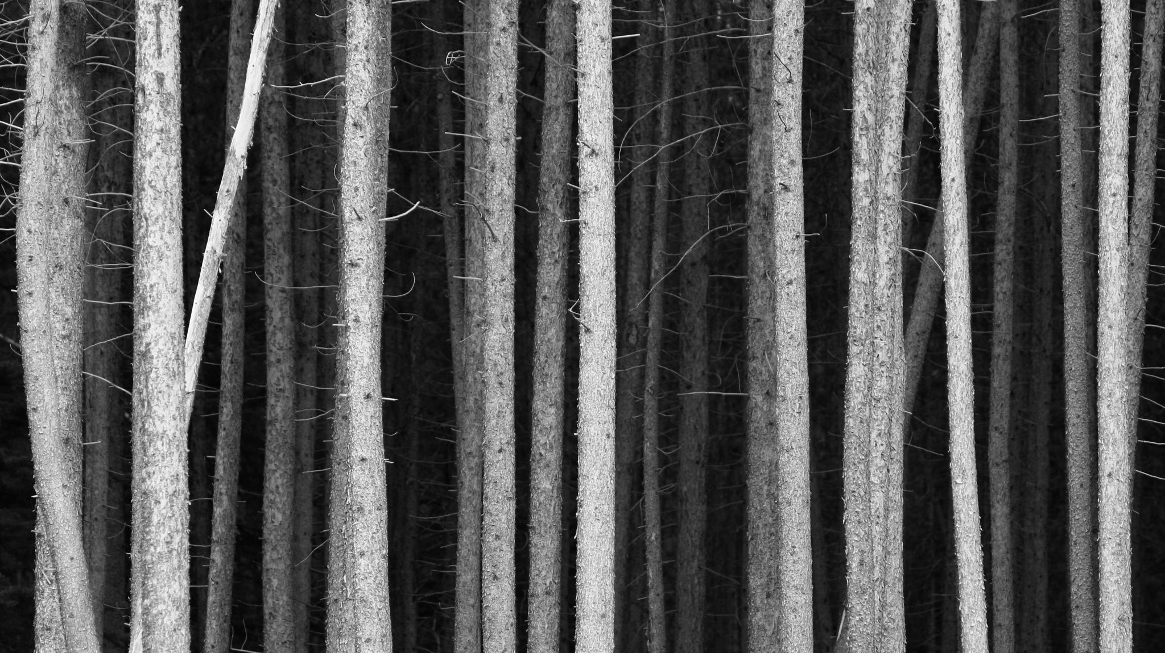
The Forest
By Haddon Smith

Slide 2
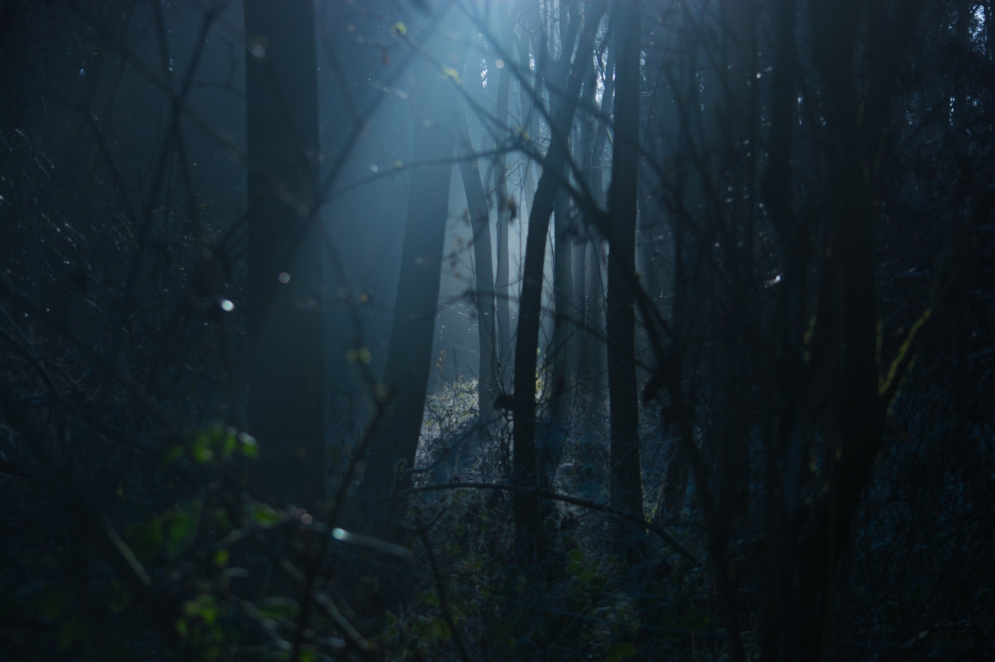
The Forest
Do you shove him back?
Or do you stay on the ground
You fly up from your lying position, panting from the nightmares haunting your every step. The moon shines down on you, reflecting its rays over your body. As you stand up the leaves crunch beneath your feet, and you spin around after catching something out of the corner of your eye. A growl comes from behind the line of tall bushes stalking the forest. Instead of an animal jumping out as you think it would, it is a boy with dirty bangs and brown eyes. “Gus” You breath out, the air floating around like a dragon breathing out smoke. His mouth moves and you can sense that he is yelling but no sound comes out of his mouth. A shove from his hands sends you flying backwards, slamming into the back of a tree. The bark drags against your arm, slicing it open. You stare up at the boy not knowing what to do.

Slide 3
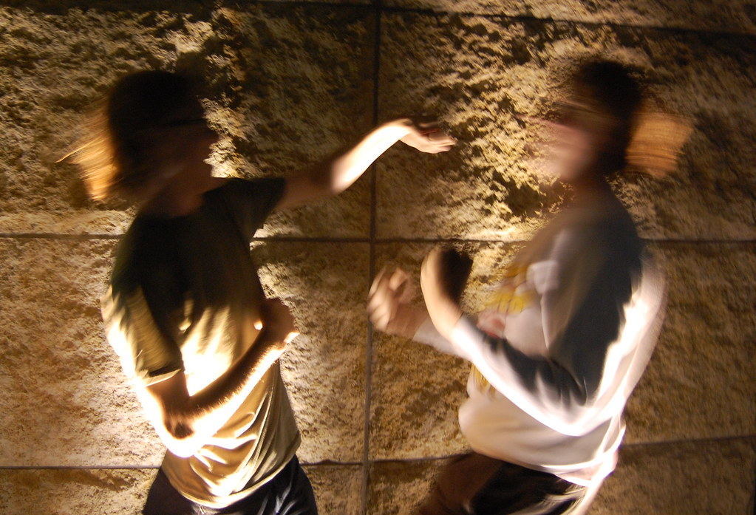
Shove him back
Your expression grows into one of annoyance and your legs stagger up from their previously limp position. Your hands push him back with a glare. Gus glowers back at you, another soundless noise coming out of his throat. He charges towards you, the cool air of the night brushing against your skin at the movements. You duck away from his punch, avoiding the hits that he can’t seem to land on you. You got too cocky though, and the tables turn so he was the one landing all the punches. His fist embeds itself into your ribs and the wind leaves your lungs. You dig your nails into the dirt in hopes of getting away. A random line of moonlight shines on a part of the underbrush. You tilt your head at the silver glimpse and reach out to grab the silver. A blade was now in your hand, and you have the upper hand.
Do you- Stab Gus?
Or do you try to talk with him?

Slide 4
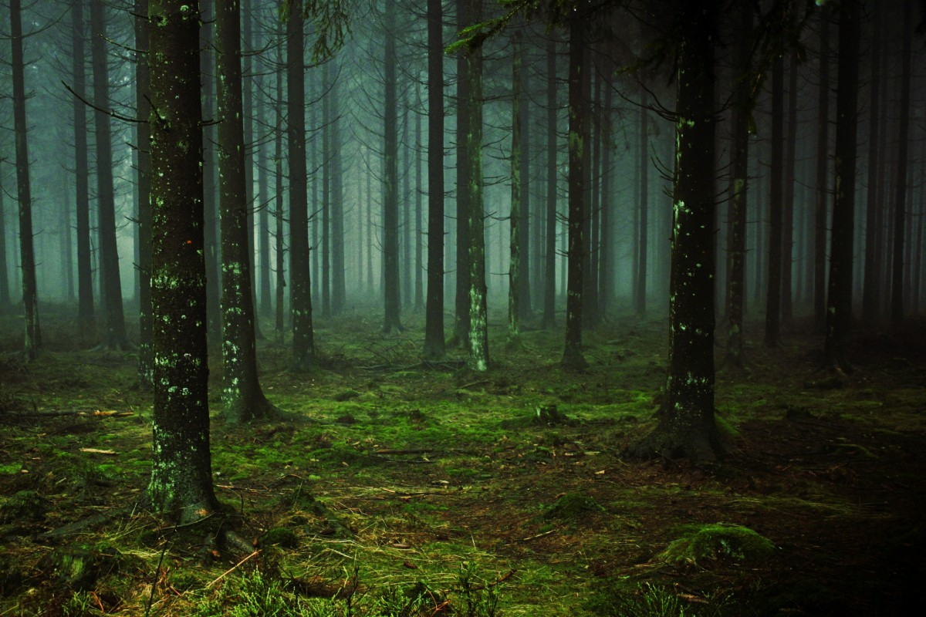
Stay on the Ground
You continue to stare up at him, not bothering to get up and argue against him. Your body seems so limp, and your brain has decided that it isn’t going to process anything else. Gus lifts you up from the back of your shirt and throws you further away from him. His lips move and you assume that he was screaming run, but your head won’t stop spinning. The world seems to be twirling like a colorful top, the forest blending, and nothing was visible to you. Your hand shakily rises to the back of your head and when it came back blood stained your fingers. In a spur of the moment, you lunge backwards, racing the opposite direction of the angry boy. You aren’t watching where you were going though, and suddenly you could hear rustling from a bush in front of you.
Do you- inspect the bush?
Or Keep running?

Slide 5
Talk to Gus
“Gus,” you plead, hand outstretched like you were dealing with a scared animal. Which, actually wasn’t so far off from his situation. The other hand hides behind your back, not allowing him to see the knife. He makes a face, and you could only assume that he is snarling at you. The older boy lunges forward, causing you to swing your arms out on instinct. Your eyes squeeze shut when you bring up your arms to protect your face with a shout. But when nothing happens you slowly peel them open to see Gus on the forest floor. His chest heaves up and down, blood pouring out of his throat where a deep slash is. You gasp and stumble backwards into a tree. But the wind seems to push you closer to the boy. Your hands reach out to hold his head in your lap, a stupid decision led by the kindness left in your soul. He blinks twice and then his body froze, and you knew that he was gone…
Go here

Slide 6
Stab Gus
You bring your hand holding the knife up and when Gus looks away, you stab his leg. He falls to the dirt floor forest and curling closer to his injury; the knife still stuck in his flesh. Gus forgets about you, or so you thought. You try to scurry away, but a hand reaches out and grabs your ankle. Your arms fly up in attempt to grab onto something that could help save you. He pulls you closer to him until you were almost two inches apart. Gus yanks out the blade with a soundless scream, and he brings you a quicker injury than you did to him. He embeds it into your ribs, smirking when you yell out in pain. Your chest turns red with blood as he stabs you again in the center of your chest. You cough on your blood, choking until your eyes roll back.
Go here

Slide 7
Keep Running
You almost step forward but in the last second you decide against it. Instead, you run to the right, away from both Gus and the bush. The morning sunlight has just begun to rise when you reach what looked like the end to the forest. You stop running and stand on the edge of the tree line, just out of the suns reach. Your eyes trail back to where the nights events had occurred, and the memories that would haunt you for a long-time flash before you. You shake your head, ridding yourself of the nightmares, and take a step forward. That is when you feel like you could finally breathe once again, with the sun's rays blinding your eyes, trailing down your bare arms. You stand in the grass for a minute, relishing the freedom from the forest that is forbidden to enter. Then, you take your first steps towards the village, ready for all the questions to come….
Go here

Slide 8
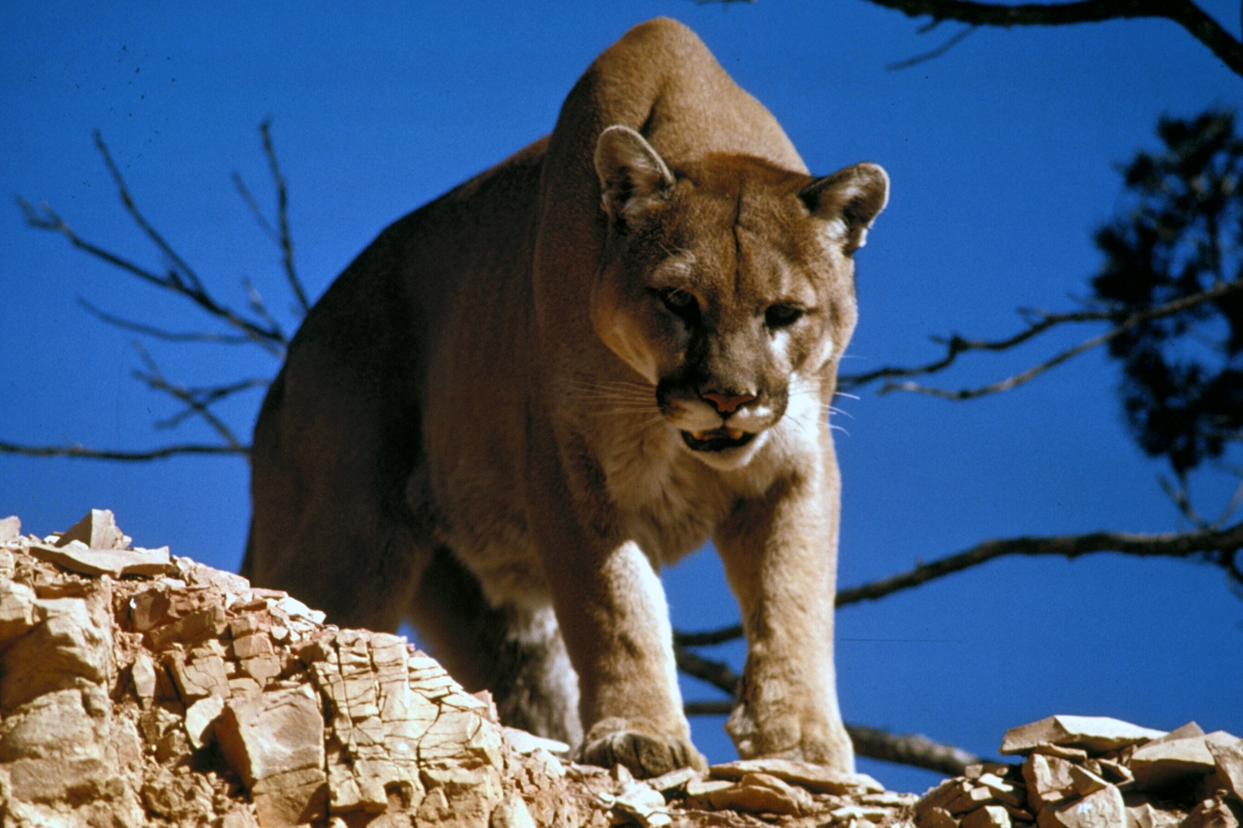
Inspect Bush
You creep closer, curiosity possessing you. The bush rattles some more, and it reminds you of an animal shaking in fear. Then, slowly, a tiny mountain lion paws its way out of the green shrub. Your face contours itself into an awing look, fawning over the adorable creature in front of you. It tilts its head in your direction, waddling over to your legs, rubbing its head up and down with a fond smile. You reach down to pet it, but a growl erupts from behind you. Your soul stops and you mentally whack your head, number one rule of baby creatures is to never approach because mamas are protective. Gradually, you turn around and slowly back up before turning that run into a hard on sprint. You run and run, hearing the snarls of the lion behind you. Your head runs straight into something, sending you flying backwards and towards the pouncing lion. You fall into the jaws of death, dying a slow antagonizing death of being eaten by a lion all because her child looks adorable.
Go here

Slide 9
Ending
You Died
Try Again

Slide 10
Ending
You made it out alive, congratulations

Slide 11
Ending
HEHE
YOU DEAD

Slide 12
Ending
Gus Died
…Boring

