Slide 1
not so fun camping
By: Mattie Hogan

Slide 2
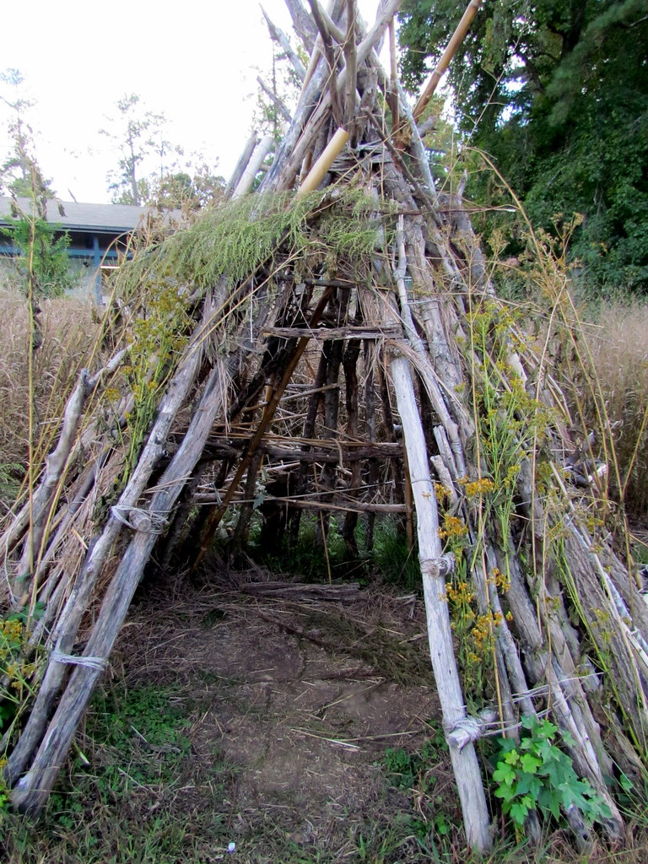
You blink your eyes open to a poorly made tent, the cloth surrounding your body feel wet and cold. You sit up from your sleeping position and slowly take in your whereabouts. Large jungle-like trees with water droplets dripping onto your face. The dark sky is protected by the thick leaves. You hear a sudden rustle behind your tent you decide to…
Stay hidden:
OR
Run away:

Slide 3
YOU CHOSE: to stay hidden
The noise behind you grows closer and closer. You are bundled up in a ball and holding your breath to be quiet, when suddenly, a long knife is thrown at your tent. It moves so fast that a clean hole now sits at the top of your tent. Luckily, the knife didn’t do any damage, and you can now use it to your advantage. Now that your tent has been exposed to the damp cold air outside and the creature trying to kill you, you feel as there is no choice but to run. You ready yourself, before dashing out of the tent, in the opposite direction of the creature. You hear light footsteps behind you, before they begin to quiet down. You start to slow your pace, resting your hands on your knees. When you can breathe normally again. You familiarize yourself with your surroundings and notice a fork in the road. There is a sign pointing to the left, but no words on it.
WHICH PATH DO YOU PICK?
LEFT: RIGHT:

Slide 4
YOU CHOSE: LEFT PATH
You hesitantly walk along the left path, which consists of several twists and turns, animals and creature snickering from the trees, something is always happening, nothing is ever quiet, you take a long-left turn, before you find yourself facing a glowing spider, you try not to move and draw attention to yourself, when you suddenly feel a bite on your left calf and begin to feel dizzy.
This Photo by Unknown Author is licensed under CC BY-NC

Slide 5
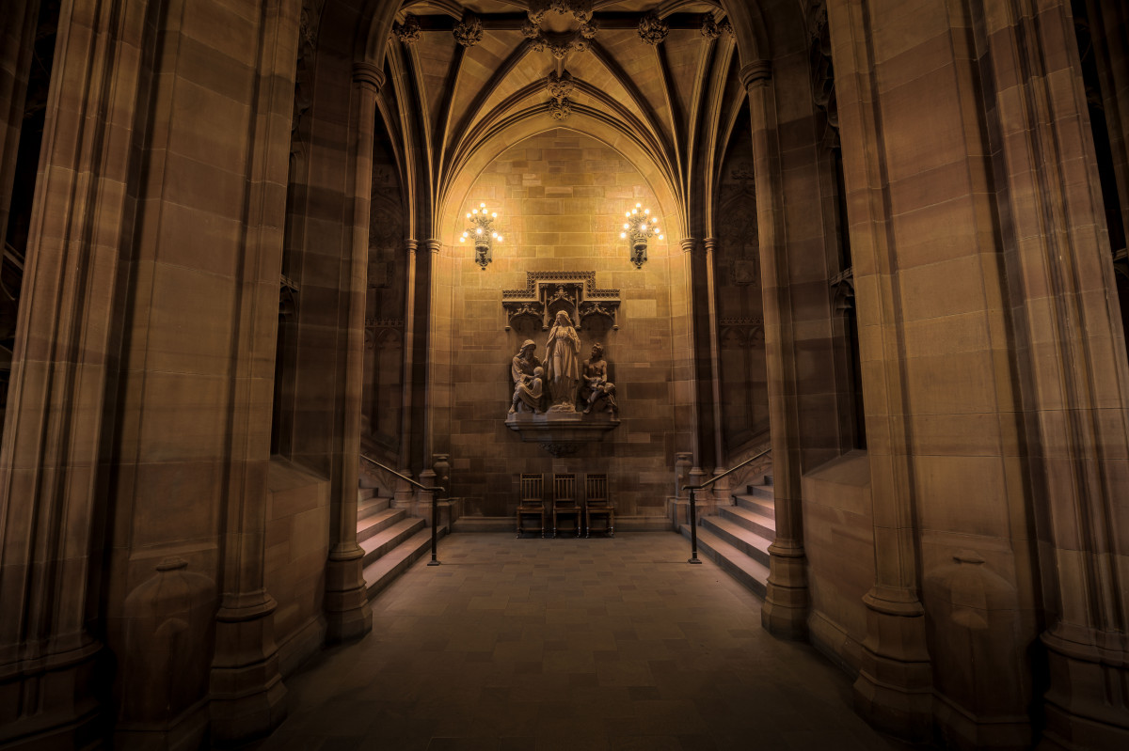
YOU CHOSE: GO INSIDE
You find a small crawlspace with spiderwebs in it. You slide through before you see a temple built of gold. The place is shining from roof to tile, everything in here is valuable. You stand there in awe, just wanting to stare for hours and hours. You take a step and the step presses down, and an arrow is shot right past your face, the ground begins to shake, and the crawlspace is slowly rising farther up. And you fall into a bottomless abyss.

Slide 6
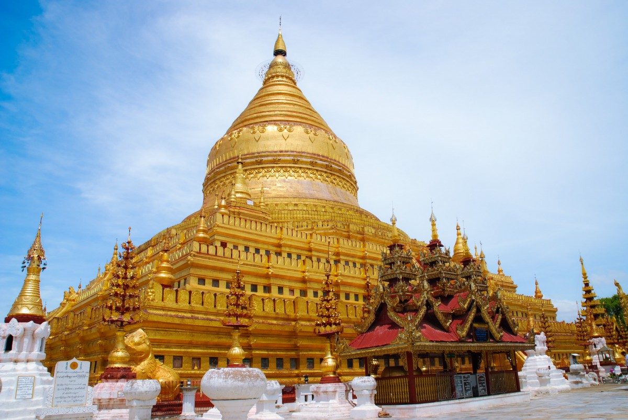
YOU CHOSE: RUNNN
You bolt out of the tent and run as fast as you can. The creature is not far behind you, you run for what feels like forever before the steps behind you begin to quiet. Wanting to be sure, you continue running for a while longer, before you find a huge temple.
WHAT DO YOU DO?
GO INSIDE: LOOK AROUND:

Slide 7
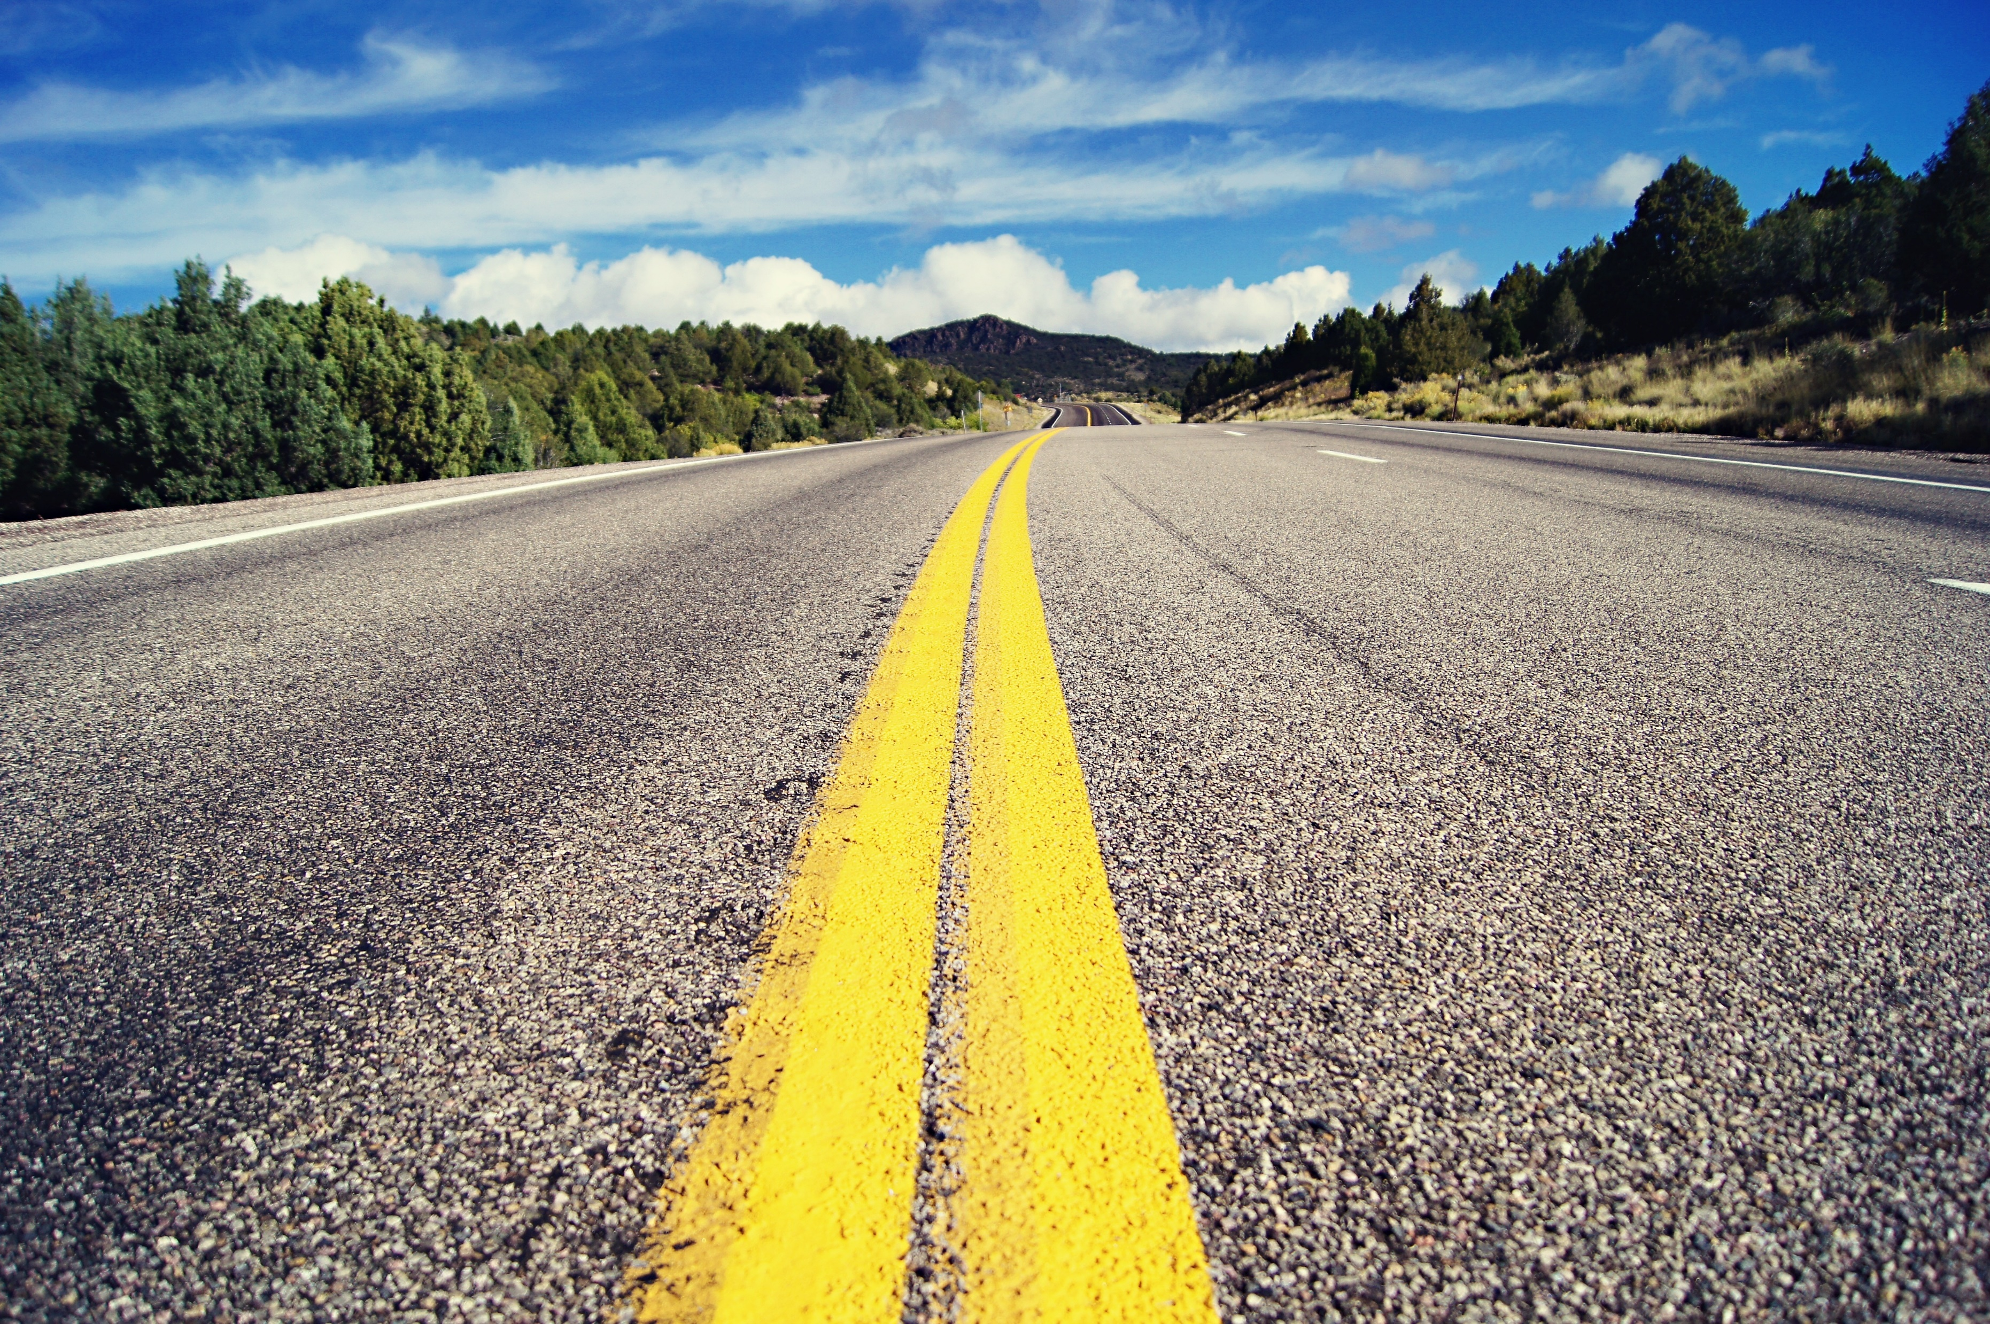
YOU CHOSE: LOOK AROUND
You begin to walk the perimeter of the temple before finding a road. A real road. You follow the road until you find a police station on the side of the road, glimpses of a city ahead. You ask an officer where you are and his only response;
"Hell."

Slide 8
YOU CHOSE: RIGHT PATH
YOU RUN TO THE RIGHT PATH. The path is straight and steady, but strangely wide. Suddenly, the ground begins to shake, and you feel sick to your stomach. Cracks begin spread on the ground and small creatures begin to fall out of trees. You see bugs and rodents and mixes of both. Larger animals begin to fall out of nowhere, making it more difficult for you to dodge. A large animal falls directly on top of you and crushes you to death.
RESTART?
This Photo by Unknown Author is licensed under CC BY-SA

