Slide 1
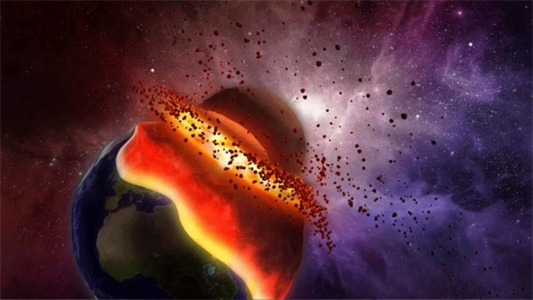
Time is almost out
LILLY PERRY

Slide 2
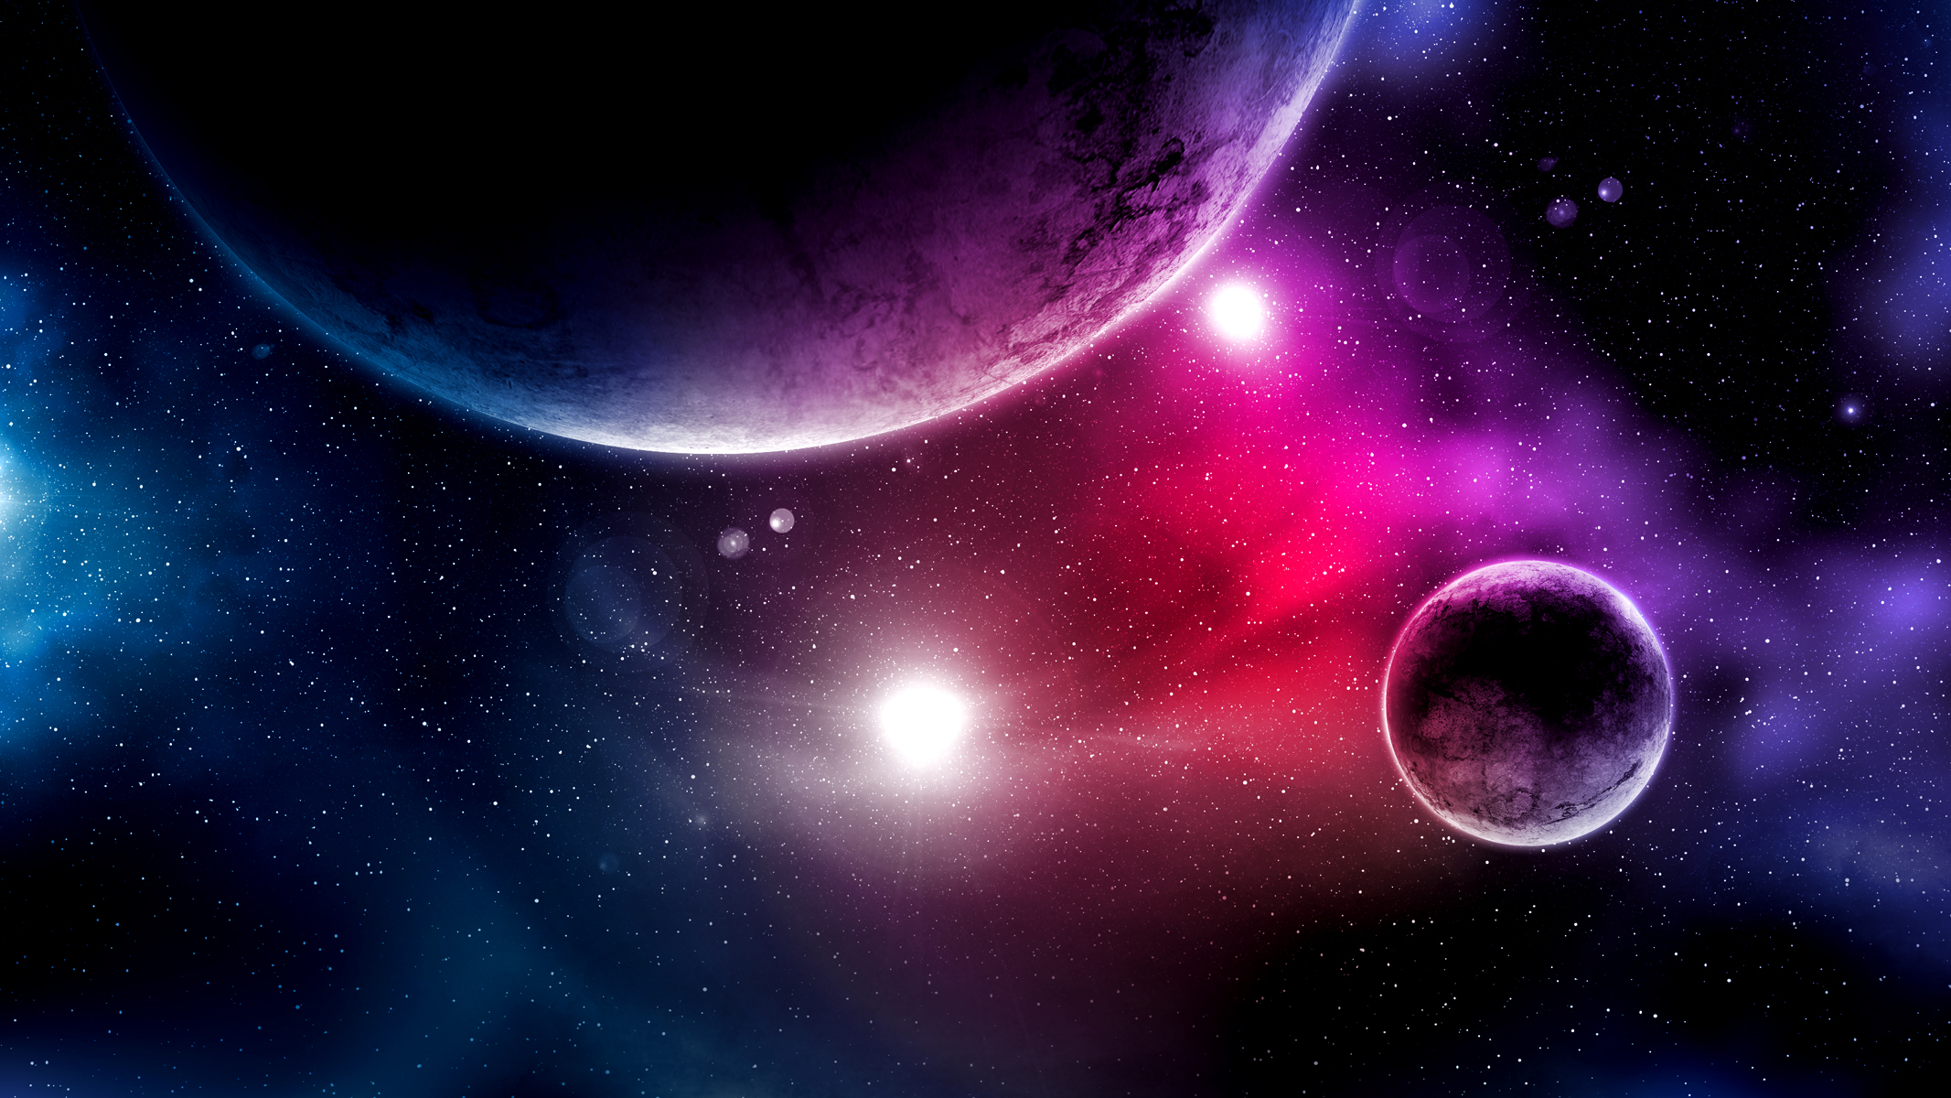
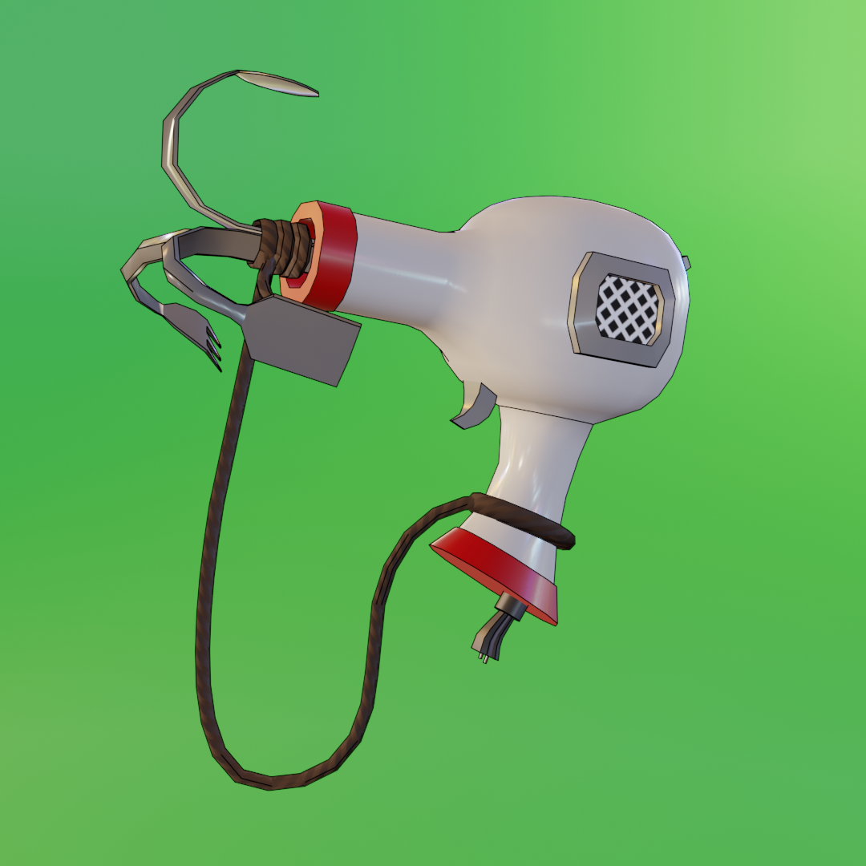
PAGE 1
This is not where you live you are a space explorer, and you are on this planet called planet prime and you want to dig enough to find the source of prime which is an energy drink that is told to give even the old and crippled energy. You want to do this for (they are not old nor crippled, but it taste good) Mrs. Surratt to get her mind of her cats so you can steal them. You are about to leave your rocketship, but can only carry one tool to help you dig.
Do you take a shovel press here or a grapling hook press here?
This Photo by Unknown author is licensed under CC BY.
This Photo by Unknown author is licensed under CC BY-SA.

Slide 3
YOU PICKED THE SHOVEL
You picked the shovel, so you probably get the point you have a shovel. Now you can go dig but you did not need a shovel on this planet shovels are banned there counted as weapons so the rankerandas attacked you
press here
This Photo by Unknown author is licensed under CC BY-SA.

Slide 4
Ending 1/3
YOU DIED

Slide 5
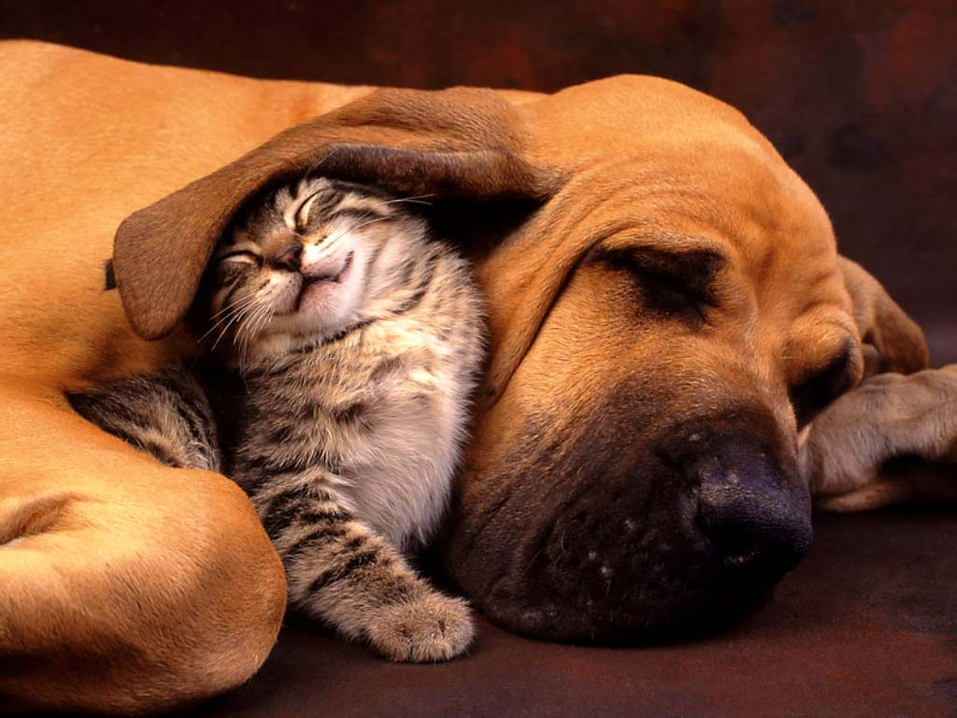
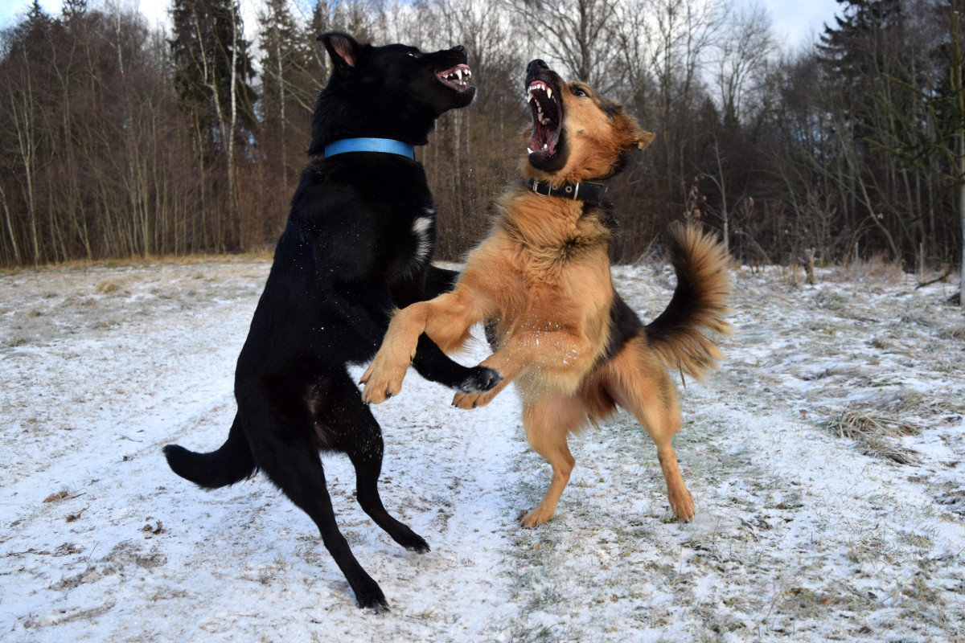
YOU PICKED THE GRAPPILING HOOK
You picked the grappling hook, so you get the point you have a grappling hook lucky for you this is very good on planet prime the rankerandas love these they are considered graceful the rankerandas praise you
Now you have a choice do you fight or be kind
Click here for kindness click here to fight
This Photo by Unknown author is licensed under CC BY.
This Photo by Unknown author is licensed under CC BY-NC-ND.

Slide 6
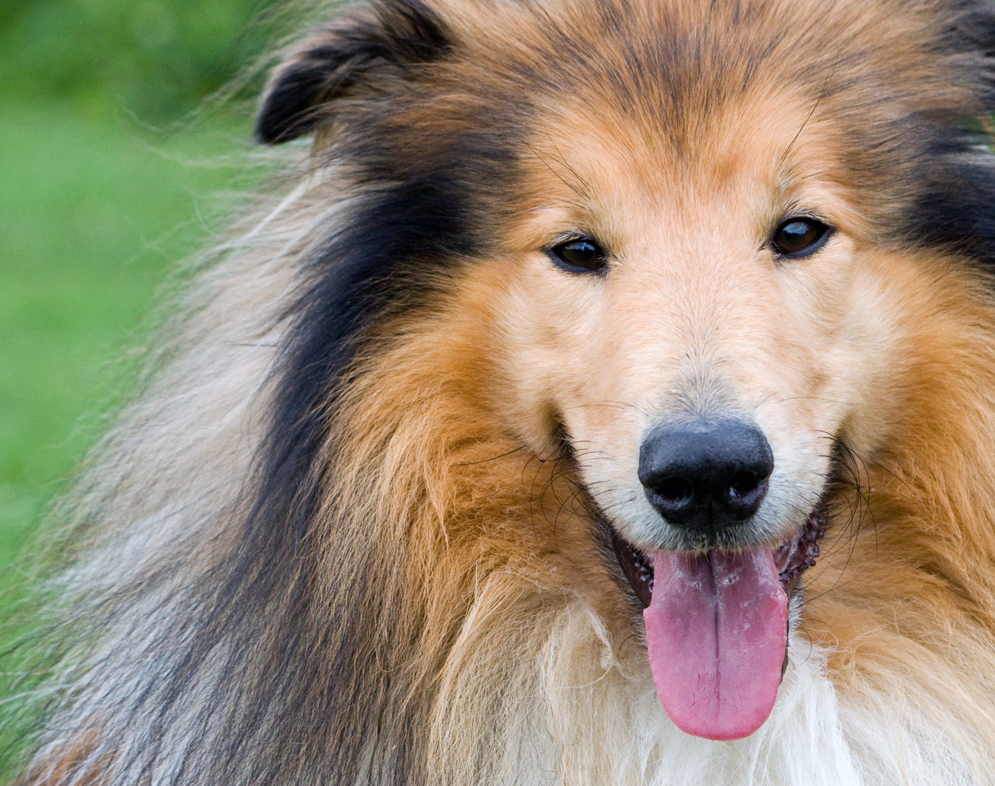
YOU PICKED KINDNESS
You picked kindness and the rakerandas told you to come with them you do
Click here

Slide 7
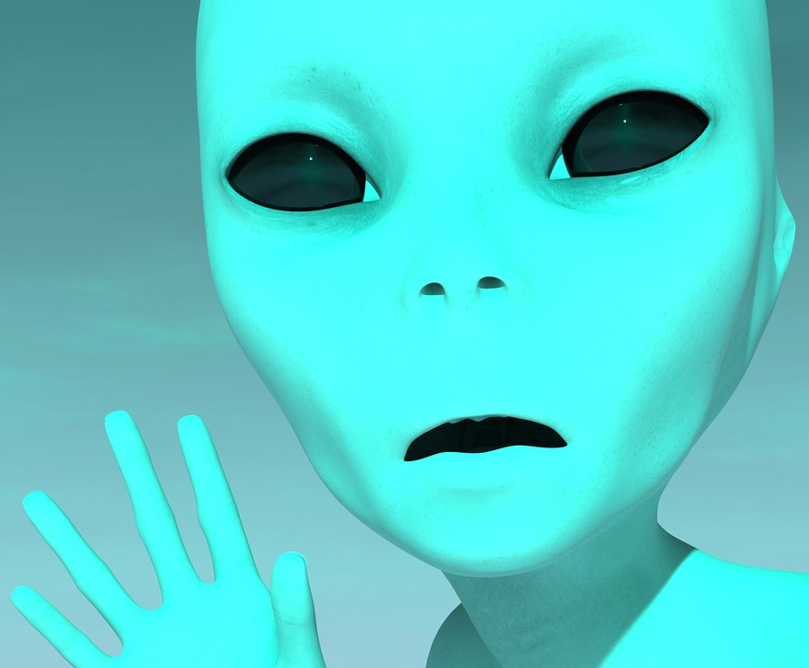
Ending 2
The rankerankas show you were all the prime is and praise you

Slide 8
You picked fight
You attacked and the king got his lazer and well
Click here or click here

Slide 9
Congrats you picked the right one
You get to go home and bring all the prime
Or a dungoen
For dungion click here for home click here

Slide 10
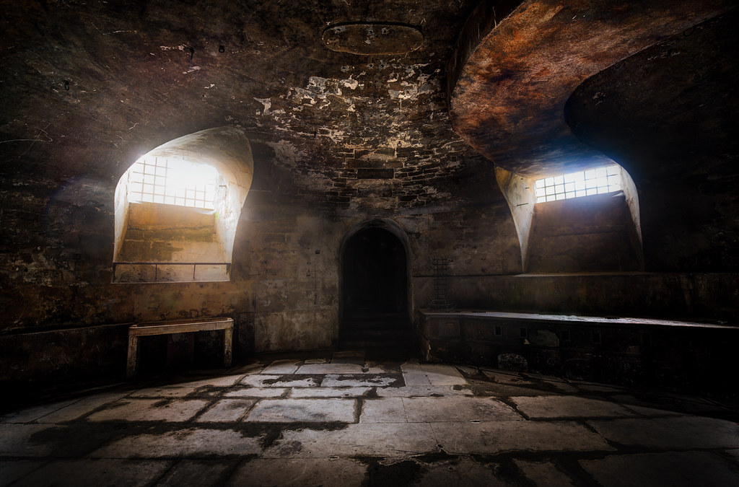
Ending 4
You chose dungun
You spend ur life here now
This Photo by Unknown Author is licensed under CC BY-SA-NC

Slide 11
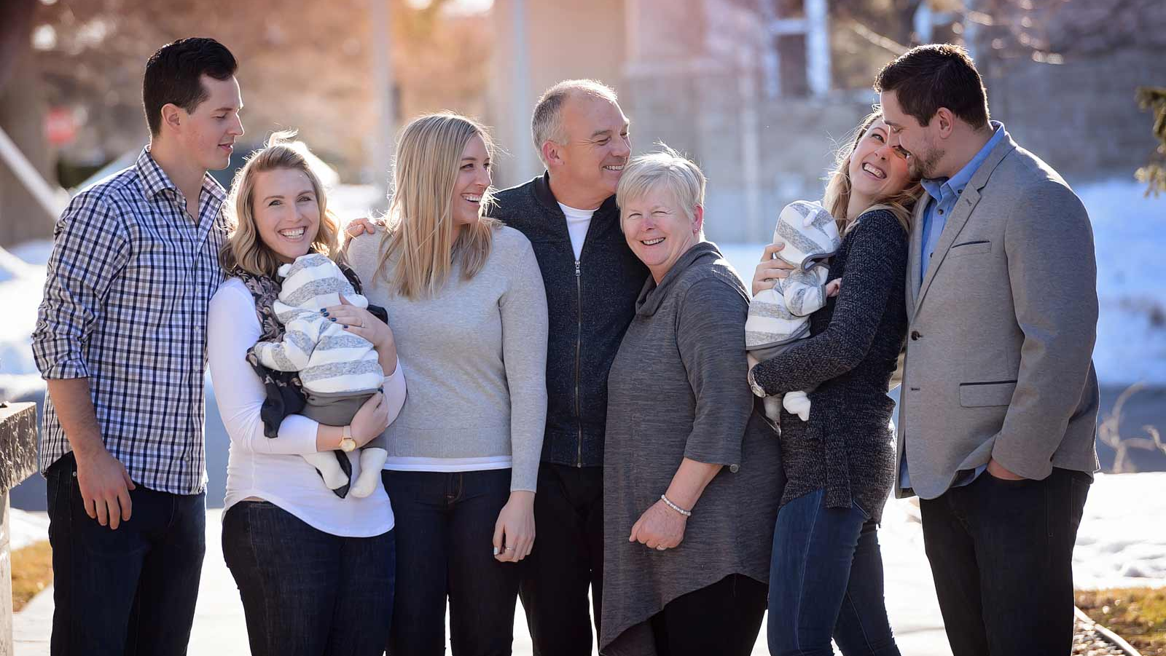
Ending 5
You chose home you spend your life here now
This Photo by Unknown author is licensed under CC BY-NC-ND.

