Slide 1
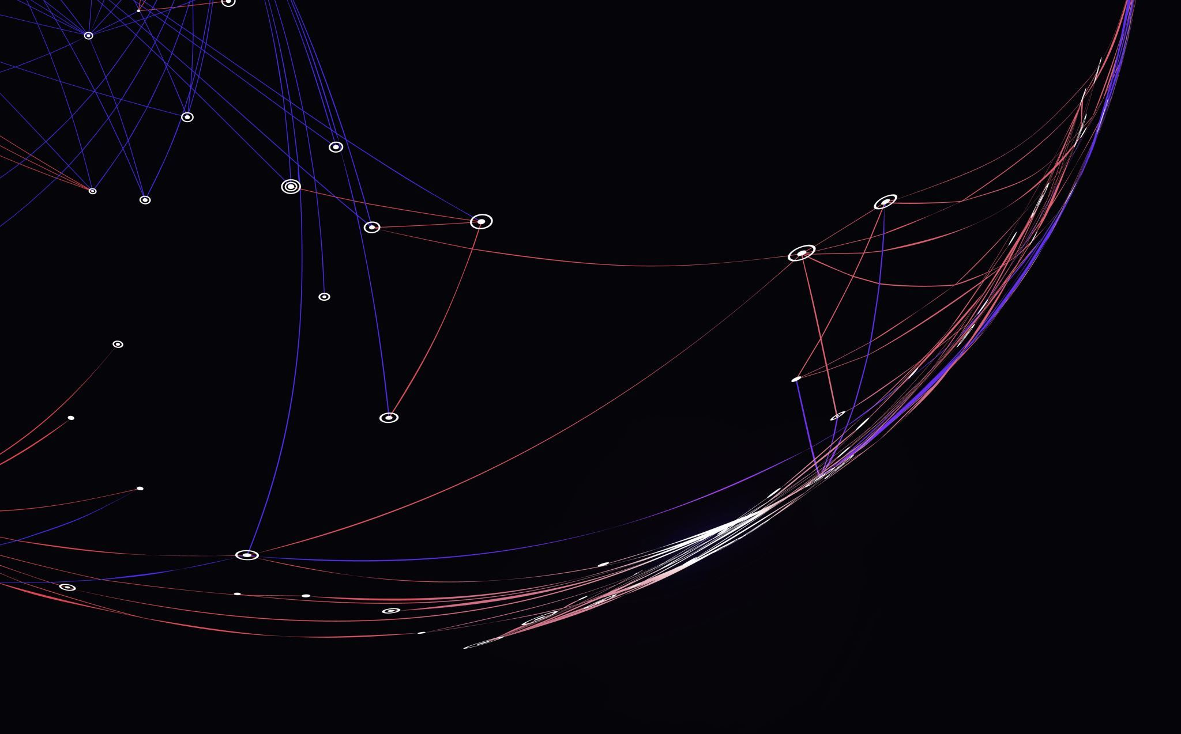
Aaron's super cool interactive story in Power point – choose your own adventure (made in Power point using hyperlinks) shoutout to my boi Aaron Landau
Made by Grayson

Slide 2
Part 1
You are Aaron Drumgold, swordsman of the court. You wake up in a bed to find you are in a huge hallway that looks it was made for a giant. You were put in here because you committed a serious crime : Grand Theft Auto of someone's wheelbarrow.
Do you
investigate
DIE
investigate
DIE

Slide 3
You continue but a man bursts through the door, he claims he is here to help, and assures you that he is not sus.
DO YOU?
RUN!!
RUN!!
Trust
Trust

Slide 4
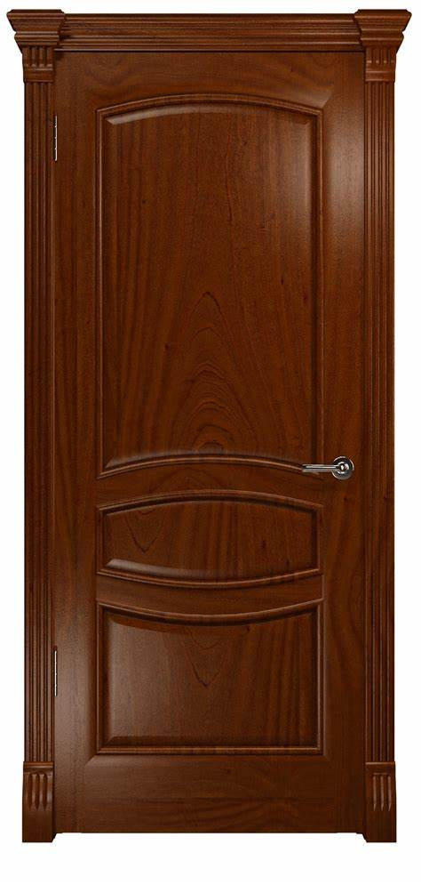
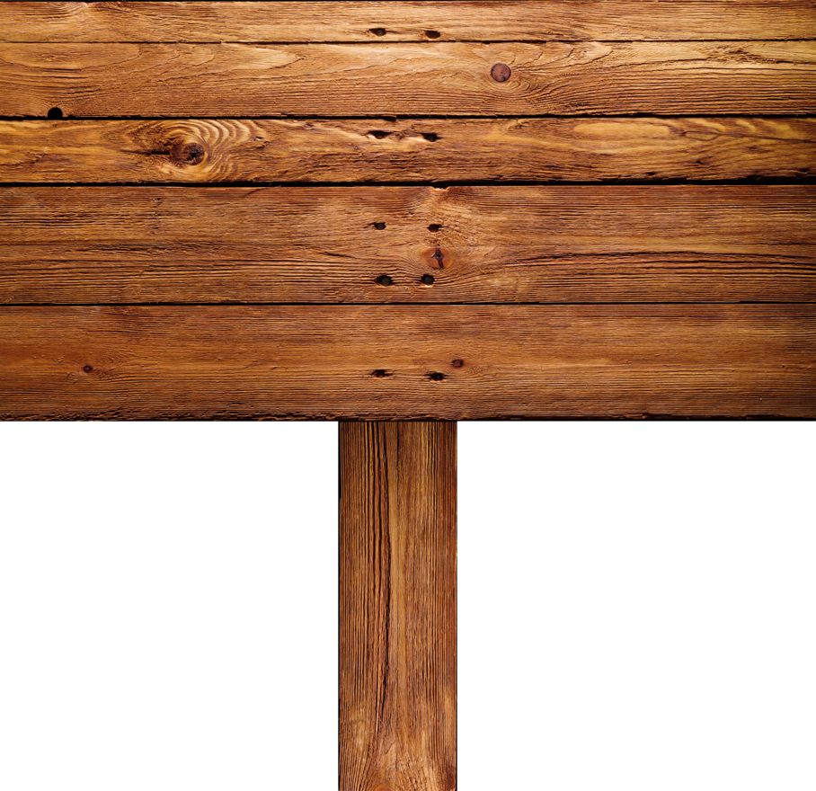
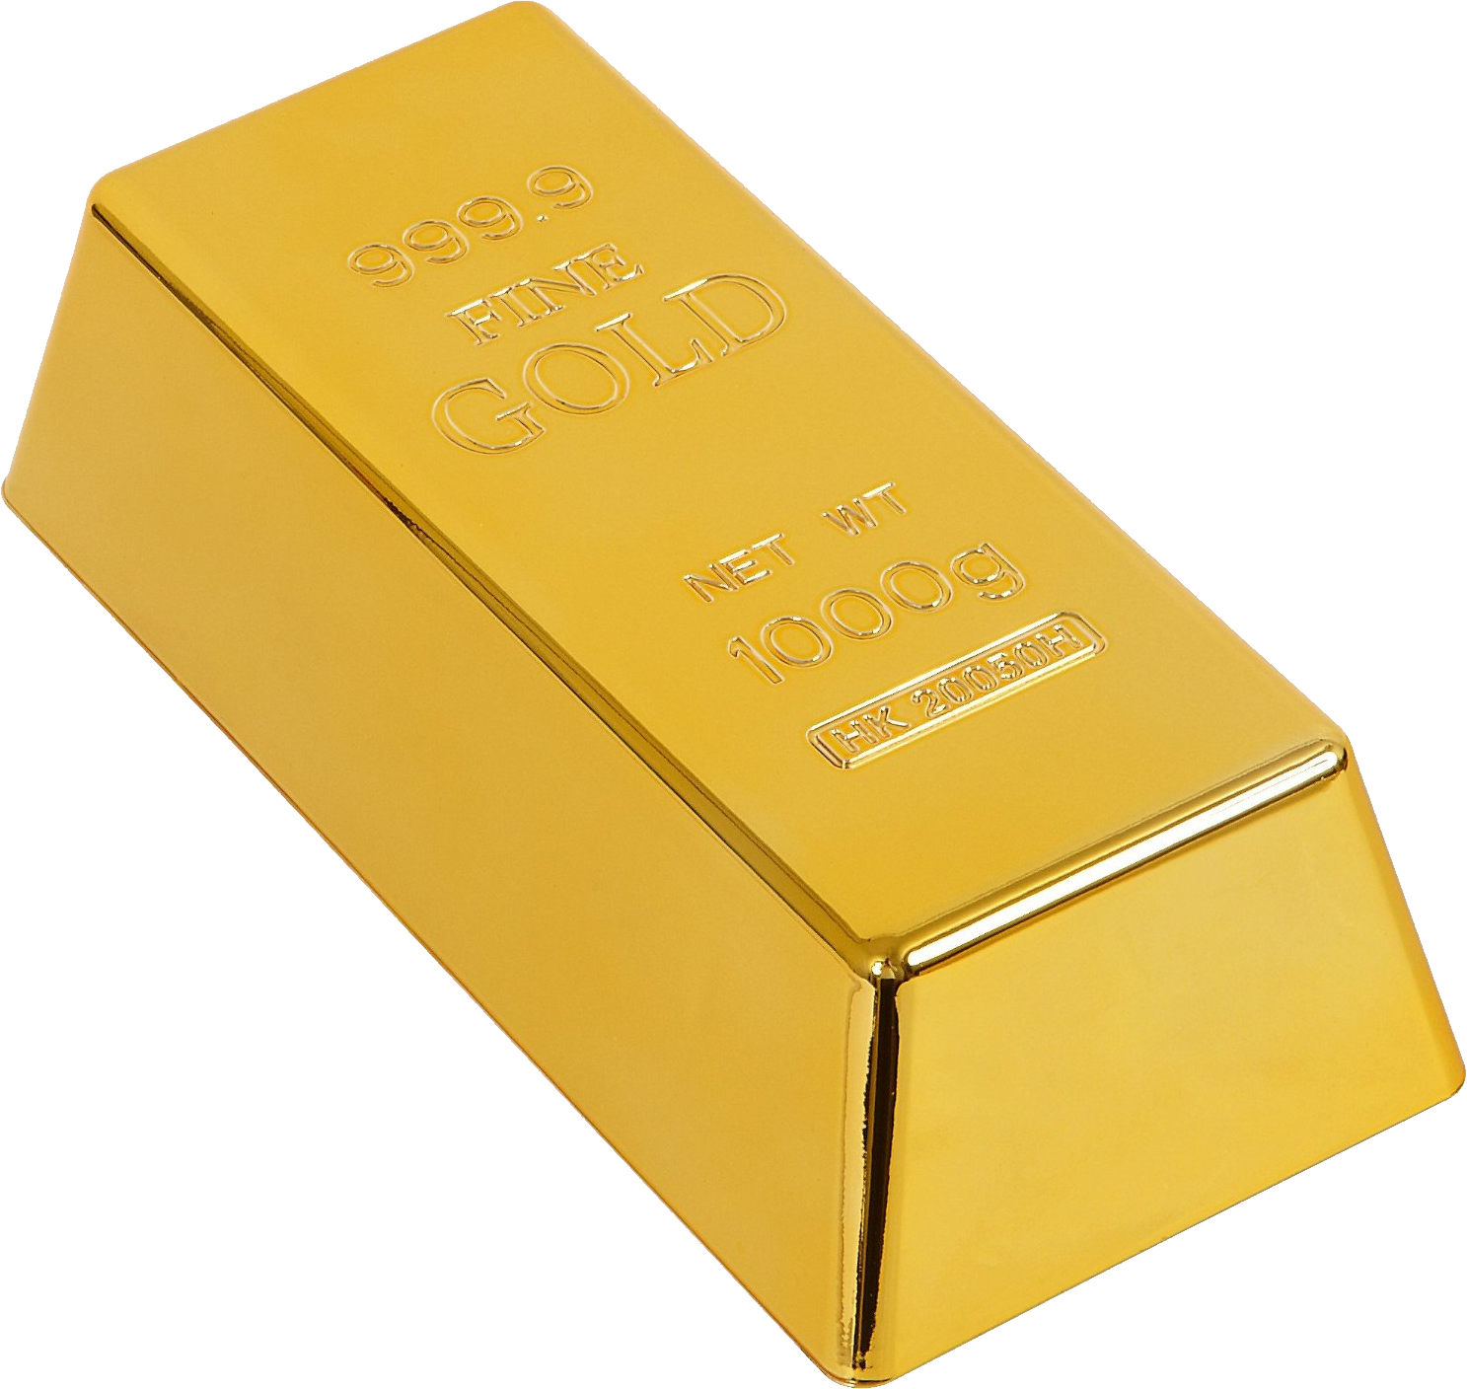
You blink, and the man disappears. You open your eyes to find that you are in a stranded desert, with no sign of human life within miles. Though, in front of you lies 3 objects. There is a golden trophy, a golden bar with the word's "riches" engraved on it, and a door. To the left of all these objects labels a sign that reads " choose one ".
Choose one nerd

Slide 5
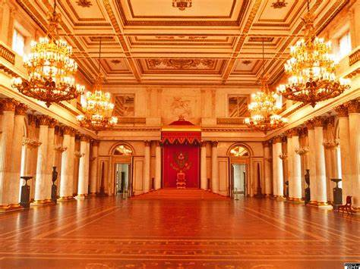
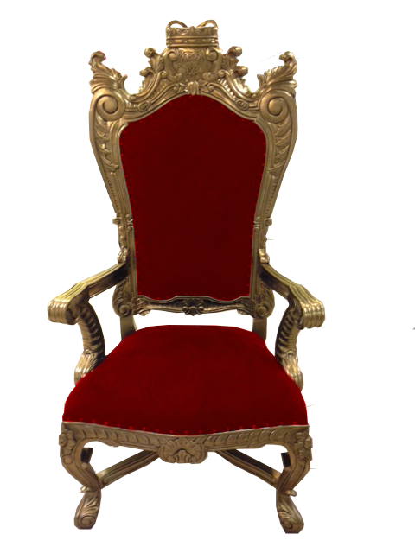
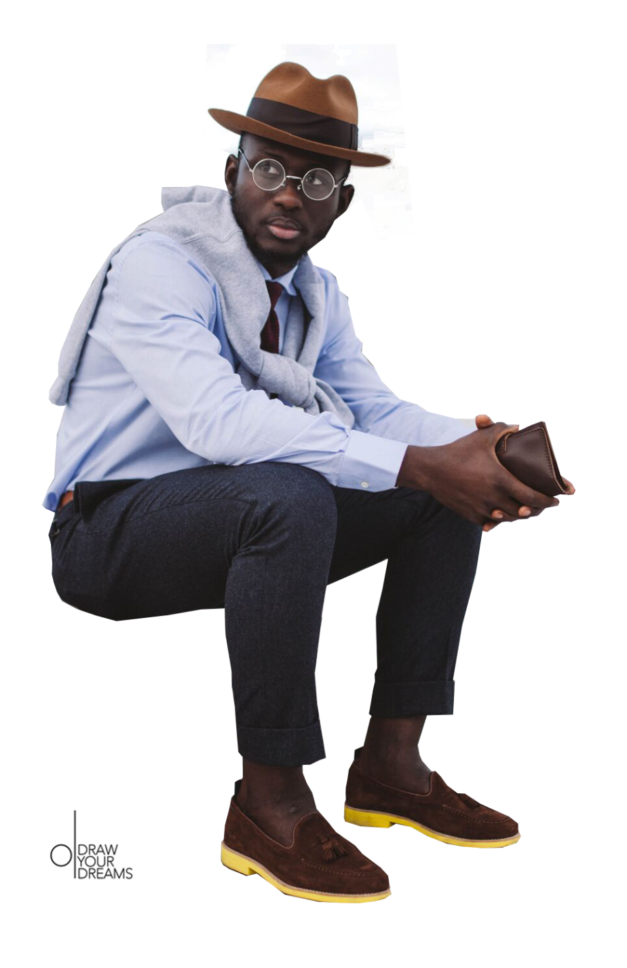
You hold the handle of the door to feel a strange feeling until you open it. You walk through the door to find… you. It looks as though you are in a wealthy building, and by the looks of a castle. The other you sits in a small throne, yet has a oversized crown. Funny enough, you both look equally confused. You realize that when opening the door you made someone standing near fly back. You are both thinking of what to do. Do you fight, or work with your twin to escape this place.
Fight
Peace

Slide 6
You take the gold bar, then wake up in the chair of someone rich. It is clear to you that you are a king or leader of something. You suddenly hear a man walk up to you and yell "who are you"
Truth
Lie
Truth
Lie

Slide 7
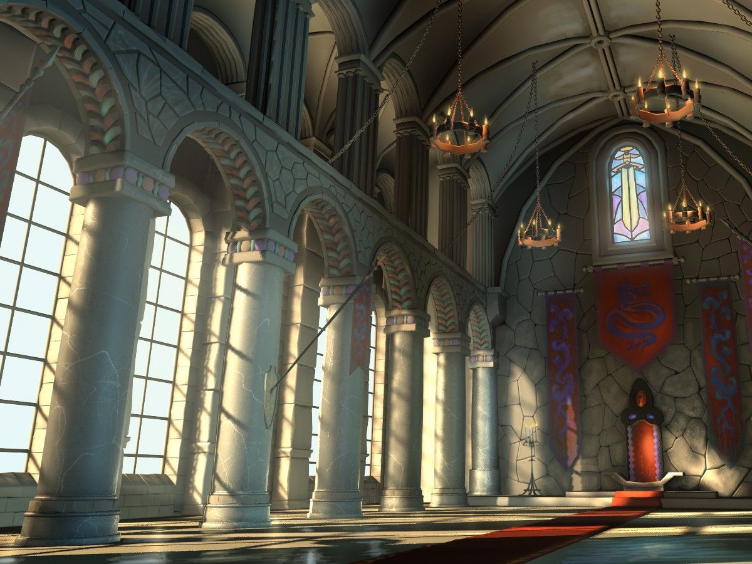
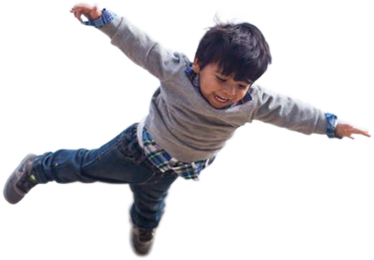
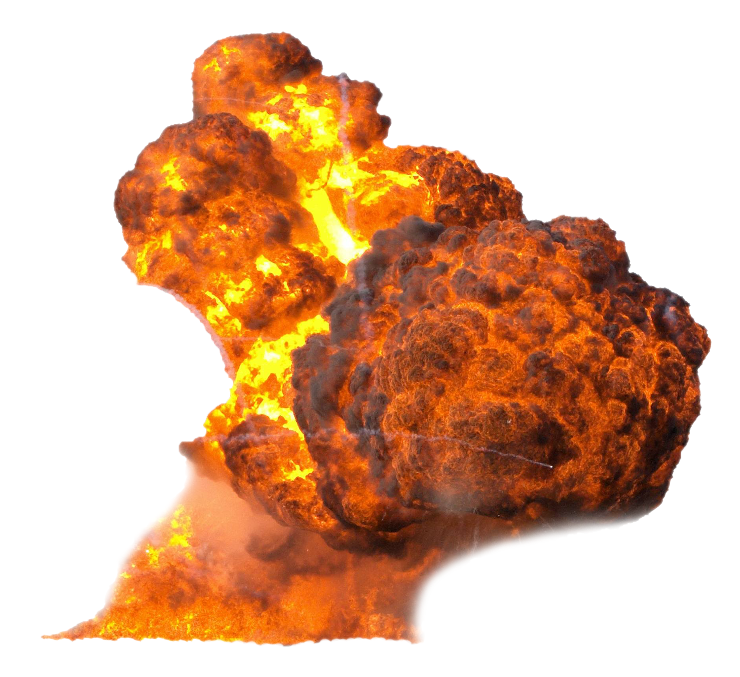
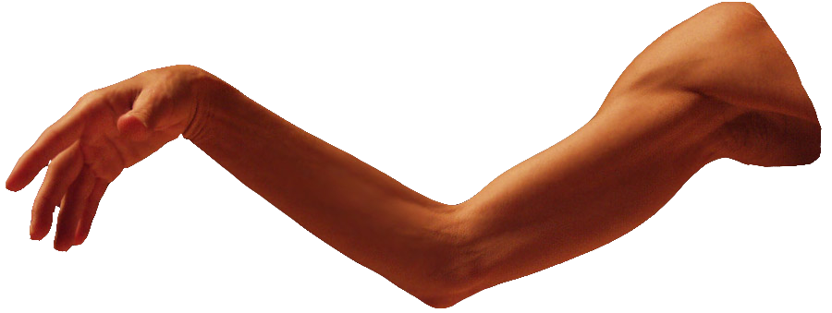
Before you can talk, a door appears out of thin air. This sends the person flying into the air, out the window. The door opens, and to your surprise, you walk out of it. He then stands in front of you, as dumbfounded.
Fight
Peace

Slide 8
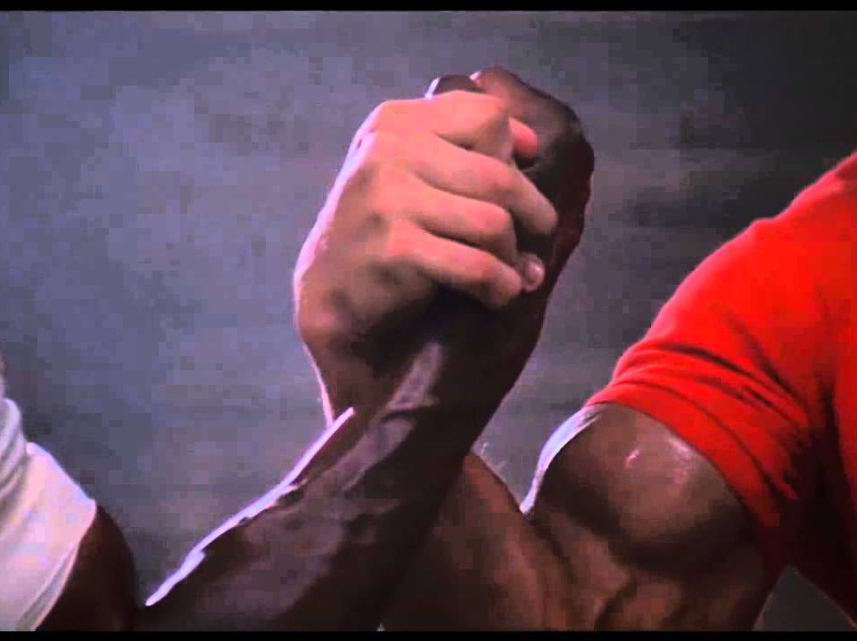
You both decide to figure out how to leave this place by working together. There are two options. You can either enter a secret climbspace inside the building built for special occasions. Or just leave through the door at the end of the castle. Which do you choose?
Exit
Climbspace

Slide 9
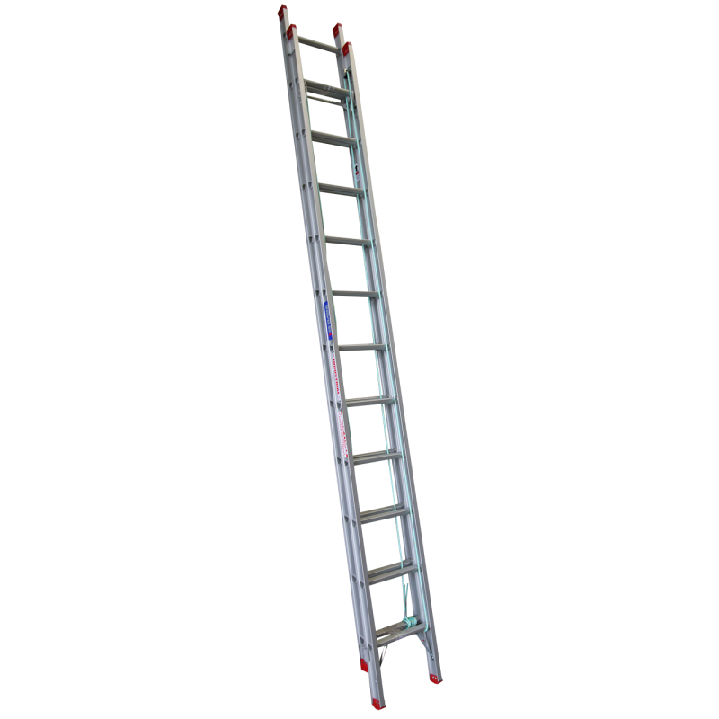
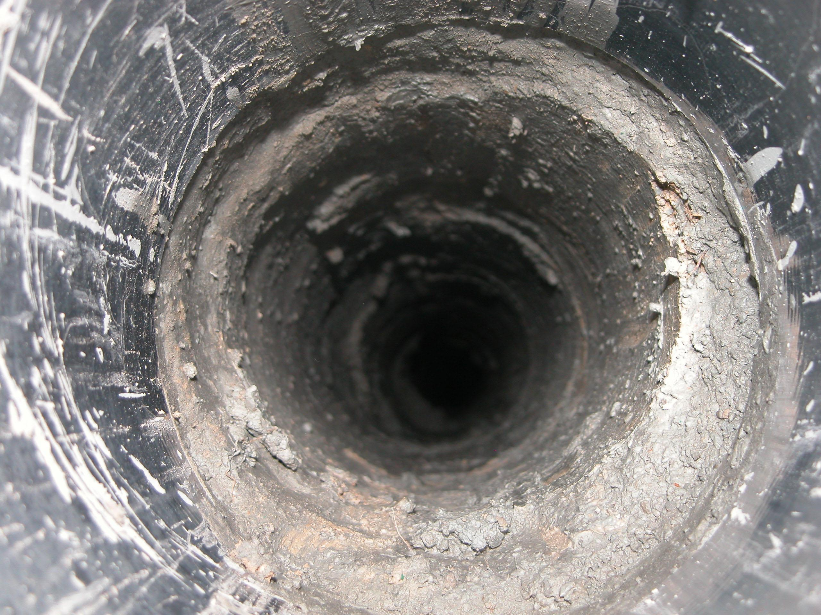
Despite a one person sign on the top of it, you both go down the hole. This causes the ladder to snap under your weight and you fall down. Sad if someone else needs to jump down a hole
ENDING #6
ENDING #6

Slide 10
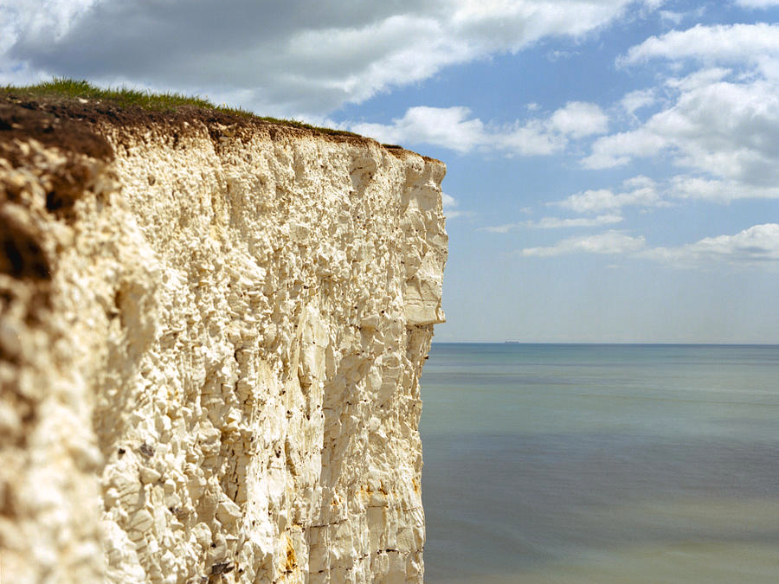
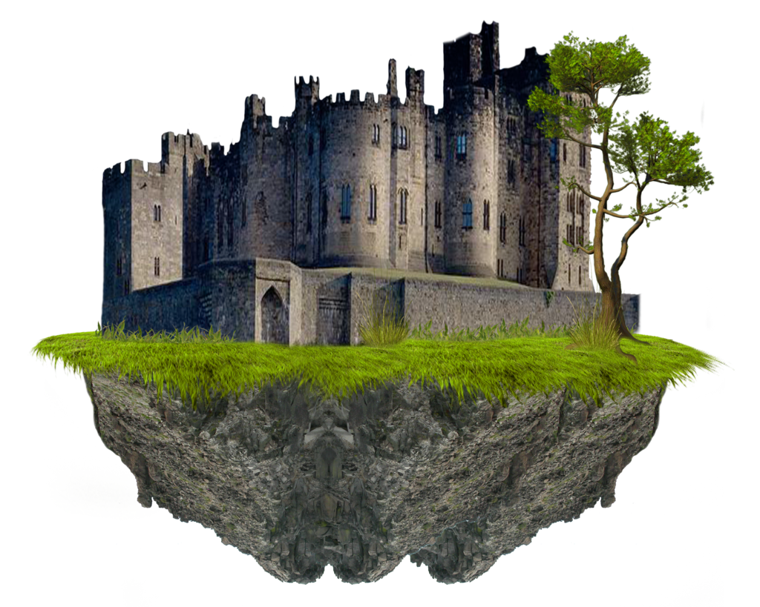
You both walk outside the castle, when suddenly the ground begins to shake and parts of the castle fall apart. Suddenly you feel a jerk in the floor and fly out the door. You realize the castle was built on a cliff, the reason the man came to you was to tell their king to evacuate. You fall into the ocean from 5000 feet in the air.
ENDING #5
ENDING #5

Slide 11
You two begin fighting, and fighting. You suddenly hear a loud noise, and feel the entire castle vibrating. You look out the window to see that it is falling off the cliff it was built near. You and your twin fly out the window and into the ocean.
ENDING #4
ENDING #4

Slide 12
You look inside the trophy to find the man, except he is very small. He glares at you, then says the trophy is made of plastic, even though you don't know what that is. He claims you have chosen greed and failed.
ENDING #3
ENDING #3

Slide 13
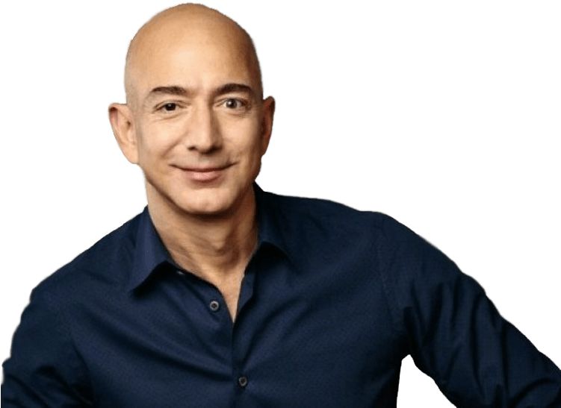
You run past the strange, yet not suspicious man, and run through another hallway that ends with a huge gate. You open the gate to see that there is an all out war happening, then a peasant bald guy runs to you claiming that he needs your help. He needs you to make his army swords so they can win the battle and make our city much, much better.
HELP
BETRAY
HELP
BETRAY

Slide 14
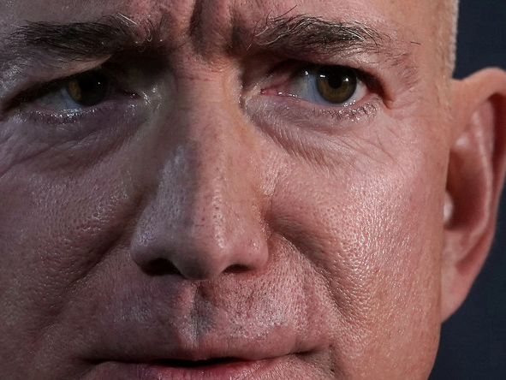
You made the weapons for jeff, but then he betrayed you. Perhaps you should have followed the strange man. Or, you could have betrayed him, as now he has many weapons and will destroy everything
ENDING #7
ENDING #7

Slide 15
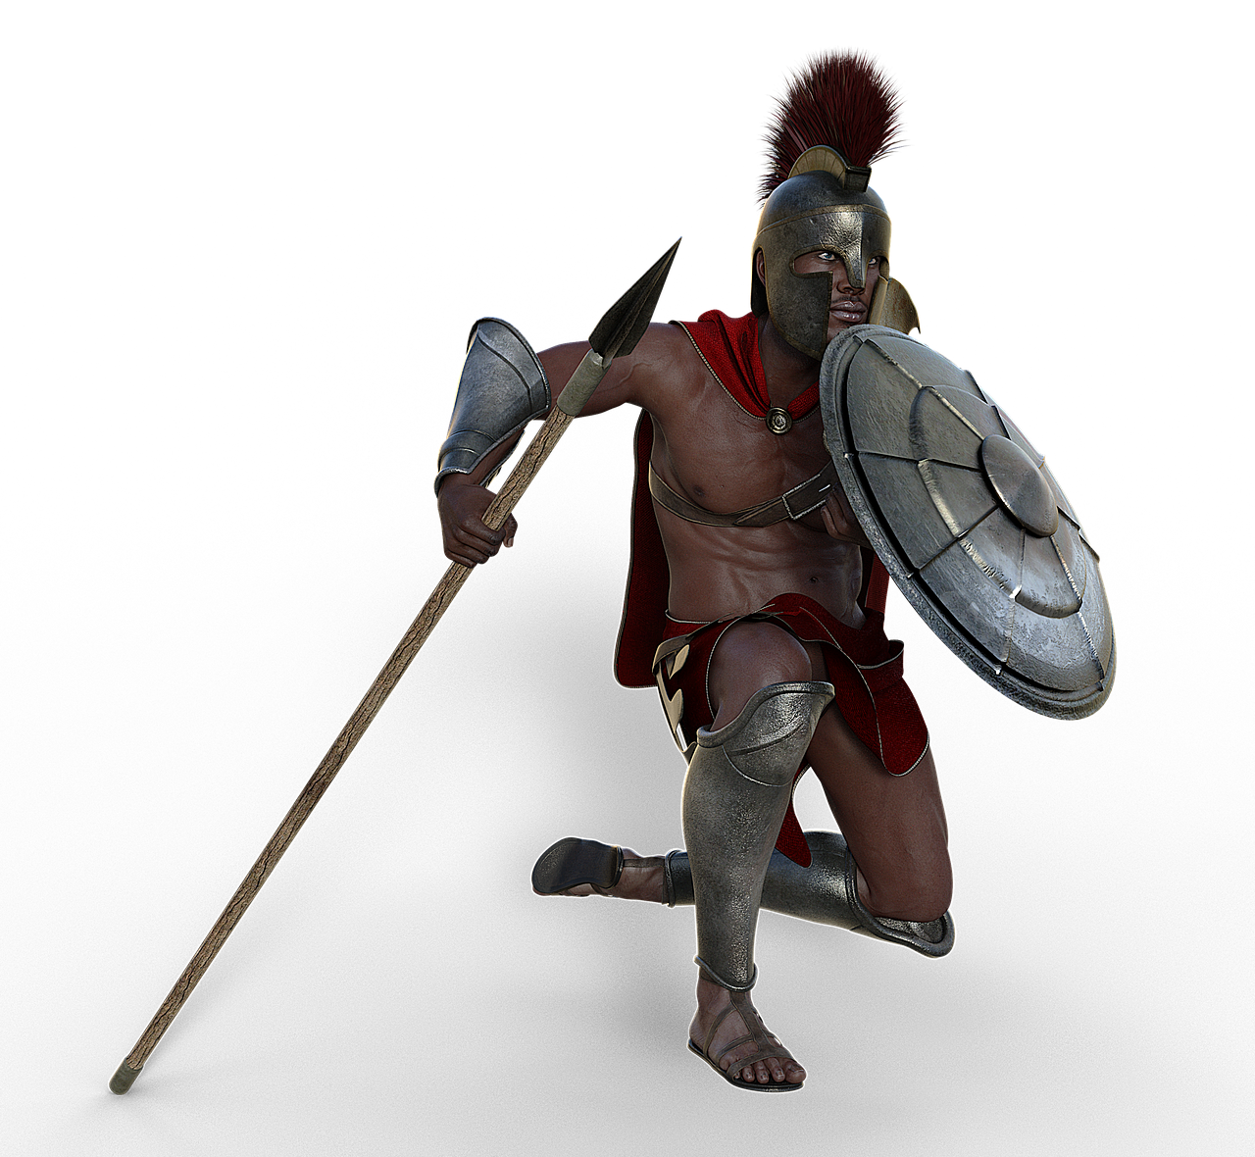
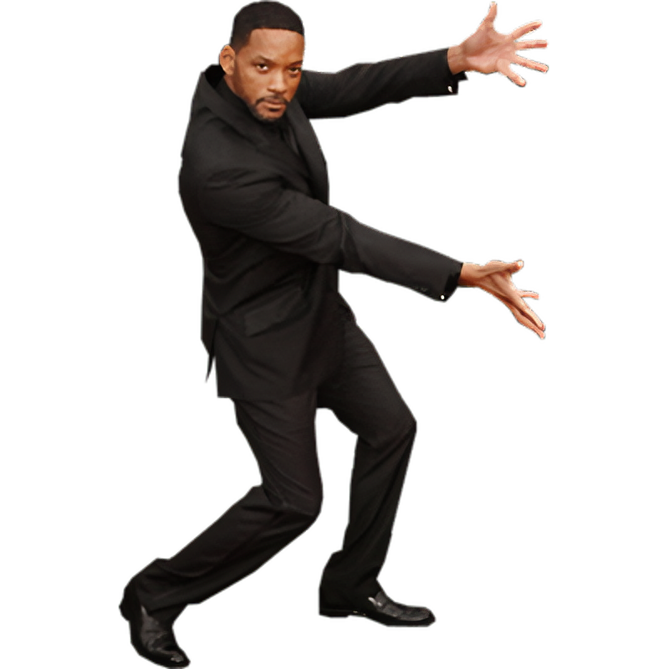
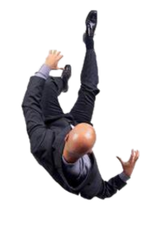
You push Jeff off the cliff, but you do so in front of every single one of his soldiers. Jeff Bezos, as always - treats his soldiers with the greatest respect and niceness that the second they saw him being pushed off the cliff that was conveniently placed next to where he asked you for something, charged at you. You had 3 seconds to live after pushing jeff off the cliff
Continue
Continue

Slide 16
You wake up in what looks like a city made from the clouds, cloud city. You see the same man who you had ran from in the first place. You feel he is here to punish you for running from him and betraying Jeff Bezos, but he actually seems happy. Jeff was actually an evil business man from the future, he was trying to get your weapons so that he could rule this time.
ENDING #8
ENDING #8

Slide 17
Rip lol

Slide 18
You wake up in what looks like a city made from the clouds, cloud city. You meet a man at a gate and think to yourself, "I'm dead". The man claims that he is here to help you, and reassures he is not sus. The man then asks if you ever commit any crimes. You can either talk to the man about yourself, or you can just walk around the gate past him. What do you do?
Walk around the gate
Walk around the gate
Talk
Talk

Slide 19
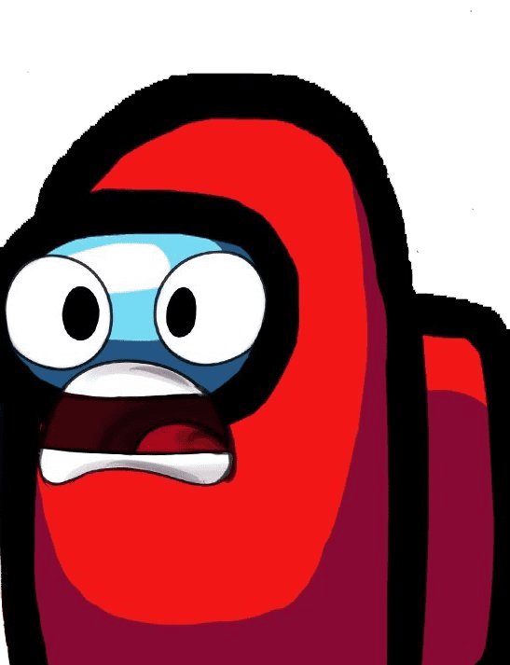
You run around the fence when the man is not looking, to suddenly not feel you are standing on anything. As you run, a hole opens in the clouds and you begin falling. And falling. And falling. Forever you fall. This is a bad ending for you.
ENDING #2
ENDING #2

Slide 20
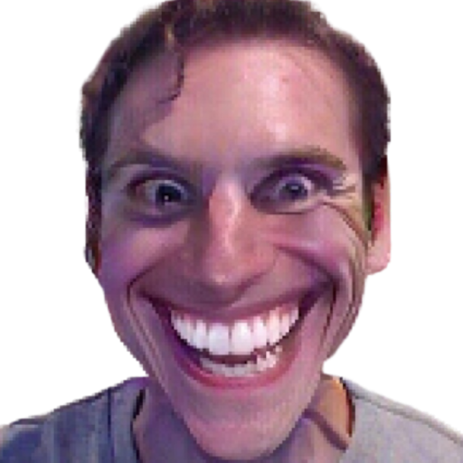
The man takes his red mask off to reveal his beautiful face, then says that you have not done anything good in your life. You must have done something positive before you die to continue.
ENDING #1
ENDING #1

