Slide 1
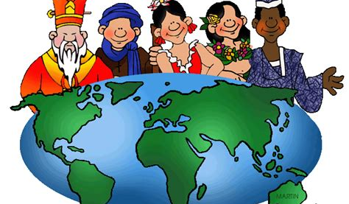
5 Strands of Social Studies

Slide 2
5 Strands’ Function
The strands of Social Studies form the identity of a region, nation and person but not necessarily in equal parts. Like a recipe, different combinations make the perfect dish!
Essential Question: Which strand of Social Studies best defines one’s identity?

Slide 3
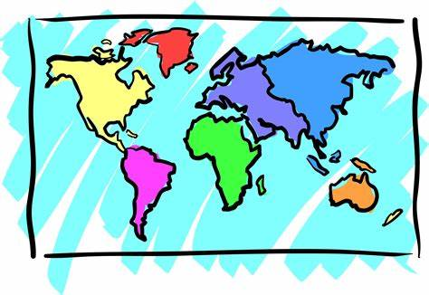
Geography
The study of people, places, and the environment.
Physical features{ Continents, oceans, landforms}
Political features {counties, states, cities}
Longitude & Latitude
Climate

Slide 4
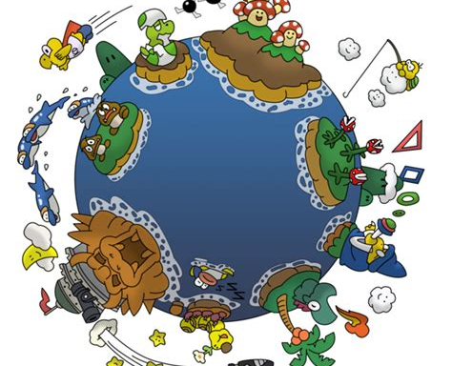
Geography
How does WHERE you live affect HOW you live?

Slide 5
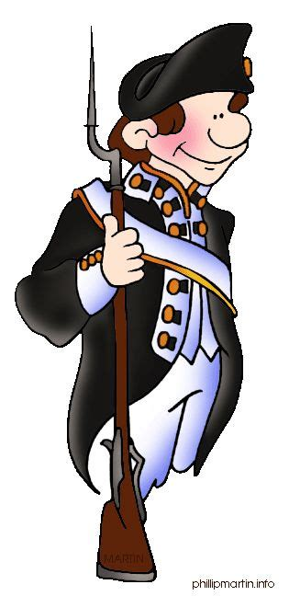
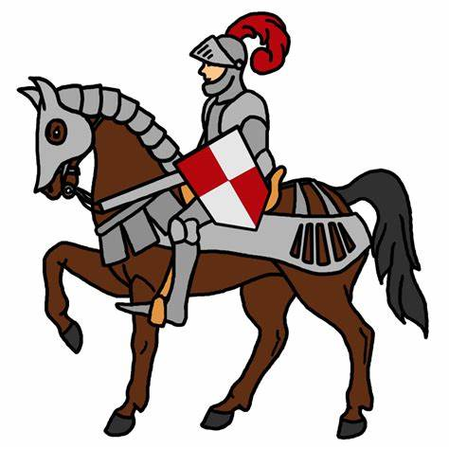
History
A record of the past either written or in an artifact
Events that change the way people live today
People who changed society.
2 Main Sources
Primary
Secondary

Slide 6
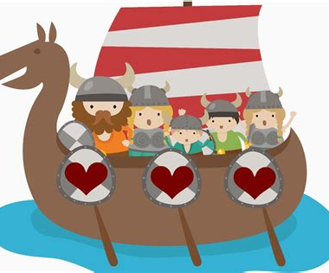
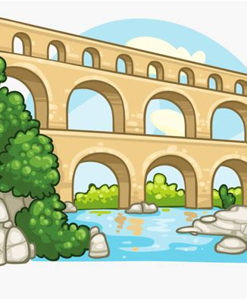
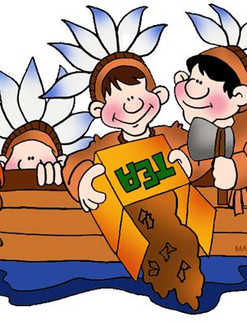
History
How does the past shape the present?

Slide 7
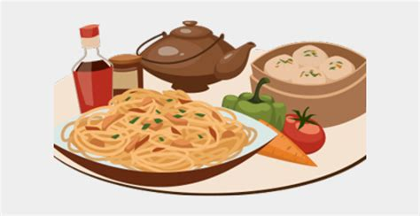
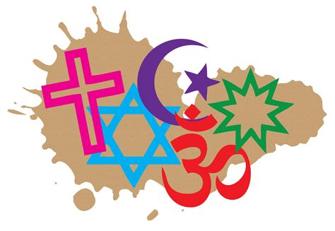
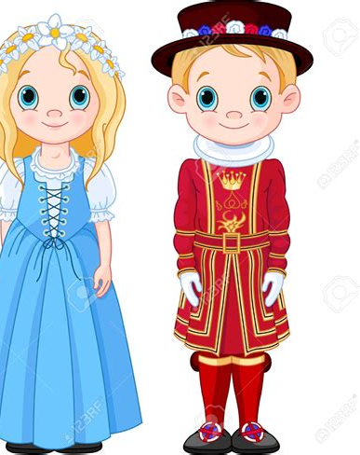
Culture
The beliefs, customs, laws, art and ways people in a group or society live.
Art & Recreation
Food, Dress, Greetings
Religion, Customs, Traditions
Language

Slide 8
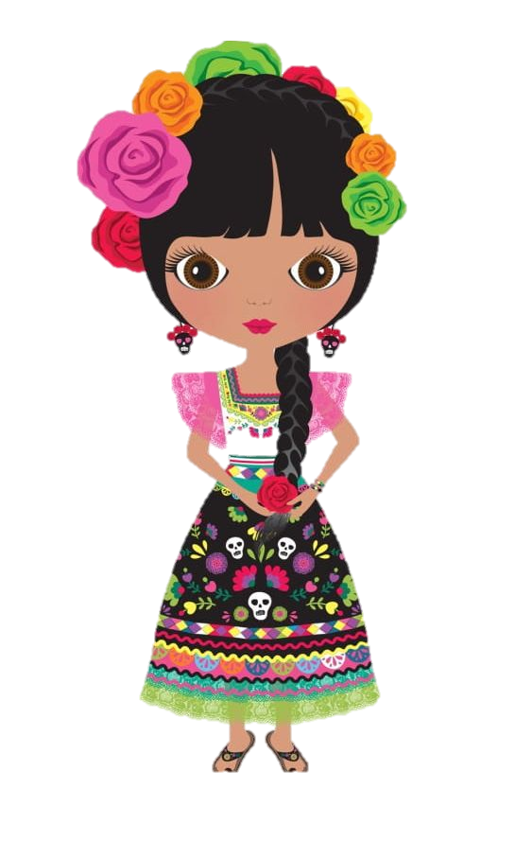
Culture
How does LOCAL culture affect the traditions of the region?

Slide 9
Government
The people and groups within a society that make laws, make sure the laws are carried out, and settle disagreements about the laws.
Types of Government {Republic, Monarchy, Dictatorship}
Structure of the government
Personal Freedoms
Citizen participation

Slide 10
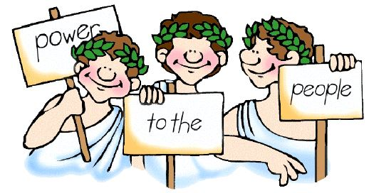
Government
How much can a citizen participate in their government?
How does citizen satisfaction impact the government?

Slide 11
Economics
The study of how people manage their resources by producing, exchanging, and using goods and services.
Economic Systems {Traditional, Market, Command, Mixed}
Natural, Capital, and Human Resources
Trade Barriers, Money, Exchange Rates
Entrepreneurs

Slide 12
Economics
Who decides what, how, and for whom things are made?

Slide 13
Exit Ticket
Give one example of EACH strand of Social Studies… Be sure to label which category your example falls under.

