Slide 1
What was the Scientific Revolution?
* FIRST – what is a REVOLUTION?
Answer:
a new way of thinking about the natural world and society that challenged traditional views and instead relied upon experimentation and new science.

Slide 2
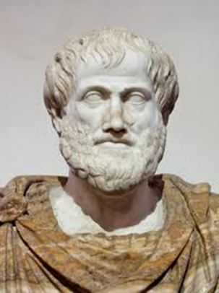
FAST-FORWARD several hundred years to the 16th and 17th centuries…
1.) Renaissance HUMANISTS mastered Greek and Latin (translated works of Ptolemy, Archimedes and Plato) – humanists disagreed with Aristotle! (preferred INDIVIDUAL thought and EMPIRICISM)
2.) NEW PROBLEMS required NEW SOLUTIONS – which led to the development of NEW TECH. and MATH!
EX.) Telescope, microscope, printing press, Algebra, geometry, decimal system
* Aristotle called the shots (Greek philosopher and scientist) during the Middle Ages – but, was he right?
* CAUSES of the SCIENTIFIC REVOLUTION *

Slide 3
Dawn of Modern Science
* Middle Ages/Renaissance scholars sought answers about the natural world from the CHURCH (mid-1500s, others began to think in new ways)
Old View (pre-Modern)
New View (CAUSES)
1.) Scholars relied on traditional authorities for beliefs about structure of universe…
2.) Aristotle developed the Geocentric Model
* Earth center of universe – sun, moon and planets revolved around sun
3.) Ideas upheld by church, accepted authority for European intellectuals
1.) Scholars (humanists) began to challenge traditional authorities (Aristotle) in the 1500s
2.) Scientists and Mathematicians began to think in new ways (empiricism)
* Posed theories, developed procedures to test ideas (EVIDENCE and EXPERIMENT)
3.) Why open to new ideas?
* Exploration (new lands, new people, new animals)
* CAUSES of the SCIENTIFIC REVOLUTION *

Slide 4
Old Views (pre-Modern) on SCIENCE, MAGIC, PHILOSOPHY and RELIGION
* Aristotle, Ptolemy and the GEOCENTRIC MODEL – accepted by the church! (science focused on observation and sensory experience)
* Belief and support of practices like ALCHEMY and ASTROLOGY (magic was possible and believable)
*Medieval Philosophy – focus on REDISCOVERY and integrating religious texts with non-religious learning…
*Renaissance Philosophy – HUMANISTS focus on Aristotle and Ptolemy
and
* RELIGION was NOT scientific and focused on unity amongst people under God…

Slide 5
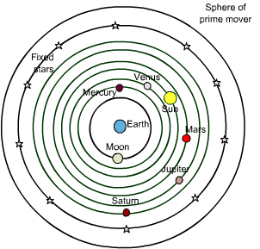
* The GEOCENTRIC THEORY (the Ptolemaic System)…
* …Aristotle in the 4th century B.C. (Ptolemy expanded theory)
* The earth was an unmoving object at center of universe! (WHAT?)… The moon, sun, and planets move around earth.
* Series of concentric spheres – beyond planets lay sphere of fixed stars and HEAVEN.
* Christianity supported theory (taught God deliberately placed earth at center of universe)
Notes:
Two commonly made observations supported the idea that Earth was the center of the Universe. The first observation was that the stars, the sun, and planets appear to revolve around Earth each day, making Earth the center of that system. Further, every star was on a "stellar" or "celestial" sphere, of which the earth was the center, that rotated each day, using a line through the north and south pole as an axis. The stars closest to the equator appeared to rise and fall the greatest distance, but each star circled back to its rising point each day. The second common notion supporting the geocentric model was that the Earth does not seem to move from the perspective of an Earth bound observer, and that it is solid, stable, and unmoving. In other words, it is completely at rest.

Slide 6
That’s what the SCIENTIFIC REVOLUTION was all about!
…with new ways of thinking and technological developments, it gave Europeans a new way to view humankind’s place in the universe! *
* BIG IDEA: Advances in mathematics and technology allowed scientists to demonstrate the proof of abstract theories with clear and logical evidence!
* BIG IDEA of the SCIENTIFIC REVOLUTION *

Slide 7
Important PEOPLE and the BREAKTHROUGHS of the Scientific Revolution!
Main Idea:
Scientific discoveries expanded knowledge about the universe and the human body. Discoveries in astronomy led to a new conception of the universe and scientific developments advanced medical knowledge while launching a new field of science – chemistry!

Slide 8
The PTOLEMAIC SYSTEM
(a Geocentric Model of the universe)
* THINK: What was the Geocentric Model that Aristotle developed focused on? (TELL ME!)
* Directions: Open your textbooks to page 304 and read “The Ptolemaic System.” As you are reading, take note of what Ptolemy’s system was like. When you are finished, draw a diagram of the universe according to Ptolemy.
* QUESTION: Why was this view of the universe accepted by the Catholic Church at the time?

Slide 9
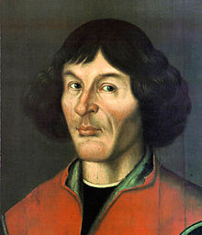
Nicolaus Copernicus and the Heliocentric Theory
* On the Revolutions of the Heavenly Bodies (published in 1543), Copernicus proposed a heliocentric system.
* Earth and planets revolve around the sun! (circular orbit)
* THINK: Why did Copernicus wait until he was on his deathbed to publish On the Revolutions of the Heavenly Bodies?
Answer: he feared ridicule from scholars and persecution from the Catholic Church
** On the Revolutions of the Heavenly Bodies began the COPERNICAN REVOLUTION **

Slide 10
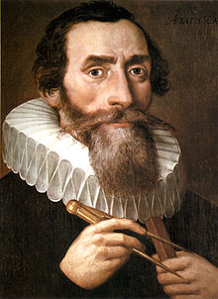
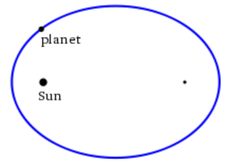
Johannes Kepler and Kepler’s First Law
* Kepler's Laws of Planetary Motion (1609) are scientific laws describing orbital motion (created to describe the motion of planets around the Sun)
"The orbit of every planet is an ellipse with the Sun at one of the two foci."
* Kepler’s First Law stated that planetary orbits are elliptical and the Sun is at the end of the ellipse, not at the center…

Slide 11
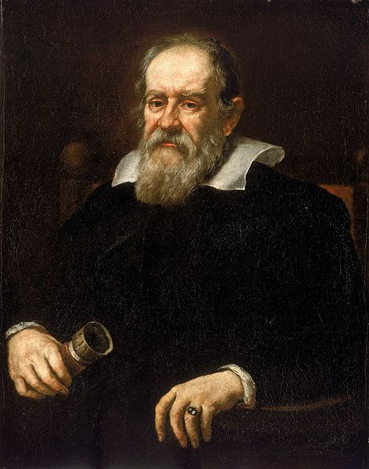
Galileo Galilei and The Starry Messenger
* By the early 1600s, scientists could explain the universe – but, what were planets made of? How is motion in the universe explained?
* Galileo Galilei – aka the “father of modern observational astronomy” aka the “father of modern physics” aka the “father of science” aka the “Father of Modern Science”
* Three discoveries published in The Starry Messenger (1610):
1.) Jupiter has four moons
2.) the Sun has dark spots
3.) Earth’s moon has a rough and uneven surface
* Heavenly objects” were composed of material substance – not pure orbs of light!

Slide 12
Galileo’s Problems with the Catholic Church…
1 Chronicles 16:30 – Fear before him, all the earth: the world also shall be stable, that it be not moved.
Psalm 104:5 – He set the earth on its foundations; it can never be moved.
Psalm 96:10 – Say among the heathen that the Lord reigneth: the world also shall be established that it shall not be moved: he shall judge the people righteously.
Ecclesiastes 1:5 – The sun also ariseth, and the sun goeth down, and hasteth to his place where he arose.
* The Catholic Church ordered Galileo to abandon his ideas! WHY?
Answer:
His discoveries threatened the Biblical concept of the universe – humans were no longer at the center and God was no longer in a specific place.

Slide 13
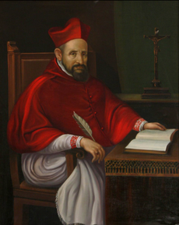
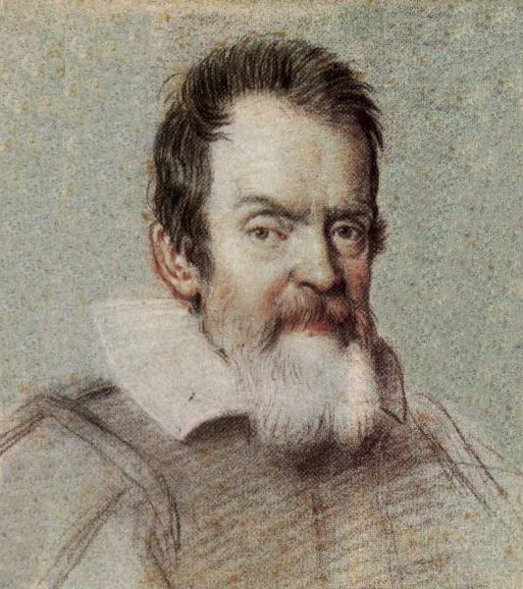
Opposing Viewpoints
Faith vs. Science

Slide 14
(read the following viewpoint and answer the question below)
Galileo argues that the Church should reinterpret Scriptural truths if they conflict with scientific truths:
… I hold the sun to be situated motionless in the center of the revolution of the celestial orbs while the earth revolves around the sun… these men [his opponents] have resolved to fabricate [construct] a shield for their fallacies [mistakes] out of… the authority of the Bible. These they apply with little judgment to the refutation [disproving] of arguments that they do not understand and have not even listened to… before a physical proposition is condemned it must be shown to be… false.
* QUESTION: What did Galileo suggest that his opponents should do before dismissing his ideas?
Answer: he suggested that his opponents prove him wrong!

Slide 15
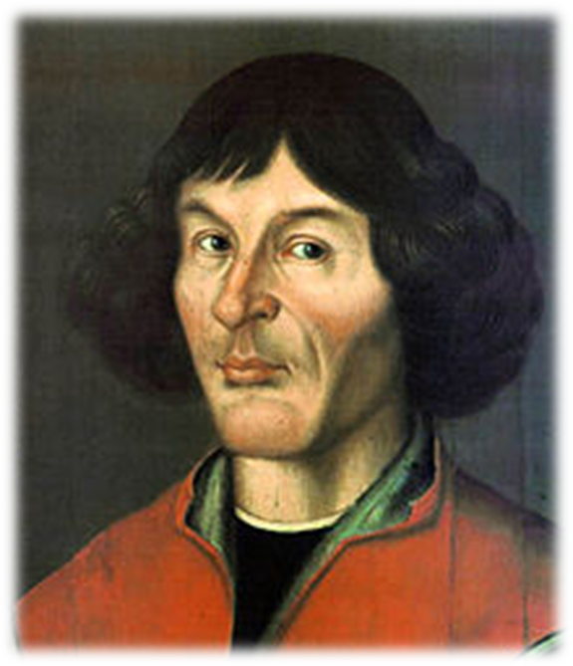
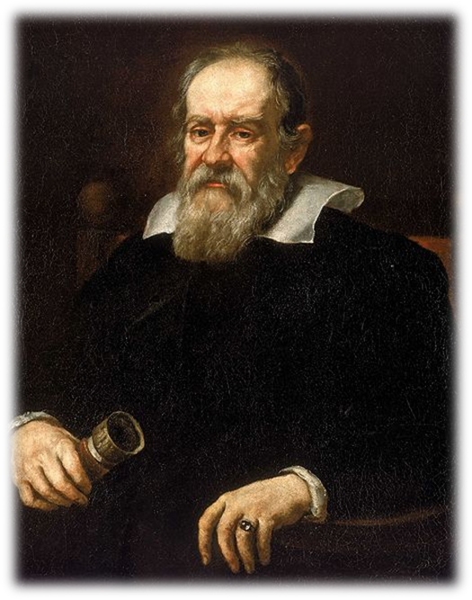
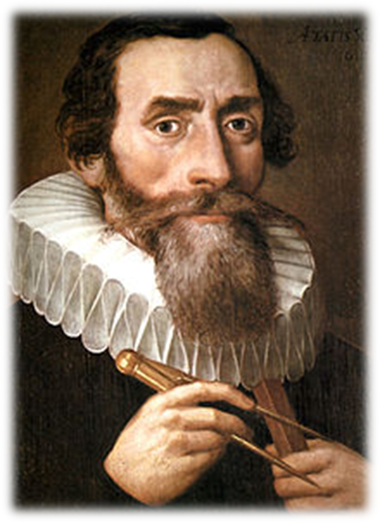
* Up until the middle of the 17th century – scientists can answer the following questions:
…what the universe looks like.
WHO and WHAT?
…HOW the universe moves.
WHO and WHAT?
…what “stuff” in the universe is made of.
WHO and WHAT?

Slide 16
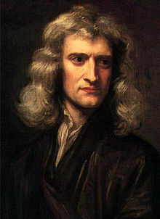
Isaac Newton’s View
of the Universe
* Copernicus, Kepler and Galileo… Newton built on their work – REBUILDING the UNIVERSE!
* Mathematical Principles of Natural Philosophy (published in 1687), Newton laid out his UNIVERSAL LAW OF GRAVITATION.
…set forth LAWS of MOTION!
* Newton describes how the Universe FUNCTIONS…
* BIG IDEA: Newton taught that scientific theory should be coupled with rigorous
experimentation – which would eventually become the basis of modern science *
Notes:
Kepler's laws of planetary motion and Galileo's mechanics culminated in the work of Isaac Newton. His laws of motion were to be the solid foundation of mechanics; his law of universal gravitation combined terrestrial and celestial mechanics into one great system that seemed to be able to describe the whole world in mathematical formulae…

Slide 17
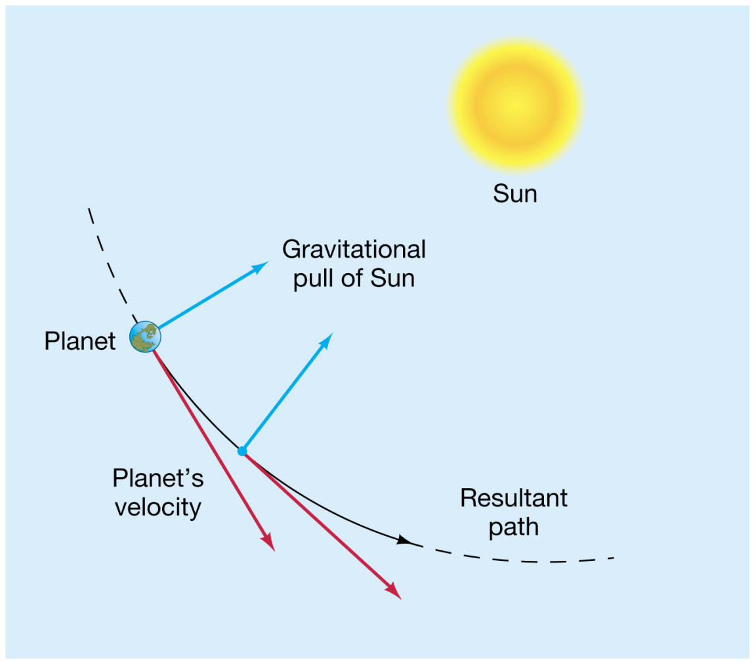
UNIVERSAL LAW OF GRAVITATION
* Every object in the universe attracts every other object by a force called GRAVITY (the degree of attraction depends on mass and distance between them)
* Newton’s WORLD-MACHINE CONCEPT created a new view of the universe! – HOW?
* QUESTION: Why was this theory important to scientists of the 17th century?
Answer:
If mathematically proven, the theory could explain all motion throughout the universe!
Notes:
World-machine concept… the universe was now seen as one huge, regulated, uniform machine that worked according to natural laws set forth by God.

Slide 18
* Now that Scientists know what the Universe looks like – they begin to question other topics…

Slide 19
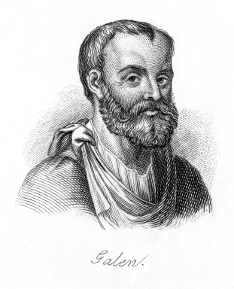
Scientific Revolution:
Breakthroughs in Medicine
(and the human body)
* Galen – Greek (or, Roman) physician and surgeon (2nd Century A.D.) who made early contributions to the understanding of anatomy, physiology and neurology…
* Focused on animal dissection, rather than human, to formulate ideas on the human anatomy – his teachings dominated until the Middle Ages… *
* The circulatory system consisted of two separate one-way systems of distribution (rather than a single unified system of circulation).
* Venous blood was generated in the liver, from where it was distributed and consumed by all organs of the body – Arterial blood originated in the heart, from where it was distributed and consumed by all organs of the body.

Slide 20
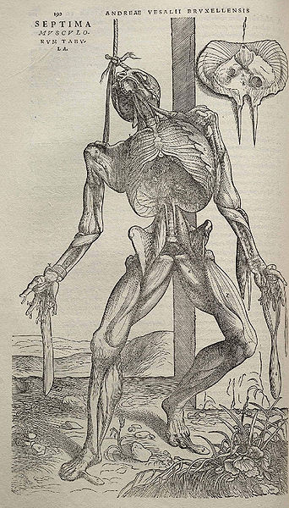
Scientific Revolution:
Breakthroughs in Medicine
(and the human body)
* Andreas Vesalius’ On the Fabric of the Human Body (published in 1543) presents an accurate examination of the organs and the complete structure (bones and muscle) of the human body
* Vesalius is often referred to as the founder of modern human anatomy!
* THINK: Why was Vesalius able to gain an understanding of the human anatomy where Galen was not?

Slide 21
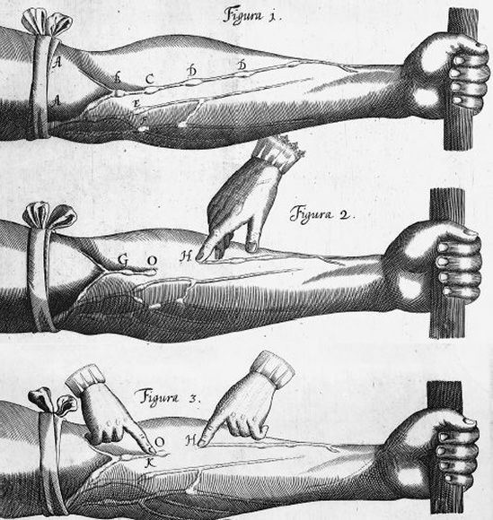
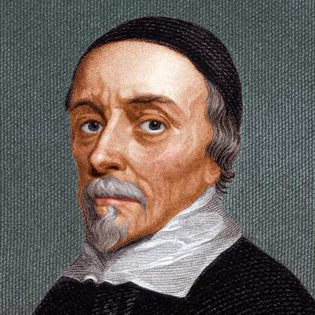
Scientific Revolution:
Breakthroughs in Medicine
(and the human body)
* William Harvey publishes On the Motion of the Heart and Blood (1628)
* The heart acts as pump to circulate blood throughout the body – the same blood flows through veins and arteries…

Slide 22
Francis Bacon and…
The Scientific Method
* MAIN IDEA: scientists came to believe that REASON is main source of ALL knowledge..
* REASON is the capacity for consciously making sense of things, applying logic, for establishing and verifying facts, changing or justifying practices, institutions, and beliefs based on NEW information!

Slide 23
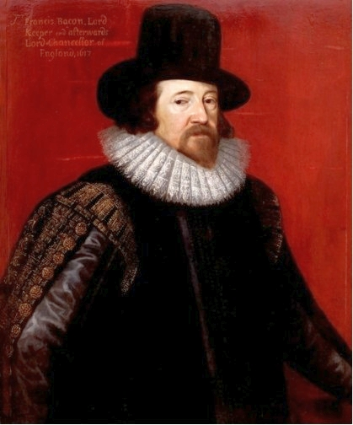
Francis Bacon and…
The Scientific Method
* What is it?
…It is a step-by-step, repeatable process for collecting and analyzing data and coming to new conclusions (systematic procedure).
* EXPLAINED by Francis Bacon (1622)
* Believed in the use of INDUCTIVE REASONING
“If a man will begin with certainties, he shall end in doubts; but if he will be content to begin with doubts, he shall end in certainties.”

Slide 24
Francis Bacon and…
The Scientific Method
* Inductive reasoning…
1.) Free mind from previous opinions that might distort the truth
2.) Start with detailed facts and proceed to general principles
* Inductive reasoning DRIVES the Scientific Revolution!
* Bacon wanted science to advance human life with new discoveries
(Science could benefit industry, agriculture and trade)
INDUCTIVE vs. DEDUCTIVE
Reasoning

Slide 25
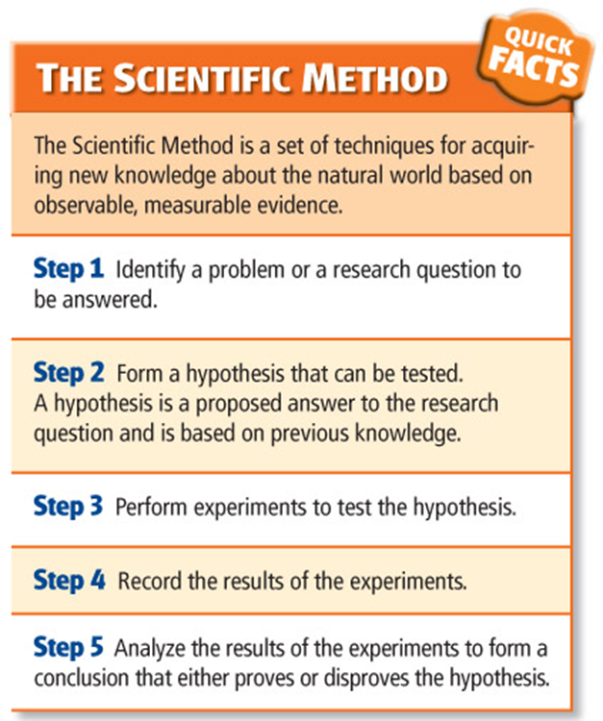
How does a scientist come
to a conclusion?
* The SCIENTIFIC PROCESS!
Step 1: make an observation (observe a natural event)
Step 2: formulate a hypothesis (a theory or possible explanation for the event)
Step 3: test the hypothesis (perform organized experiments to test theory)
Step 4: analyze results from test (draw conclusions)
* GENERAL PRINCIPLE *
* Step 5: change the hypothesis (if necessary)

Slide 26
Science often proceeds by a process of successive approximation
Make an assumption
See how it fits reality,
Modify it (junk it if necessary) and try again.
After a few iterations of successive approximation you can be very far from your starting point,
Even fairly strange initial assumptions can lead to correct results.

