Slide 1
7.7 Students compare and contrast the geographic, political, economic, religious, and social structures of the Meso-American and Andean civilizations.
1. Study the locations, landforms, and climates of Mexico, Central America, and South America and their effects on Mayan, Aztec, and Incan economies, trade, and development of urban societies.
2. Study the roles of people in each society, including class structures, family life, warfare, religious beliefs and practices, and slavery.
3. Explain how and where each empire arose and how the Aztec and Incan empires were defeated by the Spanish.
4. Describe the artistic and oral traditions and architecture in the three civilizations.
5. Describe the Meso-American achievements in astronomy and mathematics, including the development of the calendar and the Meso-American knowledge of seasonal changes to the civilizations’ agricultural systems.

Slide 2
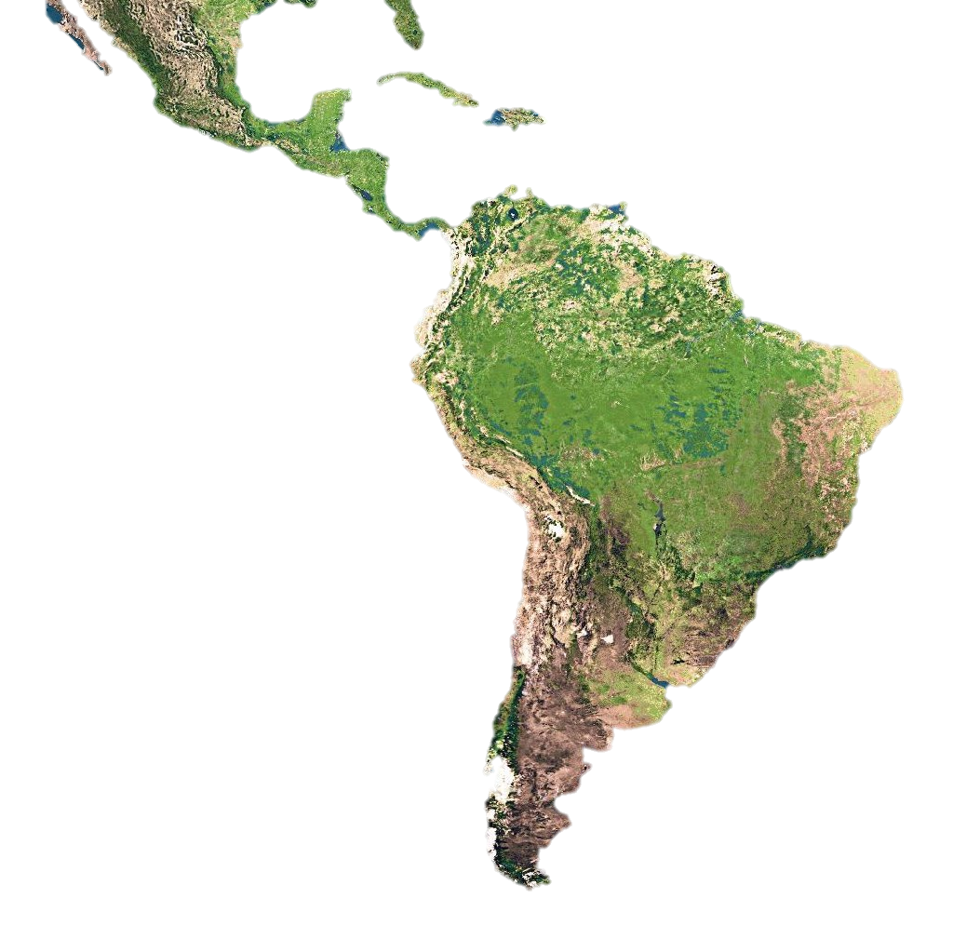
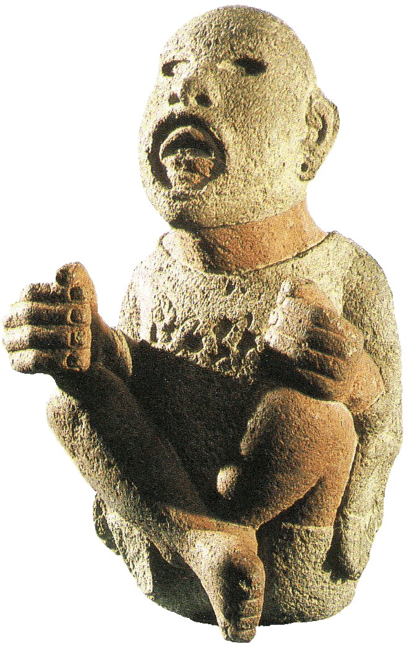
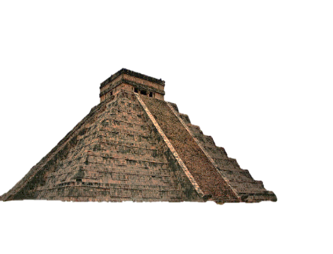
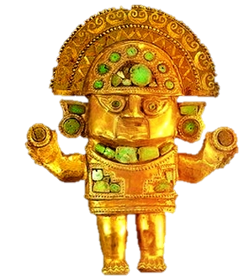
LA 4
Latin America
Part I:
The Mayans
Essential Question:
What were some of the unique aspects of Mayan life?

Slide 3
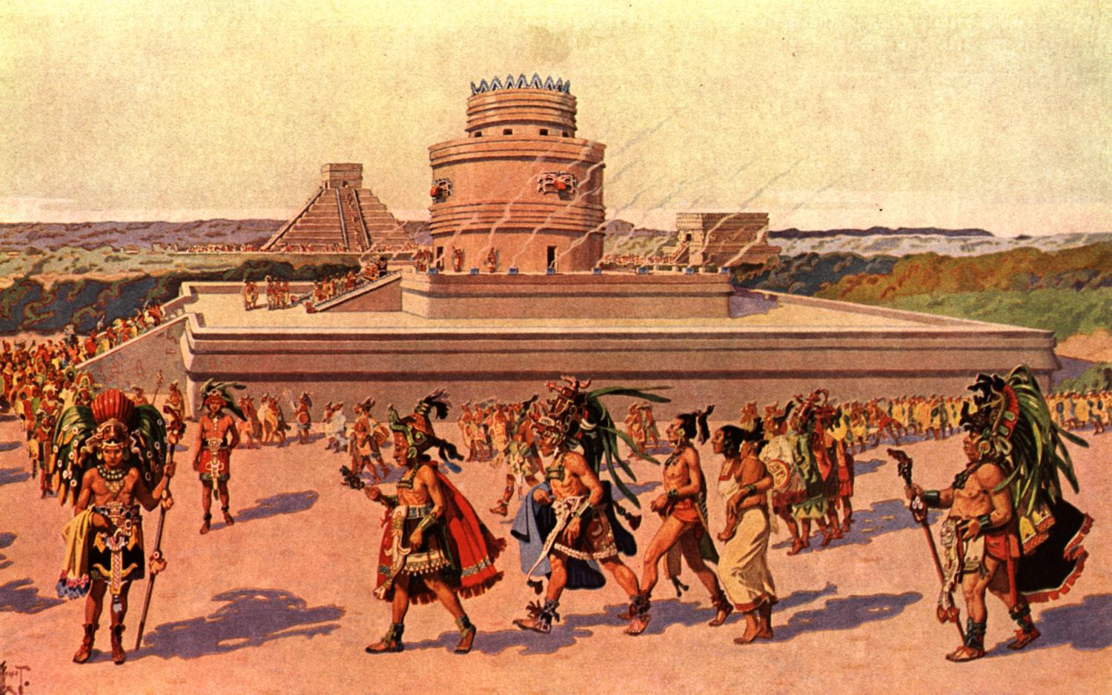
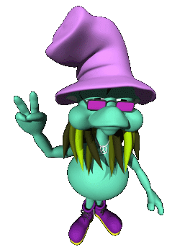
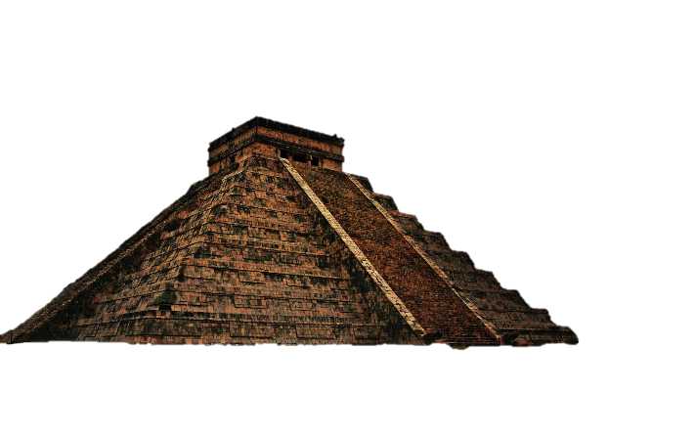

Originally known as a peaceful and advanced society.

Slide 4
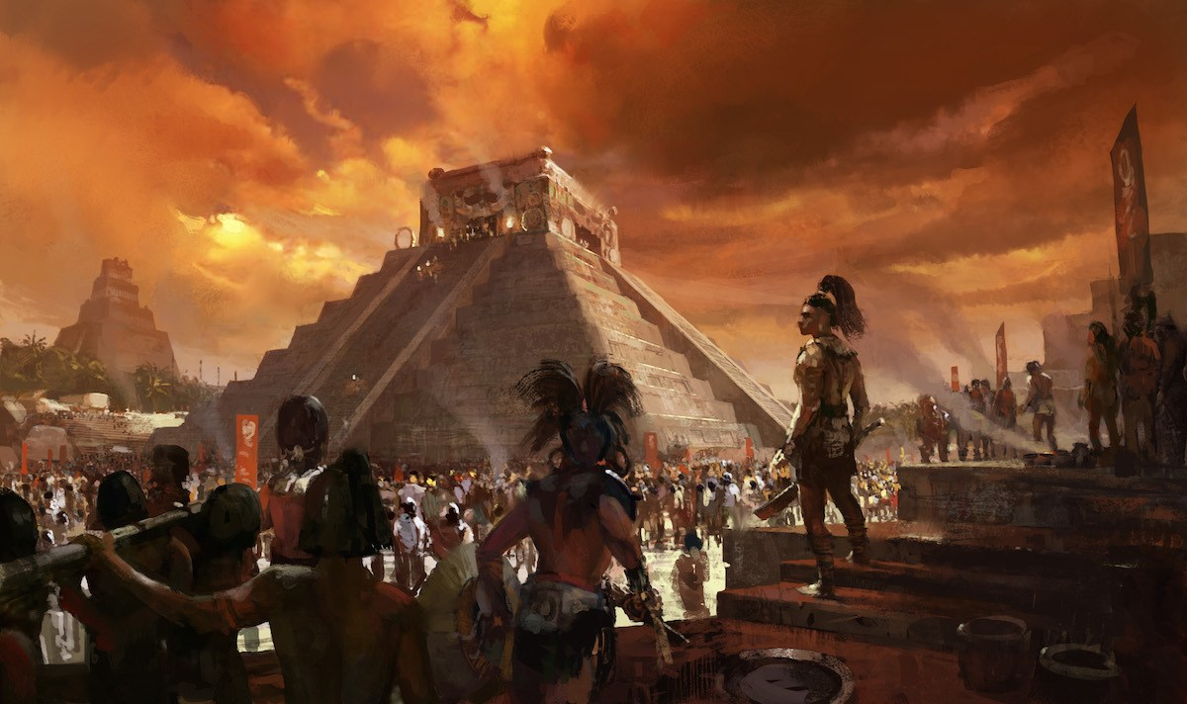
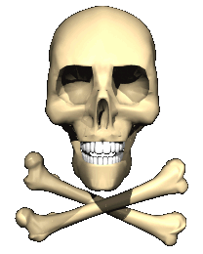

,
Now, a violent, yet very advanced people in Central America.

Slide 5
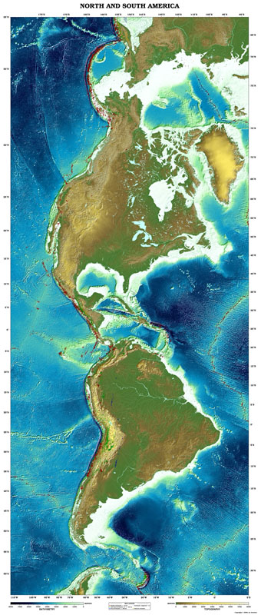
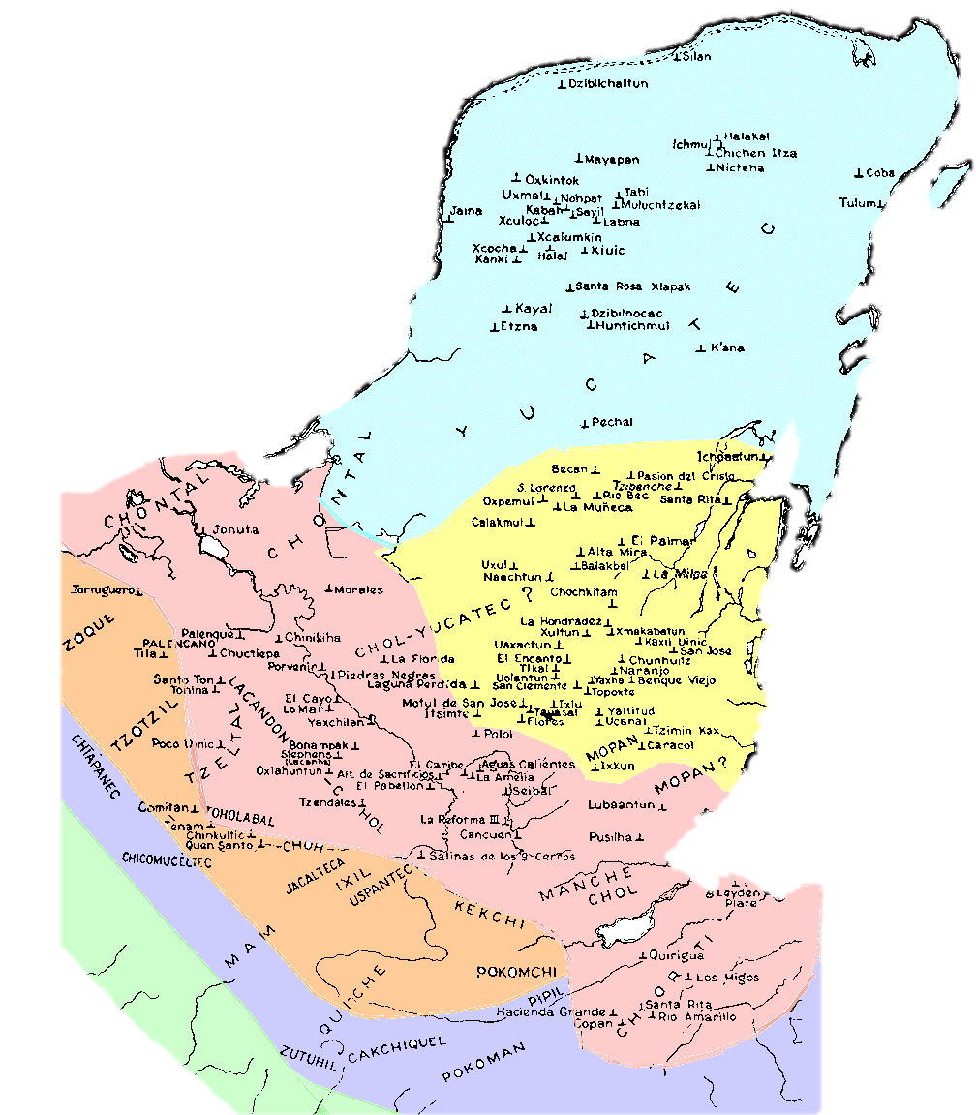
Notes:
Which number on the map best represents the location of the Mayan Empire? (7.7.3)
1
2
3
4

Slide 6
Economics
Notes:
economics

Slide 7
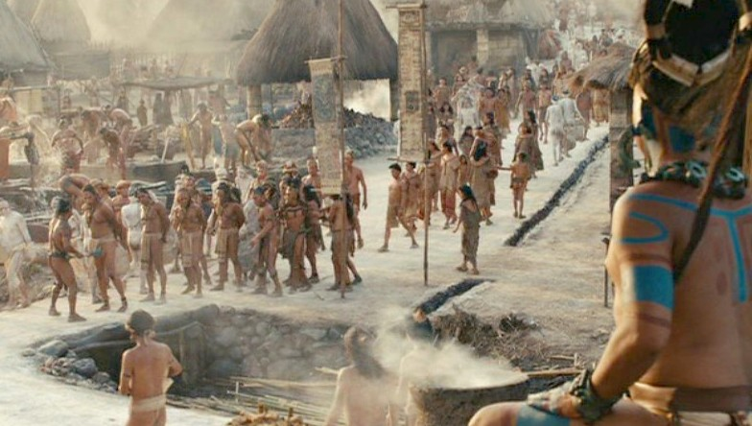
Slaves
Captured warriors used as builders and sacrifices.

Slide 8
Society
Notes:
society

Slide 9
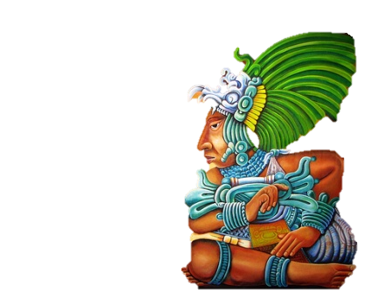

Mayan Beauty
The Mayans had a very different idea of what was beautiful…
They found flat foreheads to be very attractive…

Slide 10
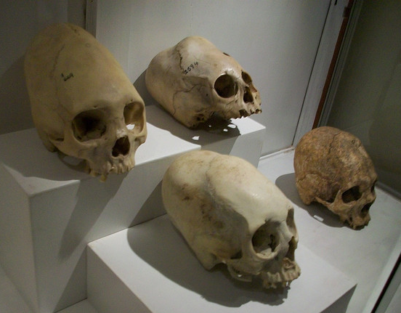
How and Why
Notes:
Boards strapped on baby heads, most likely to look like corn.

Slide 11
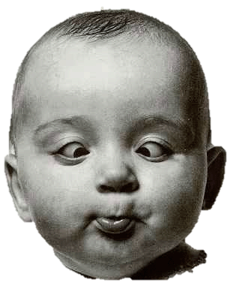

And just is case the flathead didn’t impress the ladies…
You could try crossing your eyes…

Slide 12
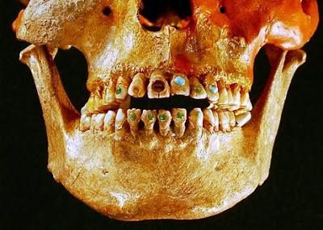
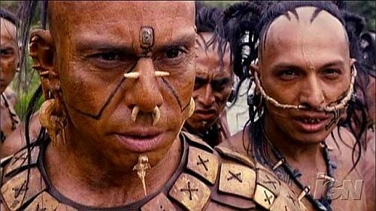
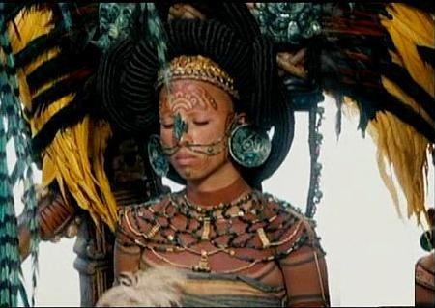
Other options:
Jam a piece of rock into your teeth.
Piercings and
tattoos!

Slide 13
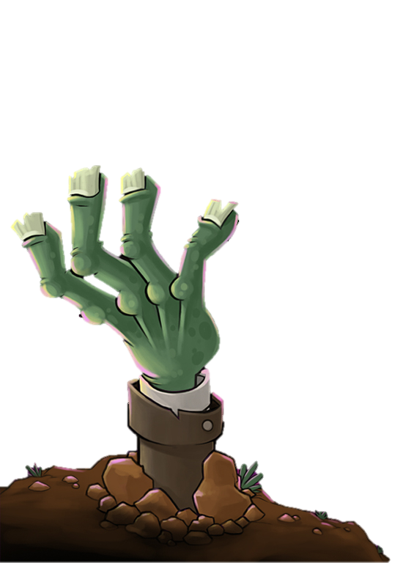
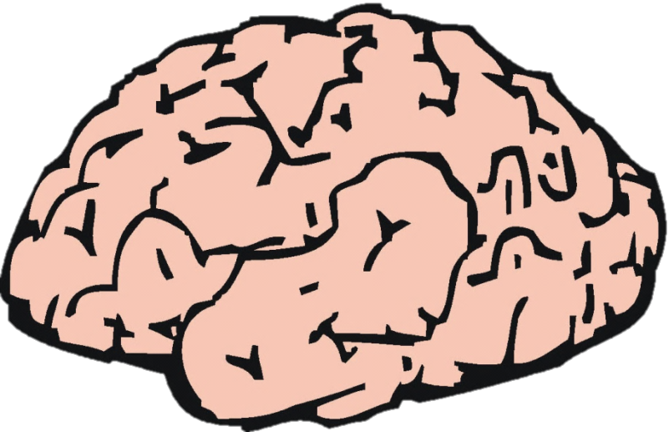
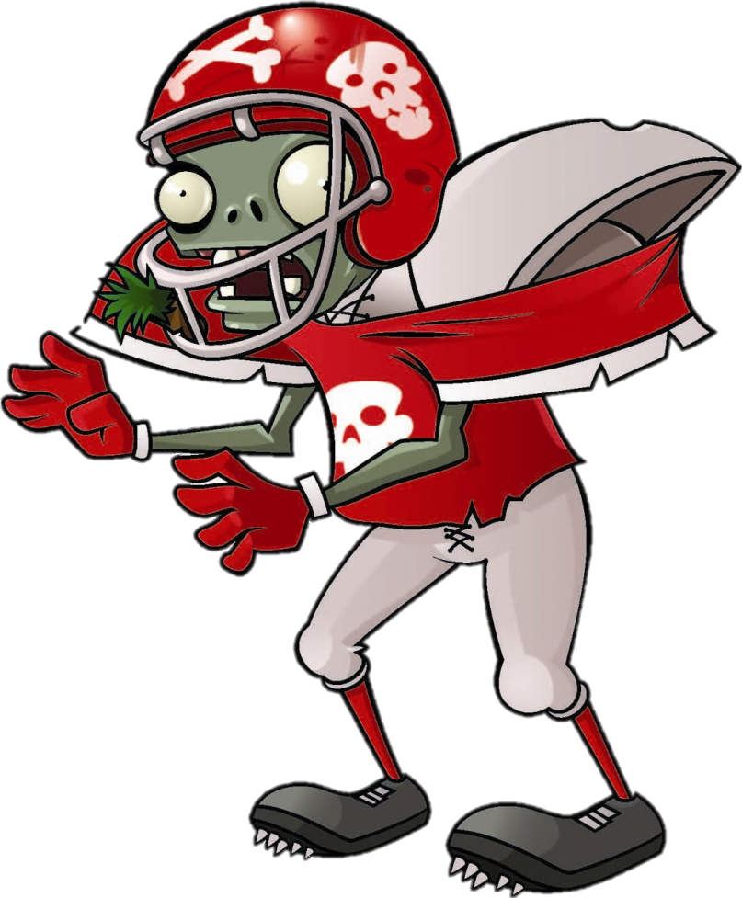

Brain
Snack
.
.
.
.

Slide 14
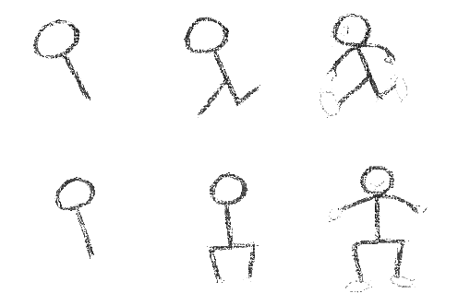
Draw It!
Notes:
Picture/artist

Slide 15
Draw a good-looking Mayan.
Notes:
Picture/artist

Slide 16
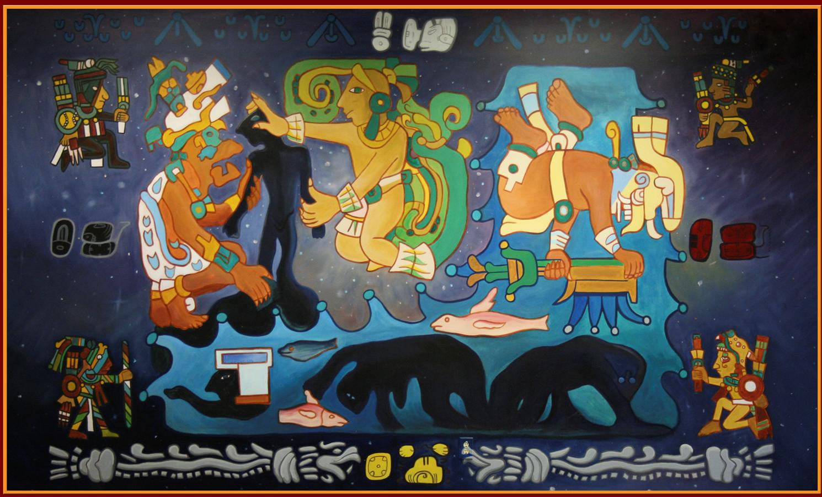
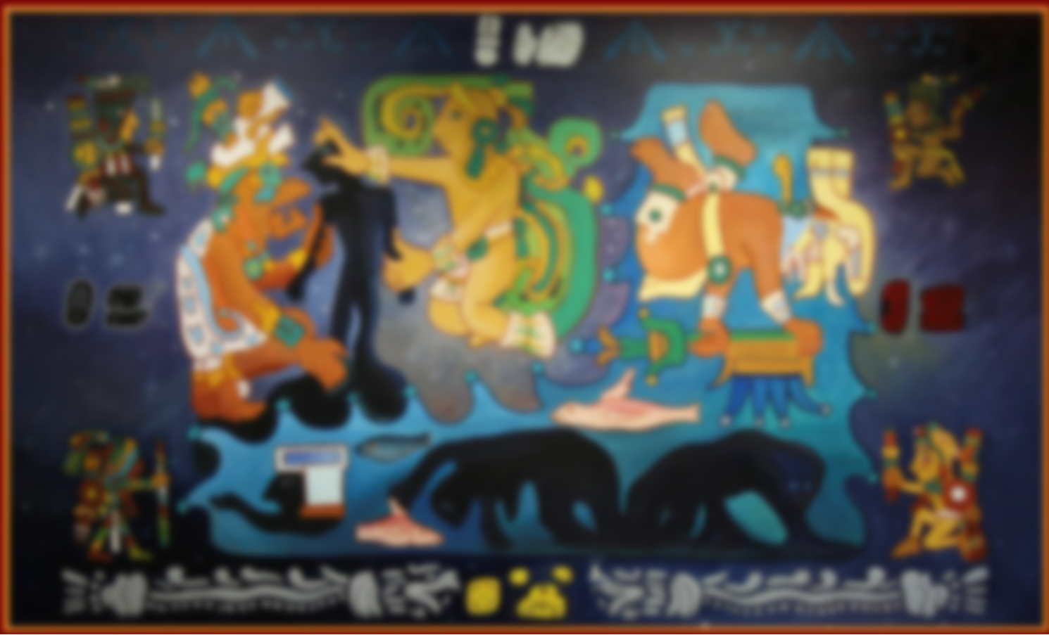
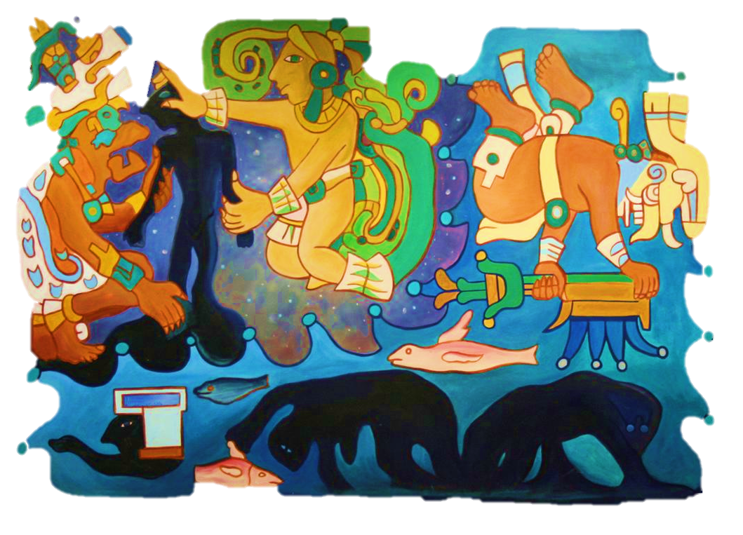
Mayan Religion
Mayan Religion
Notes:
https://www.google.com/url?sa=i&rct=j&q=&esrc=s&source=images&cd=&cad=rja&uact=8&ved=0ahUKEwjzt562pLnJAhVYMIgKHTn6D7sQjB0IBg&url=http%3A%2F%2Fgalleryhip.com%2Fmayan-religion-sacrifice.html&psig=AFQjCNFHLOxrkJCwCJtMxaX1MLjQXaXn3w&ust=1449011883874509
http://team-yellow.com/2013/08/24/18-pokemon-reimagined-as-mayan-gods-pokemayan-if-you-will/
https://en.wikipedia.org/wiki/Treehouse_of_Horror_XXIII

Slide 17
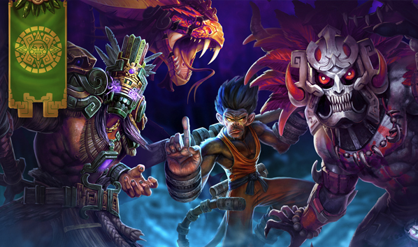
Believed in many gods and that each needed a unique sacrifice to be happy.
Notes:
What was the purpose of human sacrifice in Mexico? (7.7.2)
To reduce the population.
To entertain the leaders and wealthy classes of each city-state.
To punish the slaves.
To keep the gods happy which ensured continued rain, sun, and food.

Slide 18
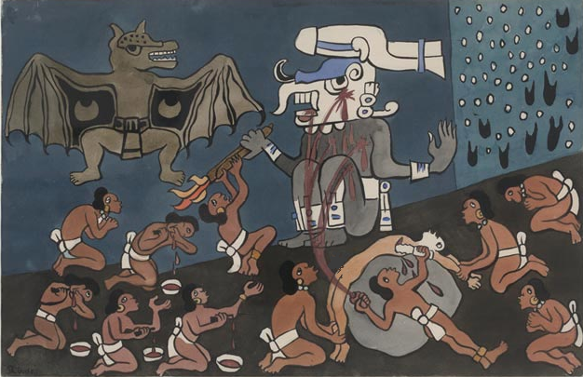
"They should cut themselves open, that from under their ribs up under their armpits their hearts should be torn out. Before everything, sacrifice. By this you will obtain grace. Next, make holes in your ears, and likewise prick your elbows and knees. Offer as sacrifice the blood that flows from them. In these ways, your gratitude will be shown."
-The Popol Vuh

Slide 19
Brain
Snack
.
.
.
.

Slide 20
1
3-2-
Complete the following 3-2-1 Summary
3-
2-
1-
Ways to look beautiful
Awful things the Mayans did
Thing you found interesting

