Slide 1
Colonization of North America

Slide 2
Colonization of the New World
European countries fighting for resources and wealth
1492: Christopher Columbus secures funding for voyage to find shorter route to India
Stumbles upon North America- what a discovery!

Slide 3
Colonization of the New World
Columbus's maiden voyage marked the beginning of the colonization of the “New World”
Colony: a country or area under the full or partial political control of another country, typically a distant one, and occupied by settlers from that country

Slide 4
Colonization of the New World
France: Looks for Fish and Fur, not as many settlers
Spain: Looks for silver and gold, sends Catholic priests, move into Latin and Central America
England: Looks for gold, minerals, raw materials, settle on East Coast

Slide 5
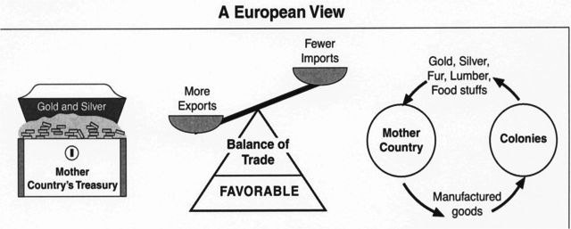
Mercantilism
Mercantilism:
Economic theory that the best way for a nation to become strong was to acquire the most gold and silver (wealth equals power)

Slide 6
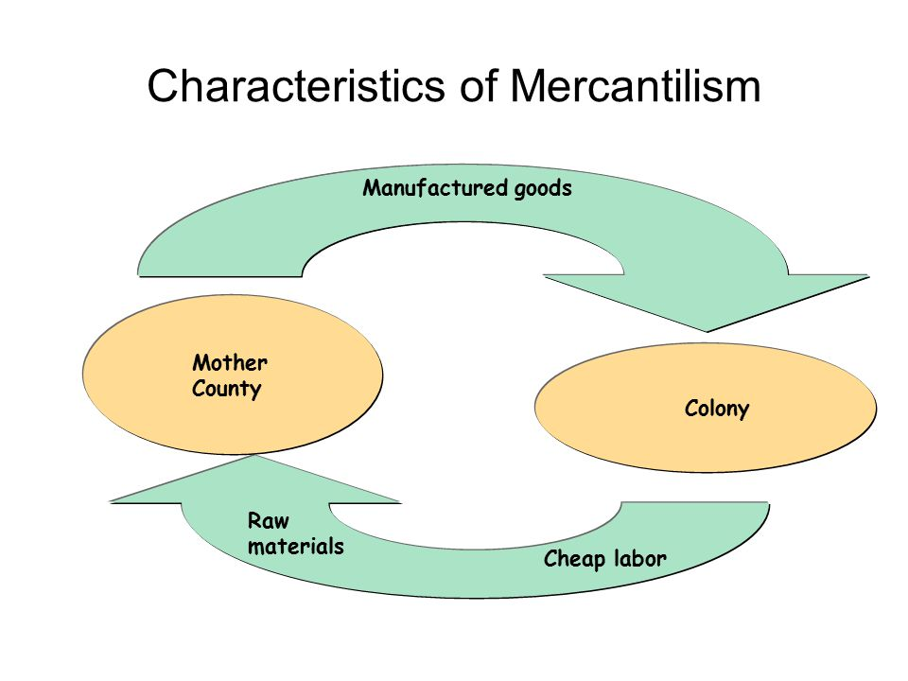
Mercantilism
Colonies are vital to Great Britain because they have raw materials not available to the mother country
Great Britain imports these raw materials and sell finished goods to accumulate more wealth

Slide 7
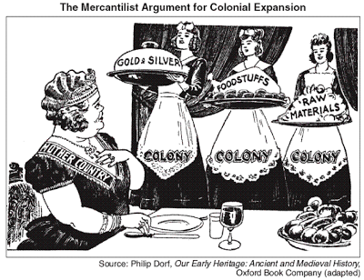
British Trade in the Mercantilism System
Raw Materials from Colonies:
Lumber
Sugar
Wool
Tobacco
Rice
Indigo

Slide 8
In turn, the British used the colonists as a ready market for manufactured goods:
All finished goods were sold by the British to the colonists at a higher price

Slide 9
Mercantilism Recap:

Slide 10
Southern Colonies
Virginia
Maryland
North Carolina
South Carolina
Georgia

Slide 11
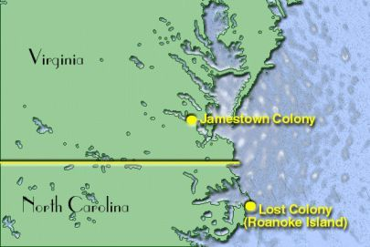
Development of the Southern Colonies
1B
It all starts with Jamestown, the first permanent English settlement

Slide 12
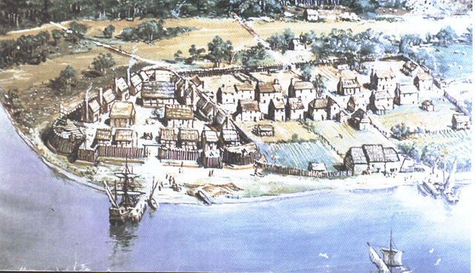
Jamestown
1607: Jamestown colony in present day Virginia
First permanent English settlement in North America

Slide 13
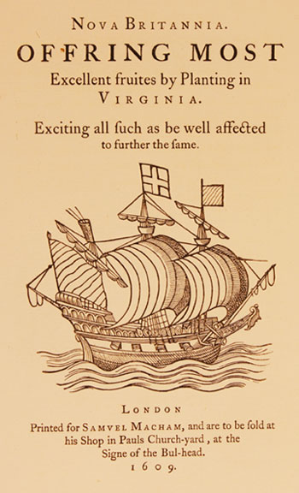
Virginia Company
Business venture: Virginia Company
Joint-Stock Company: business where investors buy shares of the company to raise revenue for the expedition to the New World
In turn, the colonists will search for gold and other valuable natural resources that they will send back to Great Britain to pay back investors and turn a profit

Slide 14
Jamestown Struggles
Jamestown suffers initially:
Disease:
Poor location of original settlement along a swampy river
Many men die from malaria and dysentery
Lack of Leadership:
Most colonists were middle class and townspeople
Few had experience in farming and working with animals
Upper class colonists won’t work
Food and Shelter were not a priority when first arrive, no supplies for the winter

Slide 15
Quote, Jamestown Survivor
“When our people were fed out of the common store and labored jointly . . . Glad was the man that could slip from his labor . . . Presuming that howsoever the harvest prospered, the general store must maintain them, by which means we reaped not so much corn for the labors of 30 men, as three men have done for themselves.”

Slide 16
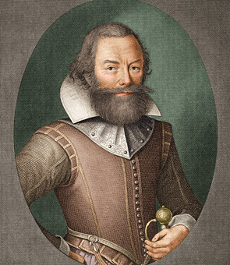
Captain John Smith
Captain John Smith
Leads Jamestown after the “starving time”
Mandates discipline and work among colonists
“he that will not work will not eat”
Encourages more farming and constructs a better fortification
away from river bank

Slide 17
Tobacco
Becomes the cash crop of the colony
Cash crop: a crop produced for its commercial value rather than for use by the grower
Saves the colony after John Rolfe introduces it to area

Slide 18
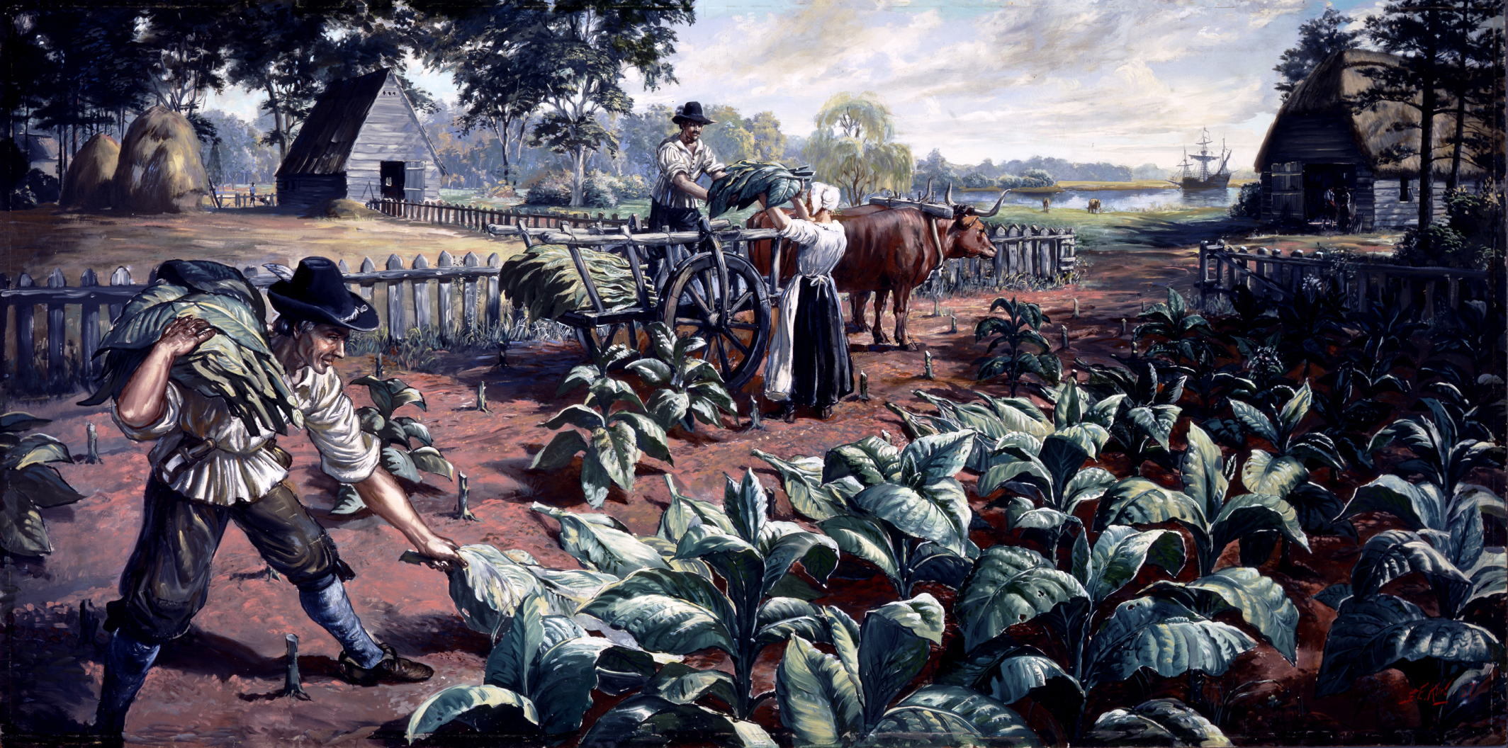
Tobacco
Labor intensive crop
Indentured servants come to work the tobacco fields
Indentured servants were men and women who signed a contract (also known as an indenture or a covenant) by which they agreed to work for a certain number of years in exchange for transportation to Virginia and, once they arrived, food, clothing, and shelter.

Slide 19
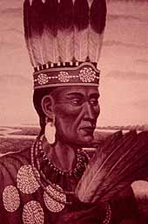
Relations with Native Americans
Powhatan, native chief, led a confederacy of Native American tribes during Jamestown’s founding
He helped develop a trade relationship between the natives and the English

Slide 20
Tobacco Grows
England becomes addicted to tobacco, colonists expand tobacco production
Moving further westward inland infringes on the American Natives’ land
This increases the conflicts between natives and English.

Slide 21
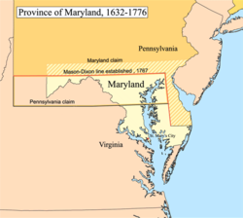
Maryland
Maryland:
Established as haven for Catholics who were being persecuted by Protestants in Europe
Tobacco cultivation begins to influence settlement

Slide 22
North and South Carolina
Proprietary Colony:
Producer of rice and indigo on plantations
Plantation: an estate on which crops such as coffee, sugar, and tobacco are cultivated by resident labor

Slide 23
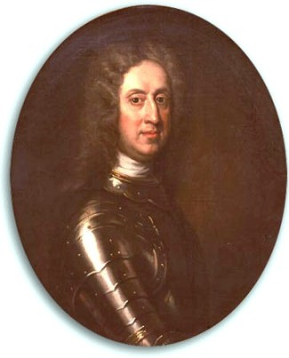
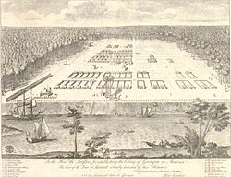
Georgia Colony
1B
Established by Gen. James Oglethorpe in 1732 to be:
Buffer zone between Spanish Florida and the Carolinas
Protect cash crops and Charleston Harbor
Debtors’ colony
Debtors from England would be given chance at new life, provide raw materials for England and defense for buffer area
Strict Rules applied to the Georgia Settlement
Small farms
Slavery banned
Alcohol prohibited
But rules only lasted 8 years, more autonomy given to colonists by 1740

Slide 24
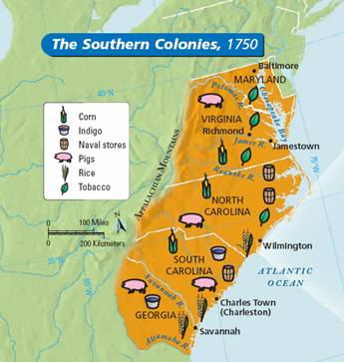
Southern Colonies Review
Reasons for settlement
Agriculture
Cash crops like tobacco, indigo, rice
Impact of geography:
Rich soils in the coastal regions and along the river valleys
Deep rivers so inland farmers were able to ship cash crops - tobacco, indigo, corn, and rice - directly from their farms to European markets

Slide 25
Southern Colonies Review
Impact of location on colonial settlement:
Large estates, spaced out, few towns- plantations near waterways, agriculture rules society
Large colonies with smaller populations
Few large cities, more small towns with citizens spread out

Slide 26
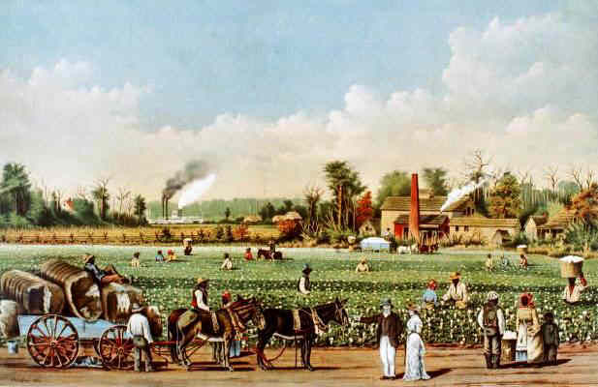
The Southern Colonies
Economic development
Lower southern colonies grew cash crops commercial farms developed that grew primarily labor intensive cash crops such as rice, tobacco, and indigo
Used indentured servants in early years, but moved toward slave labor by end of 1600s
Upper southern colonies tended to be populated by subsistence family farms
Subsistence farming: farming in which the farmers focus on growing enough food to feed themselves and their families with little or no surplus to sell

Slide 27
Interactions with American Indians:
Begin as a helpful, Jamestown colonists get help from Powhatan
As more colonists move inland for more land to grow cash crops, relationships become tense
Threat of colonists expansion erodes trust with American Indians

Slide 28
New England Colonies
1C
Massachusetts
Rhode Island
Connecticut
New Hampshire

Slide 29
Development of the New England Colonies
1C
Puritans were a religious group who were persecuted for desire to reform the Anglican Church in England
Believed it to still be too Catholic
Formed the London Company of Plymouth – a trading company
Immigrated to American colonies to escape religious persecution
Pilgrims established Plymouth in 1620
Puritans established Massachusetts Bay in 1630
Combined in 1690 to form the Massachusetts colony

Slide 30
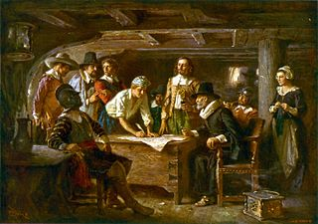
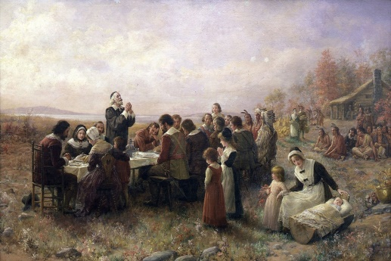
The Plymouth Colony
1C
Set sail in 1620 on the Mayflower
Had 100 passengers
Originally intended to head to Virginia, but storm blew them off course to the north
Signed Mayflower Compact before disembarking
Pledge to rule through majority rule

Slide 31
Massachusetts Bay Colony
1C
Settled by a group of Puritans led by John Winthrop
Religious tone of colony set by his “Model of Christian Charity” speech (i.e. “city upon a hill”)
Ability to prosper through hard work would be a symbol to the world & prove their devotion to God
Result was strict Puritan rules in the colony and an essential work ethic

Slide 32
Primary Source Quote
1C
“…when He shall make us a praise and glory that men shall say of succeeding plantations, "may the Lord make it like that of New England." For we must consider that we shall be as a city upon a hill. The eyes of all people are upon us.”
John Winthrop, 1630

Slide 33
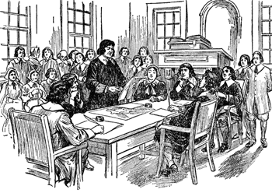
A New Type of Governance
Communities were run using town meetings.
Town meetings: members of a community come together to legislate policy and budgets for local government
Only church members could vote
Towns were run as direct democracies with each voting member having a direct role in the administration of government.

Slide 34
Church and State
Puritans are not tolerant of other religions that differed from their own
All colonists required to attend Puritan church, regardless of faith
Only Puritan church members are allowed to participate in government

Slide 35
Opposition to Puritan Rule
Puritans were not tolerant of religious beliefs that differed from their own
They often banished anyone who disagreed with Puritan ideology and practices from the colony
Roger Williams, banished Puritan, formed Rhode Island
More tolerant of non-church members

Slide 36
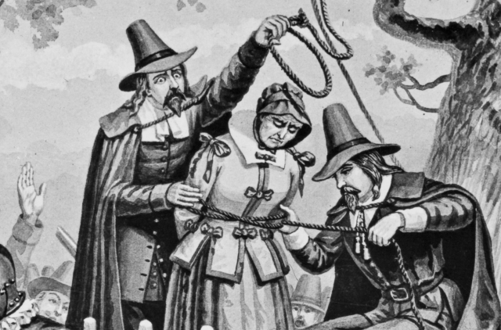
Salem Witch Trials-1692
Began in Salem, Mass.
Three girls take ill with convulsions and fits, accuse several local residents of using witchcraft to cause illness
Mass hysteria with illness spreading
Accusations spread and led to over 150 Massachusetts colonists being accused of witchcraft
29 were convicted and 19 hanged

Slide 37
Salem Witch Trials-1692
Causes of Salem Witch Trials
extreme religious faith
stress from a growing population
deteriorating relations with Native Americans,
limited opportunities for women and girls to participate in Puritan society

Slide 38
American Indian Interactions
Relationships in coastal areas were based on exchange of trade goods
As English population grew, so did tension
As colonists move inward, they infringe upon the American Indian territory

Slide 39
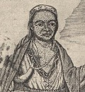
King Phillip’s War (1675–1676)
King Phillip, or Metacom, was the regional leader of natives
Conflict originated because of English influence in Native lives
Natives pushed off land
some tribal members had converted to Christianity disrupting traditional political and cultural ties among the region’s tribes.
Many colonists died in the war, but it also caused a heavy loss of life among the Native American population
Effect: large areas of southern New England were opened to English settlement.

Slide 40
The Other New England Colonies
1C
Rhode Island
Formed by Roger Williams when banished from Massachusetts Colony in 1636
Characteristics of colony:
1) Treated American Indians more respectfully & paid them for their land
2) Practiced true religious toleration
Anne Hutchinson who was also banished from Massachusetts after impressively defending herself against John Winthrop, fled here
Connecticut
Separated from Massachusetts colony in 1636
Drafted America’s 1st written constitution – The Fundamental Orders of Connecticut in 1639
Also site of controversial Pequot War
New Hampshire
Separated from Massachusetts colony in 1679
Was a bit more religiously diverse

Slide 41
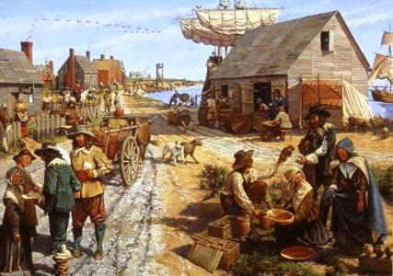
The New England Colonies
Impact of geography:
Poor, thin, rock soil unsuitable for growing cash crops
Short growing season, cold winters make farming difficult
Coastal harbors lead to settlements to develop into ports for importing and exporting goods

Slide 42
Economic Development:
Fishing, whaling, and commercial trade from harbors such as Boston
New England colonists became the merchants of the colonies
New England-based ships were the carriers of colonial goods in the Trans-Atlantic trade

Slide 43
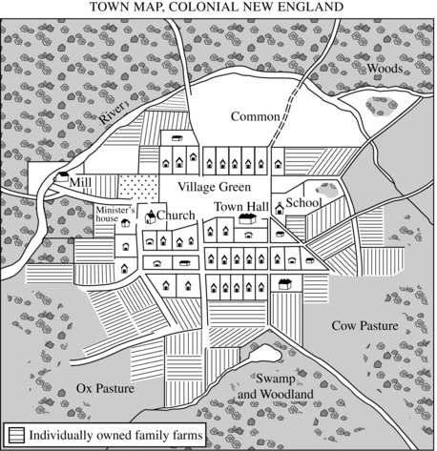
Impact of location on colonial settlement
In Massachusetts colonists live within a half mile of the town square
Most colonists live in towns or villages
In terms of land, colonies are smaller than middle or southern colonies

Slide 44
Relations with American Indians
Relations with American Indians
English outnumbered by American Indians in early years
Viewed by Puritans as needed to be saved from their sinful ways as they were not Christians
Built successful trade relationships in early years
As English population increased so did conflicts
Due to fight over land

Slide 45
Middle Colonies
1D
New York
New Jersey
Pennsylvania
Delaware

Slide 46
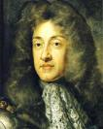
Development of New York
1D
The Dutch originally founded the colony of New Amsterdam in 1614.
Had a diverse population and was known for its tolerance of political and social issues
Colony quickly became profitable through trade business
England took over in 1664 to gain more of the trade business
Colony was given to James, the Duke of York, as a proprietary colony and thus renamed New York

Slide 47
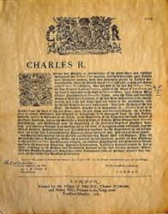
Development of Pennsylvania - 1681
In, King Charles II granted William Penn a land charter as re-payment of a debt made by Penn’s father to the king.
Land becomes known as Pennsylvania
Colony became a place of refuge for English Quakers who faced persecution for their beliefs in Great Britain and in the English colonies of North America.
Quakers believe that individuals are capable of interpreting religion without the need for formal clergy
Women given full participation in faith

Slide 48
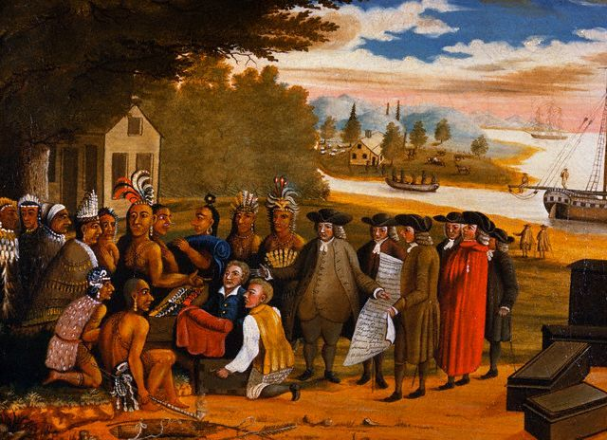
Penn called his colony the “Holy Experiment”
Penn’s philosophy of religious tolerance attracted other immigrants such as Germans and Scots-Irish
Purchased lands from American Indians
Religious tolerance and political freedom granted in Pennsylvania

Slide 49
New Jersey & Delaware
1D
New Jersey
James, the Duke of York had believed the New York colony to be too large to administer
Thus gave two of his friends (Lord John Berkeley & Sir George Carteret) part of the colony
Land was sold at low prices to attract settlers
Delaware
Originally was New Sweden
Colony was then taken by the Dutch & absorbed into New Netherland in 1631 prior to British takeover
The Duke of York then gave this land to William Penn in 1682, where it was part of Pennsylvania until 1704

Slide 50
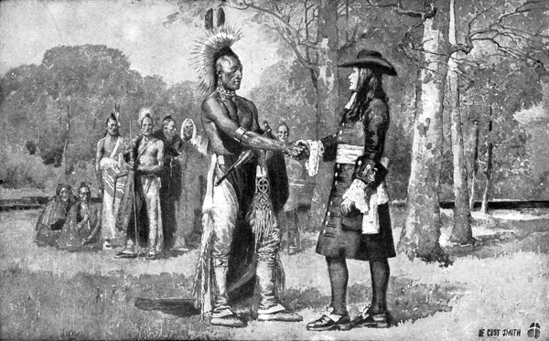
Relations with American Indians
1D
English often relied upon American Indians in region for trade
Main two tribal language groups were the Algonquian and Iroquois
William Penn had insisted on paying natives for their land & gave them a partial voice in the colony’s legislature & courts
Like Penn, most colonists respected and were not threatened by natives living in closer proximity

Slide 51
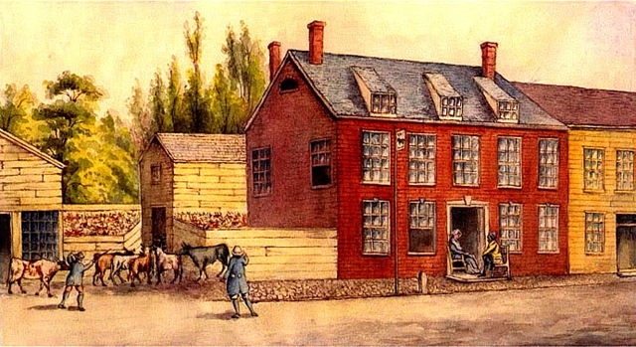
The Middle Colonies
Impact of geography:
Hudson and Delaware rivers provided entry into the interior of North America
Transported furs of Native Americans from interior to harbors on east coast to send to European markets
Later used rivers to transport wheat and agriculture to other colonies and to Europe
Economic Development
Agricultural farms that grow wheat, staple crops
Import manufactured goods from Europe and ship through the colonies
Harbors in NYC and Philadelphia become major commercial hubs to bridge between agrarian south and merchant North

Slide 52
Cultural Diversity in the Mid-Atlantic regions
Due to the Dutch founding of New York and Penn’s “Holy Experiment” the region was more religiously and culturally diverse
Immigrants from New York
Religious toleration in Pennsylvania led to immigrants from all over Europe

Slide 53
Assignment
Create a Tri-fold chart that compares the Southern, New England, and Middle colonies.
On the outside flap write a title, on the inside in EACH column, write a header for each column, describe the reasons for settlement, explain the economies and geography of each section.
Draw 2-3 symbols that represent or express something about EACH area.
EXTRA credit if you draw the outline of the states, like the ones in the PPT.

