Slide 1
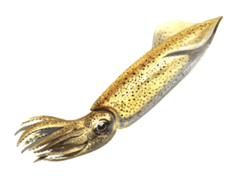
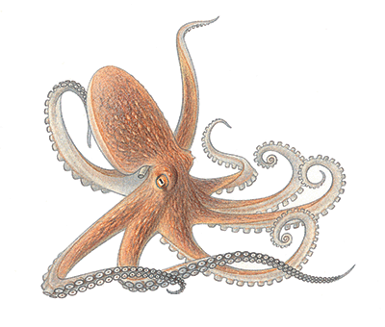
Mollusks

Slide 2
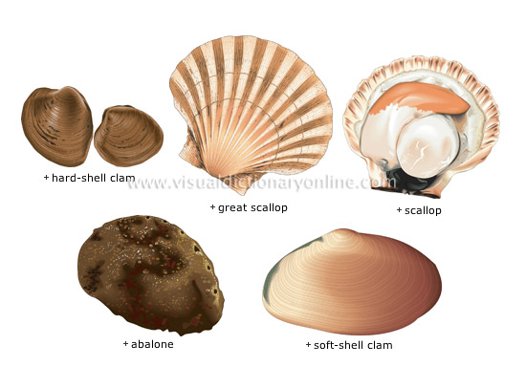
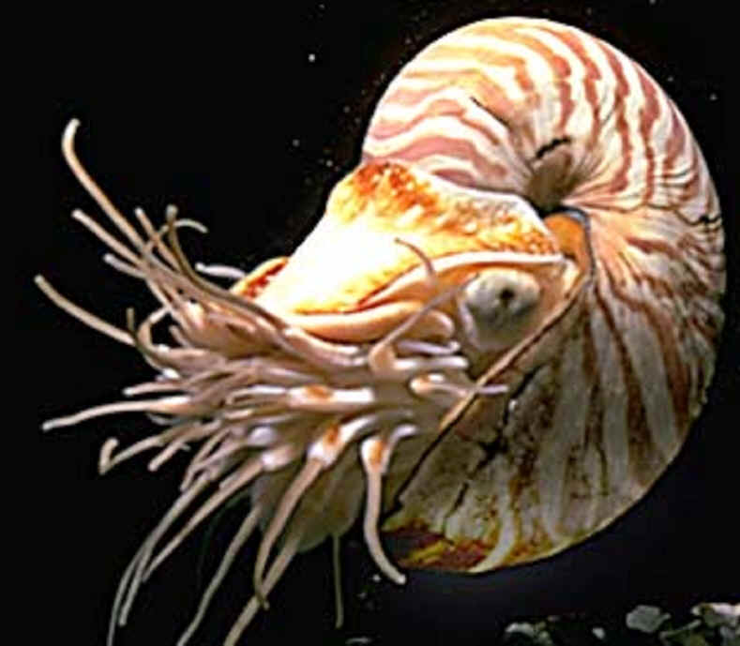
Phylum Mollusca
Includes snails and slugs, oysters and clams, and octopuses and squids.
Bivalves
Nautilus

Slide 3
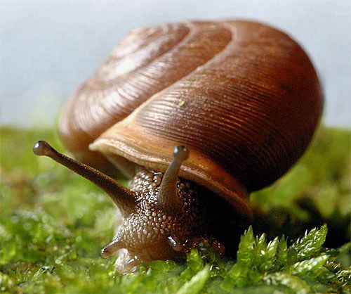
Characteristics
Soft-bodied invertebrate
Covered with protective mantle that may or may not form a hard, calcium carbonate shell
Second largest animal phylum
Have a muscular foot for movement which is modified into tentacles for squid & octopus

Slide 4
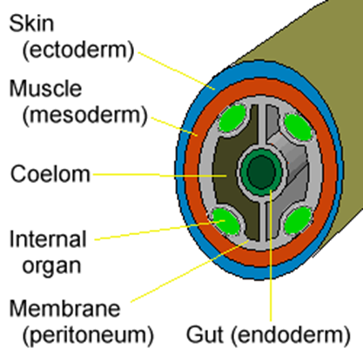
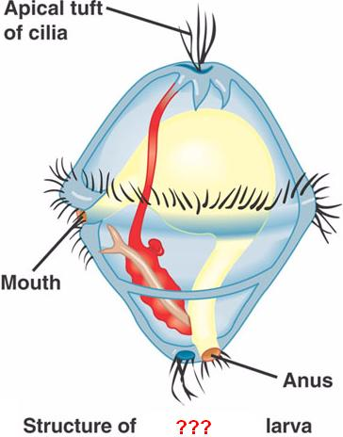
Characteristics
Complete, one-way digestive tract with a mouth & anus
Have a fully-lined coelom
Cephalization - have a distinct head with sense organs & brain
Have a scraping, mouth-like structure called the radula
Go through free-swimming larval stage called trochophore

Slide 5
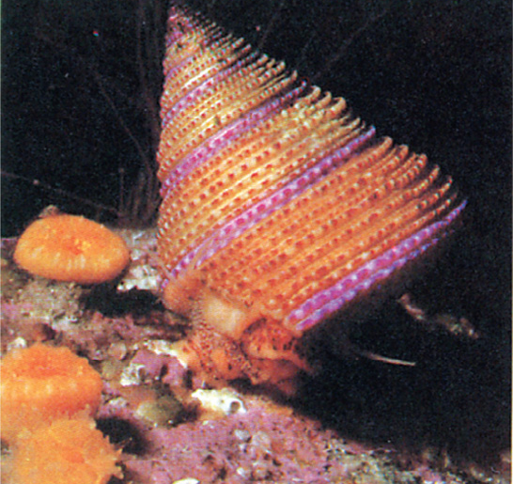
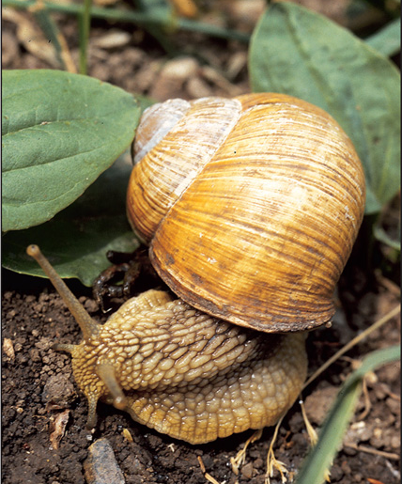
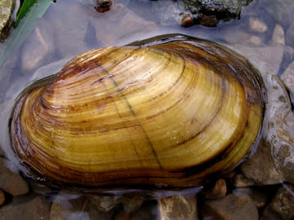
Phylum Mollusca
Most mollusks are marine
Some gastropods and bivalves inhabit freshwater
A few gastropods (slugs & snails) are terrestrial.

Slide 6
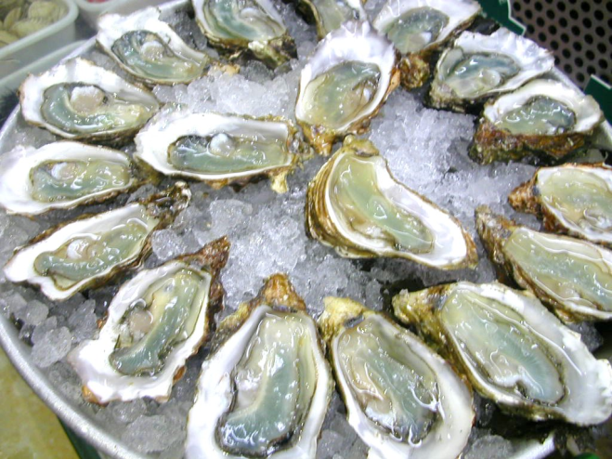
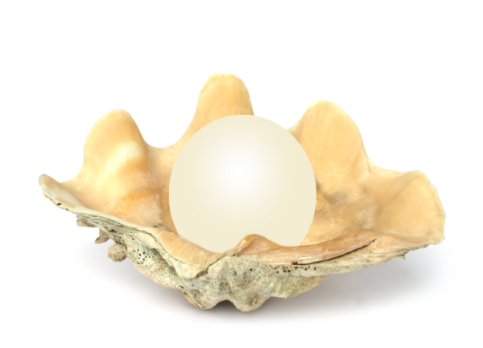
Humans & Mollusks
Uses:
As food – mussels, clams, oysters, abalone, calamari (squid), octopus, escargot (snails), etc.
Pearls – formed in oysters and clams.
Shiny inner layer of some shells used to make buttons.

Slide 7
Mollusk Pests
Shipworms – burrow through wood, including docks & ships.
Terrestrial snails and slugs damage garden plants.
Mollusks serve as an intermediate host for many parasites.
Zebra mussels – accidentally introduced into the Great Lakes and reeking havoc with the ecosystem.

Slide 8
Mollusk Body Plan
All mollusks have a similar body plan with three main parts:
Muscular foot
Visceral mass – containing digestive, circulatory, respiratory and reproductive organs.
Mantle – houses the gills and in some secretes a protective shell over the visceral mass.

Slide 9
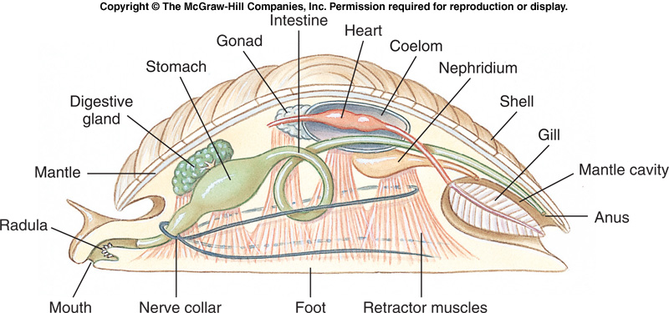
Mollusk Body Plan
Most mollusks have separate sexes with gonads located in the visceral mass.

Slide 10
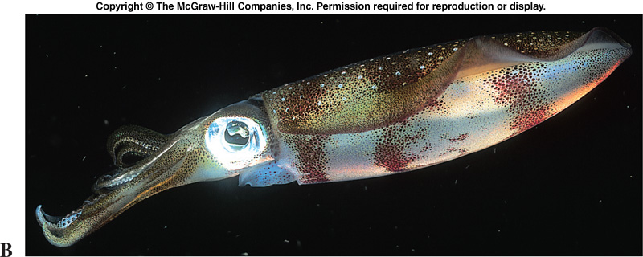
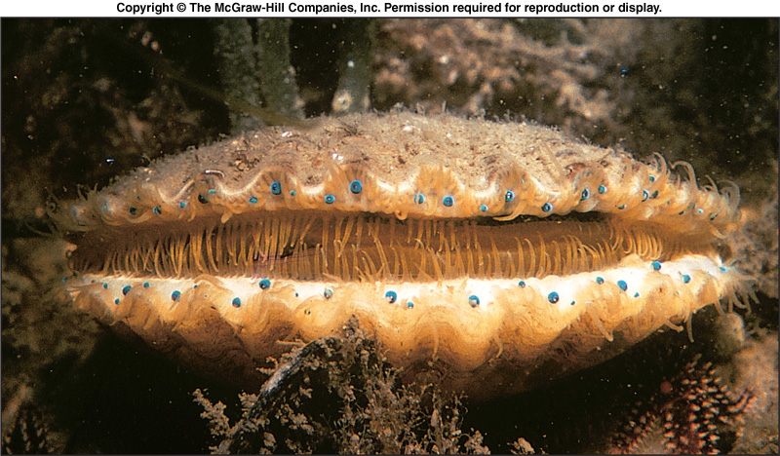
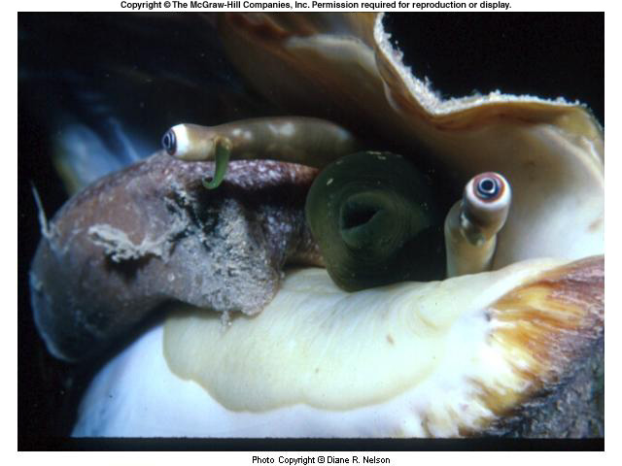
Head-Foot Region
Most mollusks have well developed head ends with sensory structures that may be simple light detectors or complex eyes (cephalopods).

Slide 11
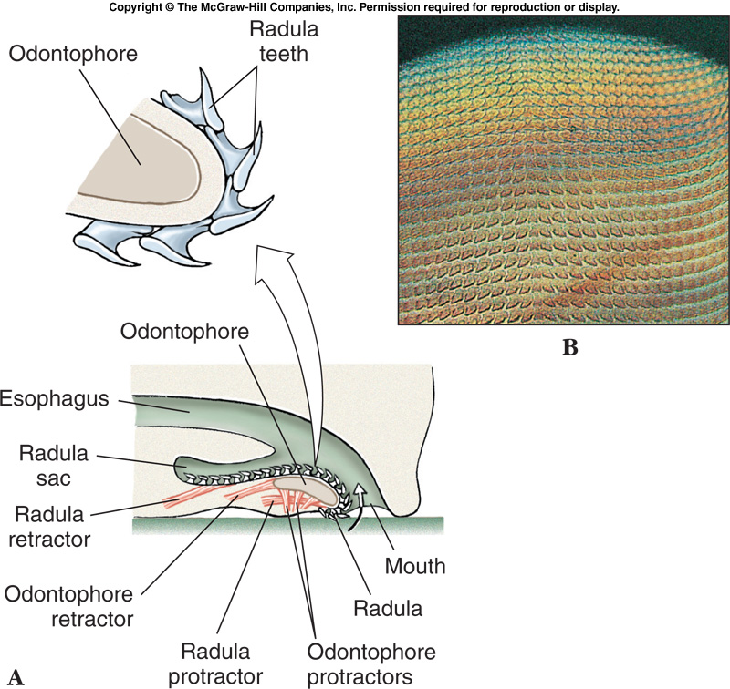
Head-Foot Region
The radula is a rasping, tongue like feeding structure found in most mollusks except bivalves.
Has tiny rows of teeth for scraping.

Slide 12
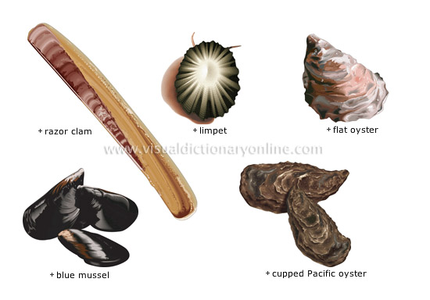
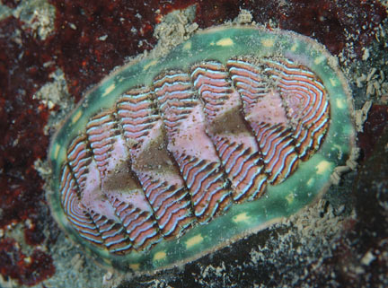
Shells
Found in snails, bivalve mollusks, chitons, and nautilus
Made of calcium carbonate (limestone)
Secreted by the mantle

Slide 13
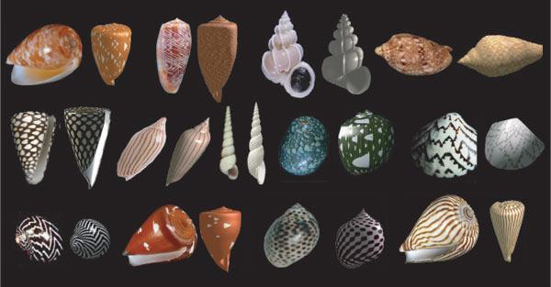

Slide 14
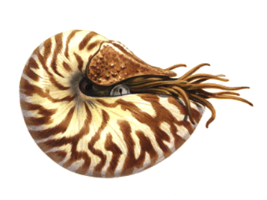
Internal Structure & Function
Many mollusks have an open circulatory system with a pumping heart, blood vessels and blood sinuses.
Most cephalopods (squid & octopus) have a closed circulatory system with a heart, blood vessels and capillaries.

Slide 15
Mantle Cavity
The space between the mantle and the visceral mass (body organs) is called the mantle cavity.
The respiratory organs (gills or lungs) are generally housed here.

Slide 16
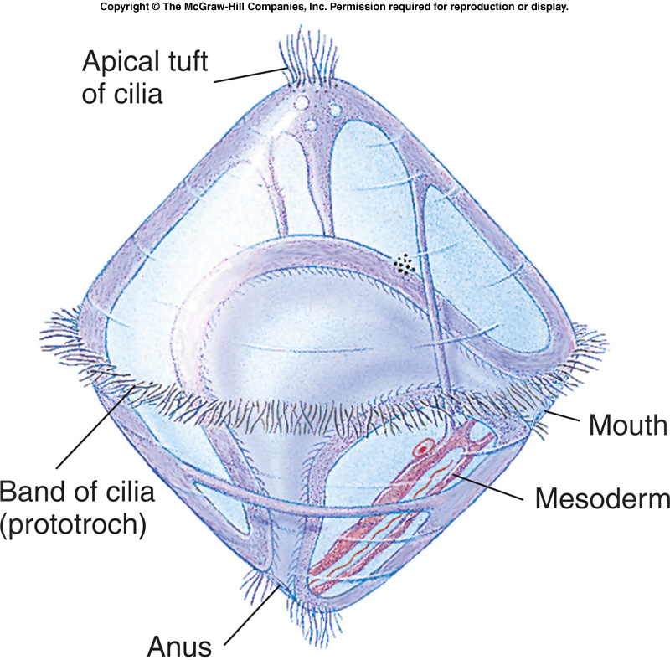
Mollusk Life Cycle
Most mollusks are dioecious (separate sexes)
Some are hermaphroditic
The life cycle of many mollusks includes a free swimming, ciliated larval stage called a TROCHOPHORE

Slide 17
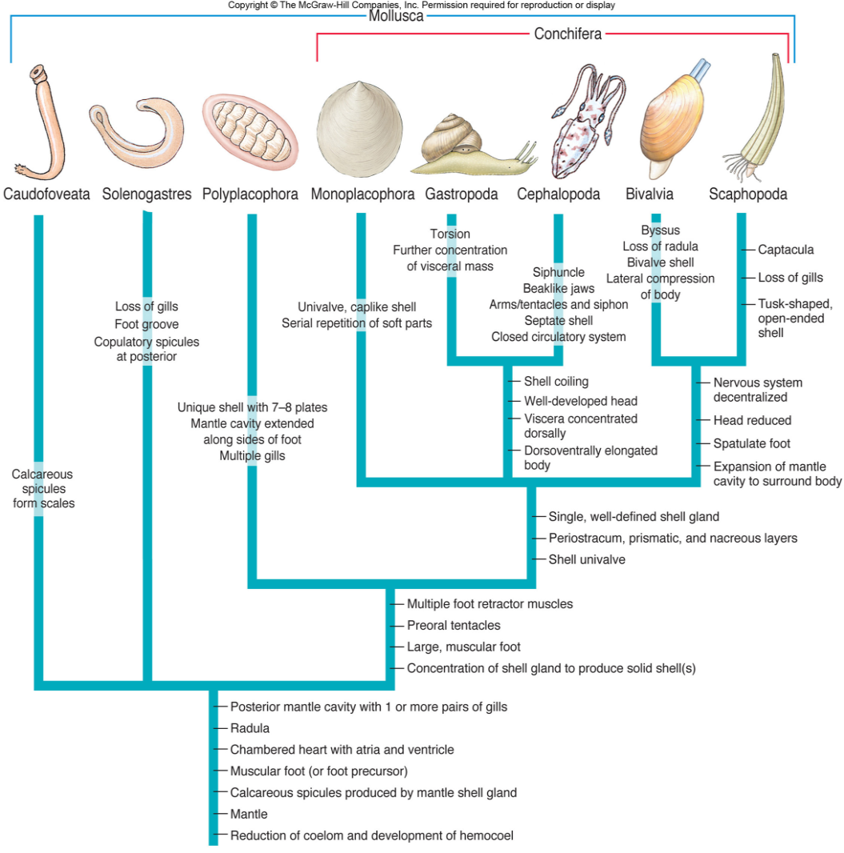
Major Mollusk Classes
Four major classes of mollusks:
Class Polyplacophora – the chitons
Class Gastropoda – snails & slugs
Class Bivalvia – clams, mussels, oysters
Class Cephalopoda – octopus & squid

Slide 18
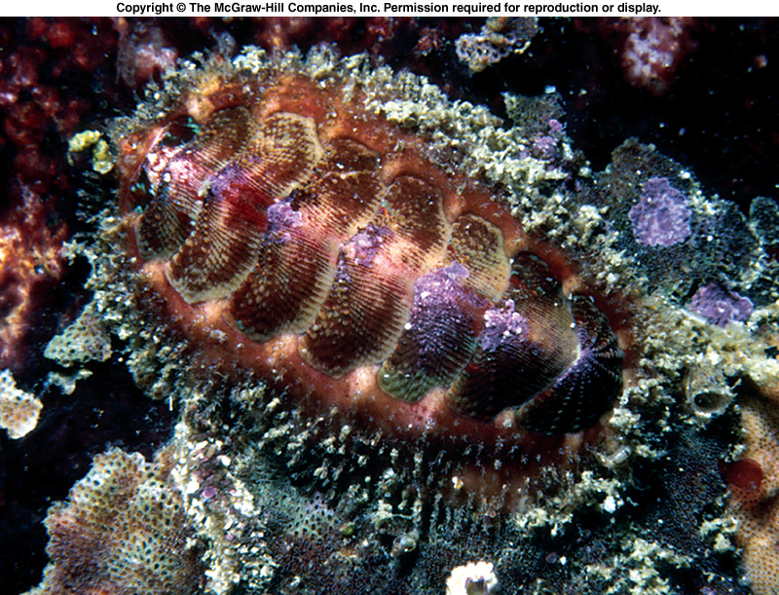
Class Polyplacophora
Includes the chitons
Eight overlapping plates
Can roll up
Live mostly in the rocky intertidal zones.
Use radula to scrape algae off rocks.
Water flows over gills to respire

Slide 19
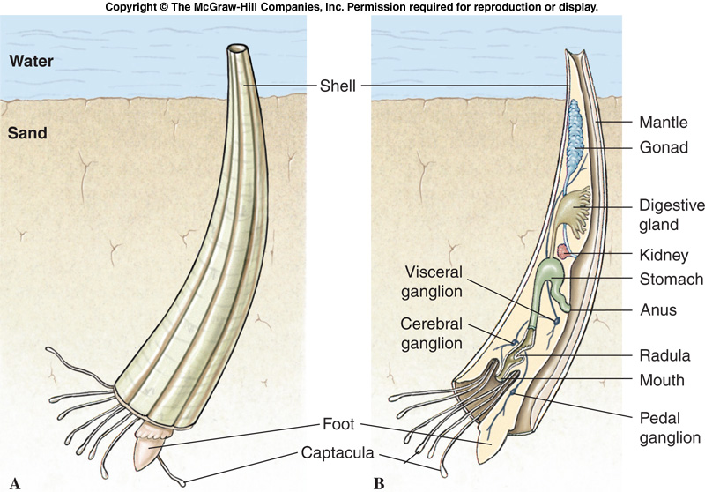
Class Scaphopoda
Includes the tusk shells.
Found in subtidal zone to 6000 m deep.
Mantle wraps around visceral mass and is fused, forming a tube.

Slide 20
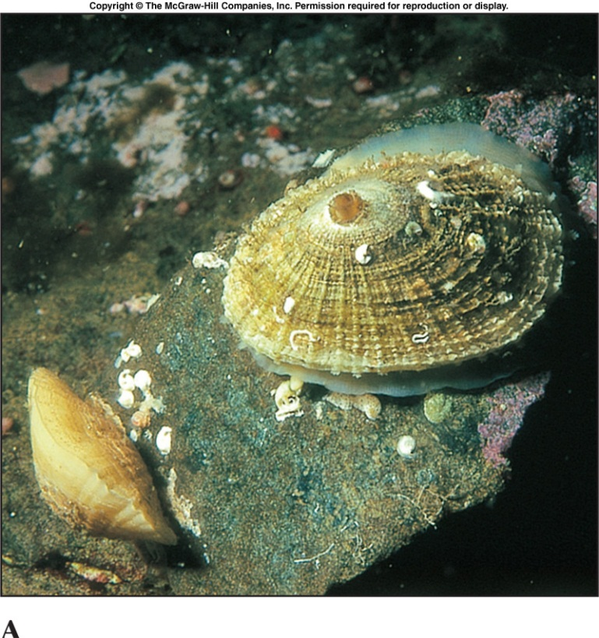
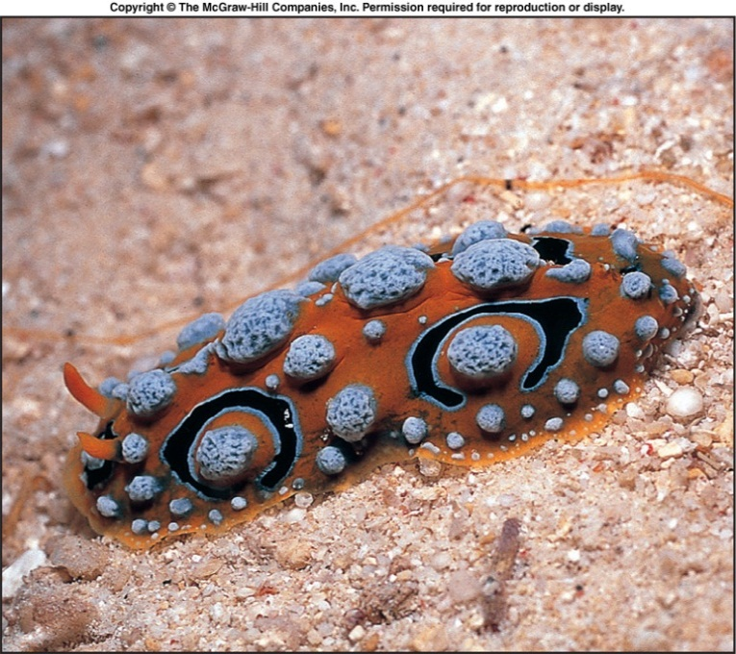
Class Gastropoda
Gastropoda is the largest of the mollusk classes.
70,000 named species.
Include snails, slugs, sea hares, sea slugs, sea butterflies.
Marine, freshwater, terrestrial.
Slugs lack a shell!

Slide 21
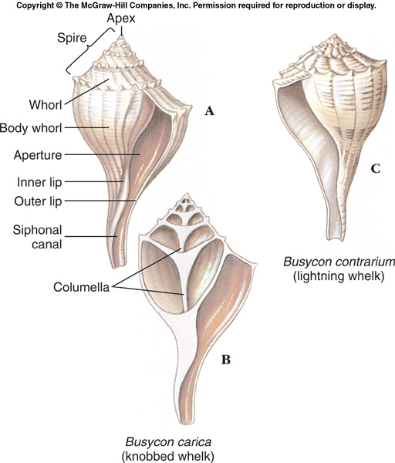
Class Gastropoda
The shell of a gastropod is always one piece – univalve – and may be coiled or uncoiled.
The apex contains the oldest and smallest whorl.
Shells may coil to the right or left – this is genetically controlled.

Slide 22
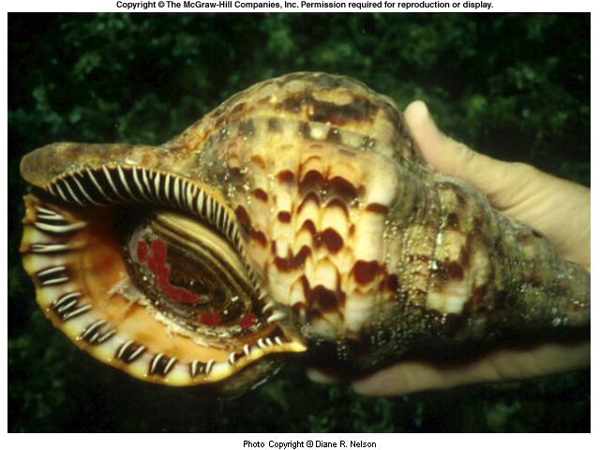
Class Gastropoda
Many snails can withdraw into the shell and close it off with a horny operculum.

Slide 23
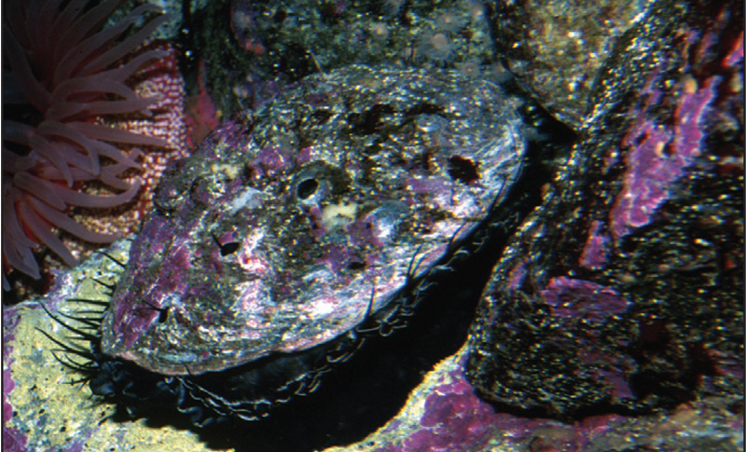
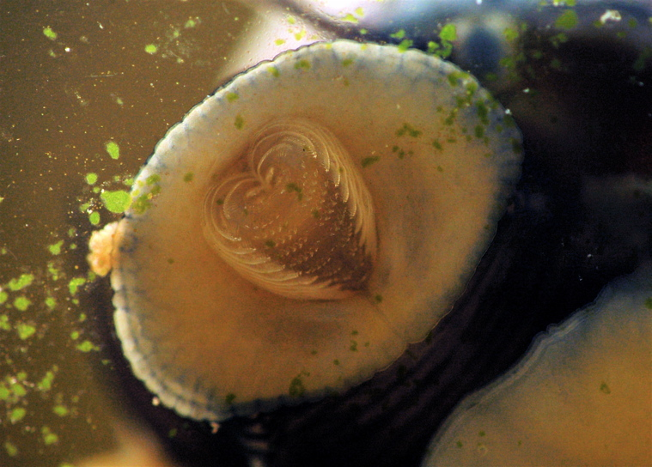
Gastropod Feeding Habits
Most gastropods are herbivores and feed by scraping off algae using the radula.
Some are scavengers of dead organisms
Others are carnivores that drill into other mollusks

Slide 24
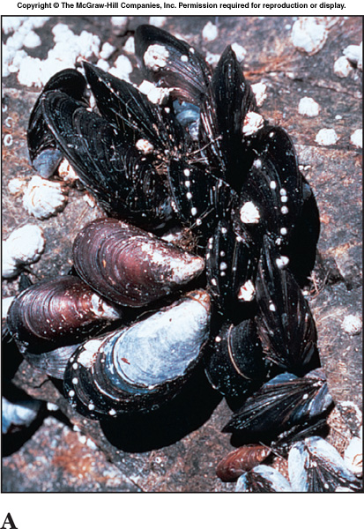
Class Bivalvia
Bivalve mollusks have two shells (valves).
Mussels, clams, oysters, scallops, shipworms.
Mostly sessile filter feeders.
No head or radula.

Slide 25
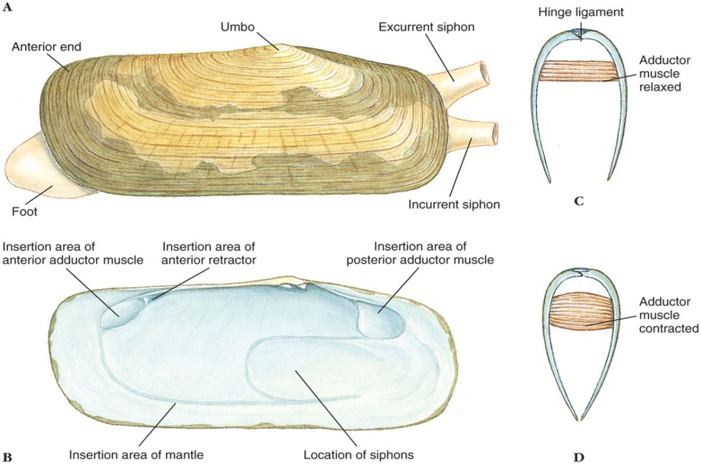
Class Bivalvia
Laterally (right-left) compressed shell
Shells are held together by a hinge ligament
Umbo is the oldest part of the shell
Growth occurs in concentric rings around it.

Slide 26
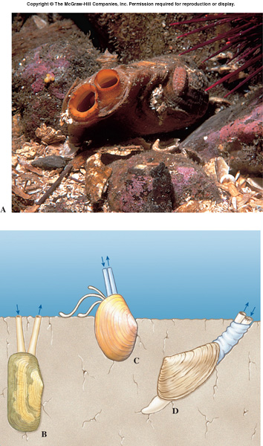
Class Bivalvia
Incurrent and excurrent siphons are used to pump water through the organism for:
Gas exchange
Filter feeding
Jet propulsion.

Slide 27
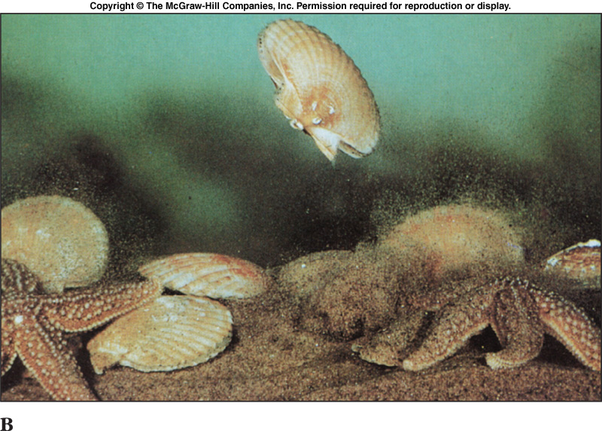
Class Bivalvia - Locomotion
Bivalves move around by extending the muscular foot between the shells.
Scallops and file shells swim by clapping their shells together to create jet propulsion.
http://www.youtube.com/watch?v=u_RfgvIETEY&feature=related
http://www.youtube.com/watch?v=vmi_I8QW5eo

Slide 28
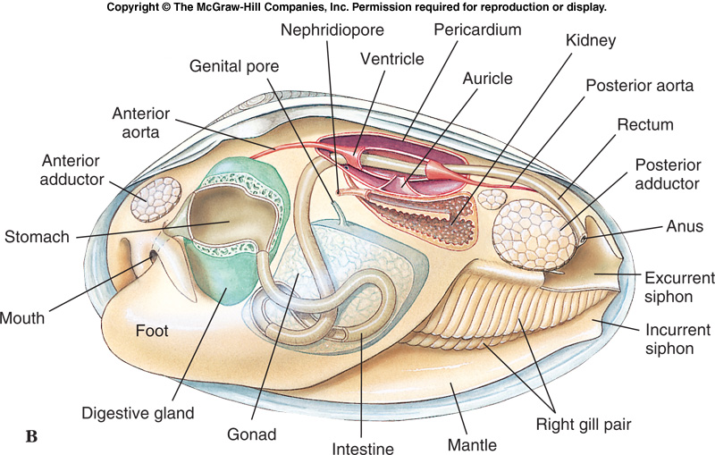
Class Bivalvia
Like other mollusks, bivalves have a coelom and an open circulatory system.
They breathe through gills and filter feed

Slide 29
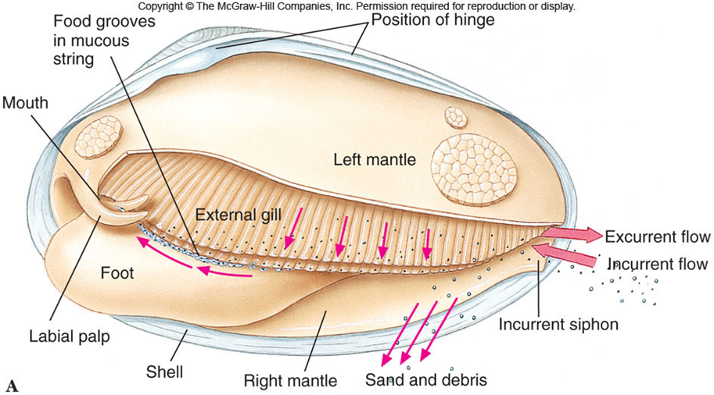

Slide 30
Class Bivalvia
Scallops have a row of small blue eyes along the mantle edge. Each eye has a cornea, lens, retina, and pigmented layer.

Slide 31
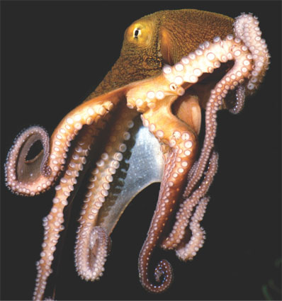
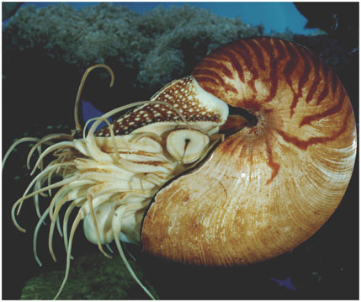
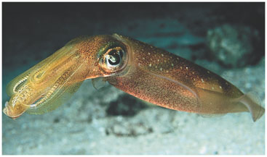
Class Cephalopoda
Cephalopods include octopuses, squid, nautiluses and cuttlefish.
Marine carnivores with beak-like jaws Surrounded by tentacles modified from their foot.

Slide 32
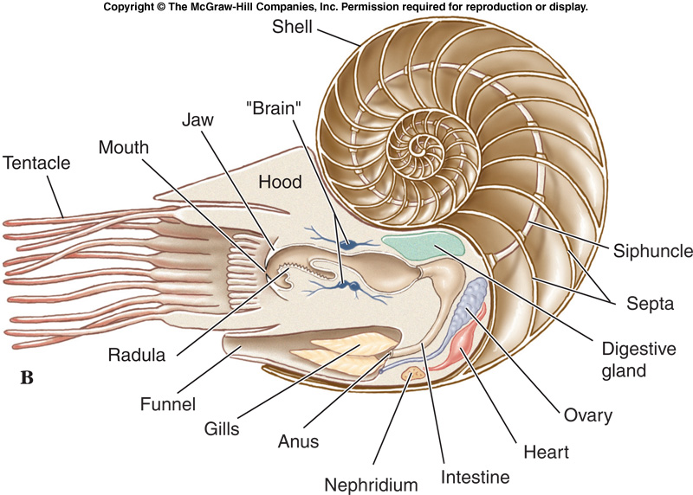
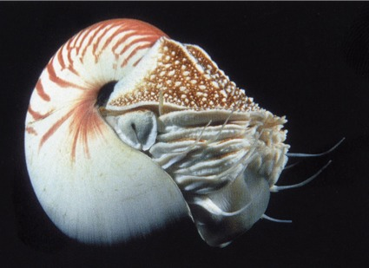
Class Cephalopoda - Shells
Shells of the Nautilus are made buoyant by a series of gas chambers.

Slide 33
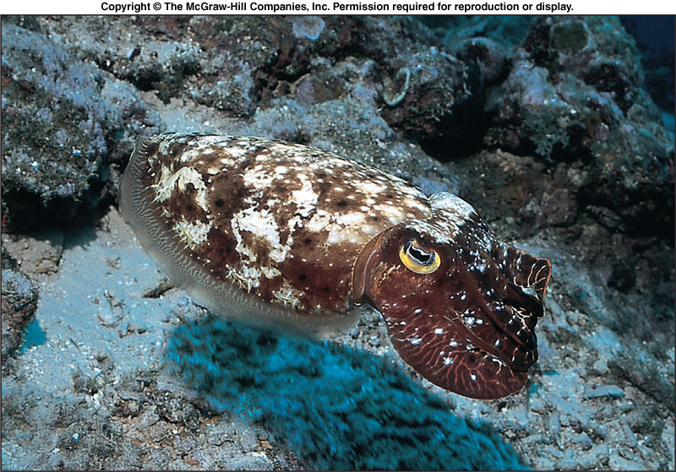
Class Cephalopoda - Shells
Cuttlefish have a small curved shell, completely enclosed by the mantle.

Slide 34
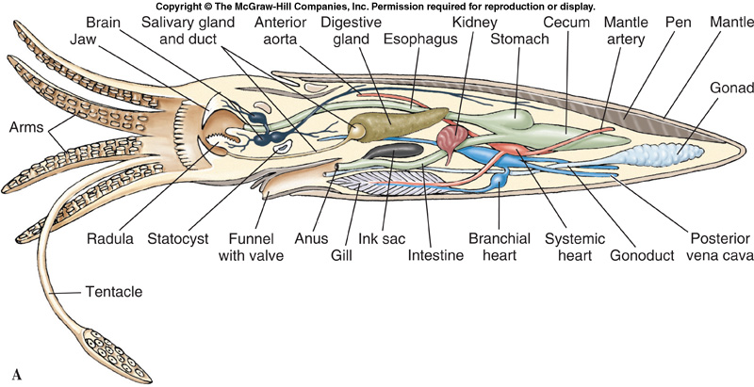
Class Cephalopoda - Shells
In squid, the shell has been reduced to a small strip called the pen, which is enclosed in the mantle.

Slide 35
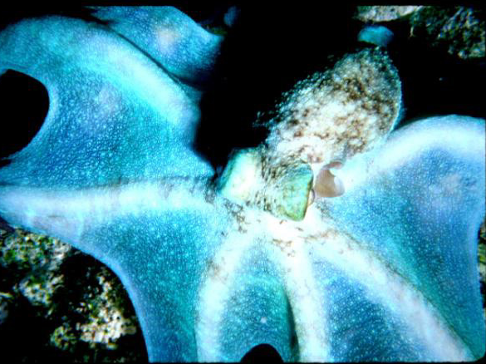
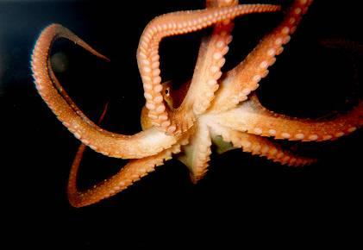
Class Cephalopoda - Locomotion
Cephalopods swim by expelling water from the mantle cavity through a ventral funnel.

Slide 36
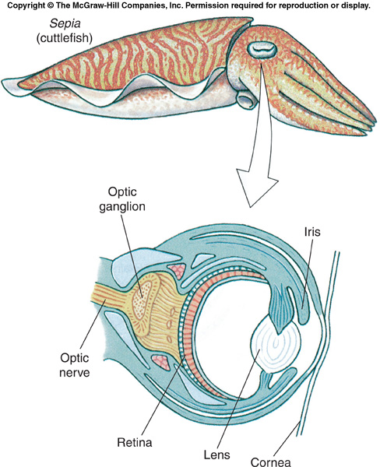
Class Cephalopoda
Most cephalopods have complex eyes with cornea, lens, chambers, and retina.
Largest invertebrate brain
Closed circulation

Slide 37
Protection
Color changes effected by chromatophores (pigment cells)
Allows them to blend into their background
Squirting out water by jet propulsion helps escape predators
Squids also release an inky substance into the water

Slide 38
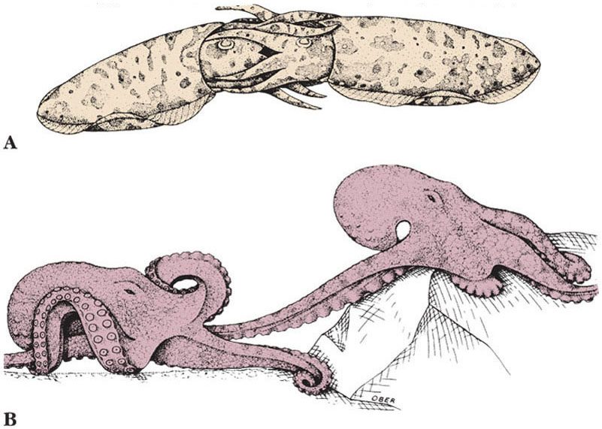
Class Cephalopoda - Reproduction
Sexes are separate in cephalopods.
Juveniles hatch directly from eggs – no free-swimming larvae.
One arm of male removes a spermatophore from mantle cavity and inserts it into female.

