Slide 1
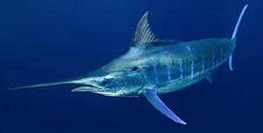
Atlantic Blue marlin
Makaira nigricans

Slide 2
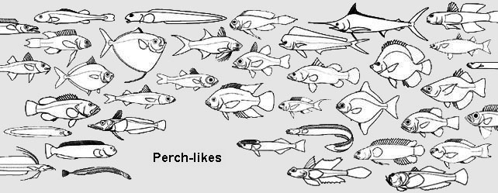
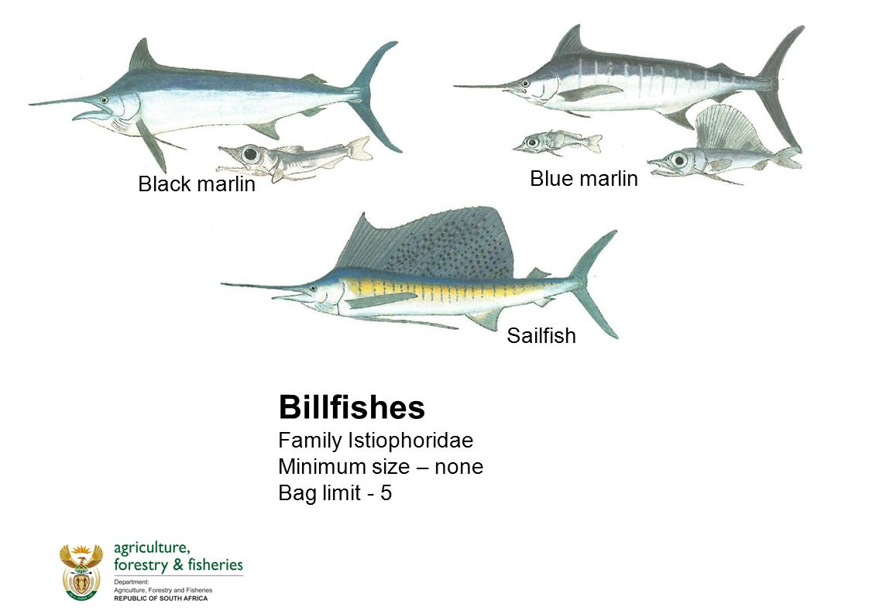
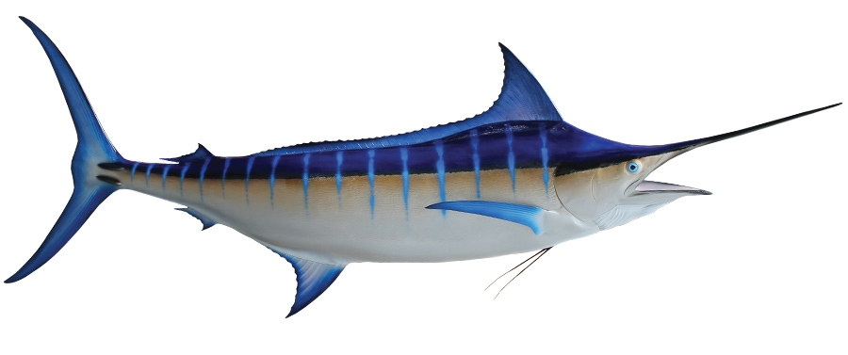
taxonomy
Kingdom – animalia
Phylum – chordata
Class – Osteichthyes
Order – perciformes
Family – istiophoridae
Genus – makaira
Species - nigricans

Slide 3
Physical Characteristics
Eye is the largest of all billfish species and can be kept warm with specialized cells to enhance vision in low-light conditions
Most distinctive feature is the long bill projecting outward from the front, thinner than that of its closest relative, the black marlin. It is covered in rough denticles that can stun prey
Ear bones called otoliths detect vibrations caused by soundwaves propagating through water
Lateral line uses specialized hair cells to sense prey
Stiff operculum protects gills
Specialized bones act as hinges to allow the jaw to open wider than would otherwise be possible, allowing the marlin to consume larger prey
Pectoral, dorsal, and pelvic fins aid the marlin in balance and maneuverability; also can be retracted to enhance speed
A highly developed optic center in the brain endows the marlin with excellent vision to aid in hunting
Lunate caudal fin extends above and below width of body to enhance swimming efficiency.
The Blue Marlin can grow up to 14 feet in length and weigh up to 1,985 pounds!
https://www.nationalgeographic.com/animals/fish/b/blue-marlin/

Slide 4
Internal Anatomy the blue marlin’s internal organs are similar to those of most osteichthyes
Notable features
gills – delicate flaps of tissue beneath operculum used for gas exchange
Spinal cord – relays sensory information throughout the body
Heart – pumps blood throughout the body for gas exchange with tissues
Stomach and intestines – digest food and absorb nutrients
Pyloric cacum – secretes enzymes that aid in digestion
Liver – secretes enzymes to break down fats; helps filter waste from body
Gonad – reproductive organ
Urinary orifice (vent) – site of waste excretion

Slide 5
Range and distribution
The Atlantic Blue Marlin is ubiquitous throughout the tropical, sub-tropical, and temperate waters of the Atlantic Ocean.
Its latitudinal range extends from about 44̊ N to 30̊ S.

Slide 6
reproduction
The Blue marlin is a spawning species, with females producing millions of eggs in a reproductive season (May – November).
Males produce milt, the seminal fluid of bony fishes, to fertilize the eggs.
Spawning is known to occur offshore of cuba.
Females can spawn up to four times in one season, producing upwards of 7 million eggs. Less than 1% of the offspring will survive to adulthood.
The blue marlin larvae are about 12.5 mm when first hatched.

Slide 7
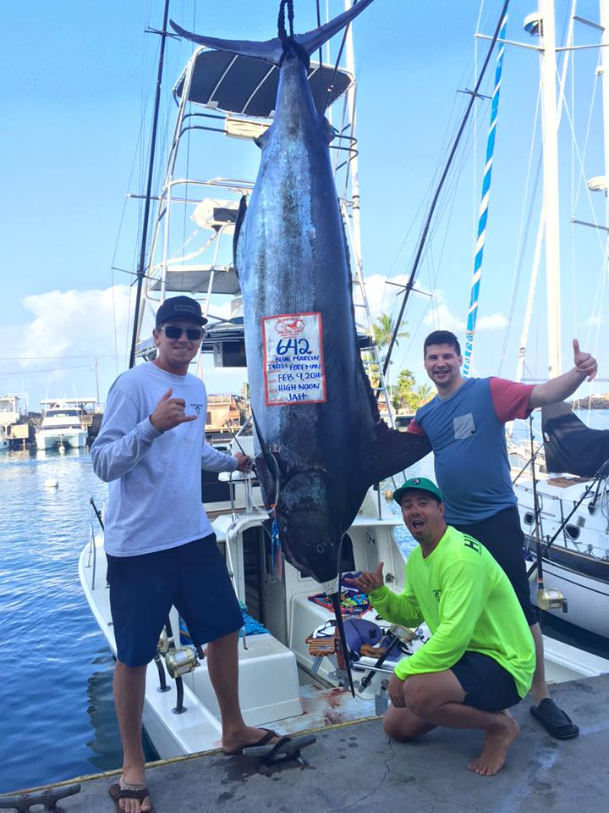
Unique characteristics
Arguably the most unique and identifying characteristics of the Atlantic blue marlin include its long, spear-like bill and large, pointed first dorsal fin. These distinctive features, along with its copious size make this species highly sought after by humans, both for its meat and as a trophy for sport anglers.
Although not endangered, marine conservationists worry that the species is currently being fished at rates that may not be sustainable.

Slide 8
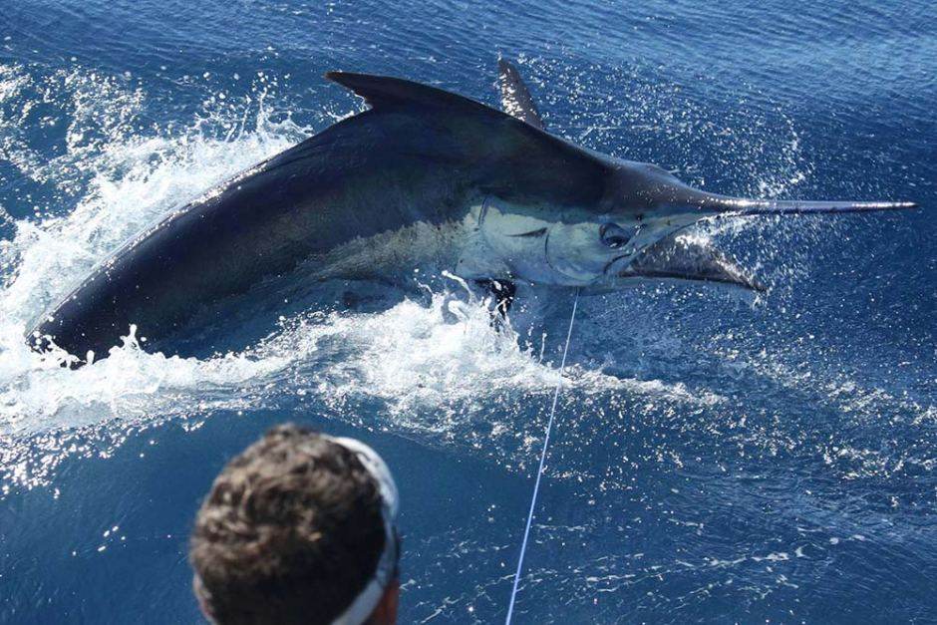
diet
The Atlantic blue marlin is an apex predator that spends most of its time near the surface waters of the open ocean. As such, its primary food sources include tuna, mackerel, dolphinfish, and other species that may be found in the same area. They are also known to feed on invertebrate species such as squid.
Anglers often use the blue marlin’s natural prey as live bait to catch them

Slide 9
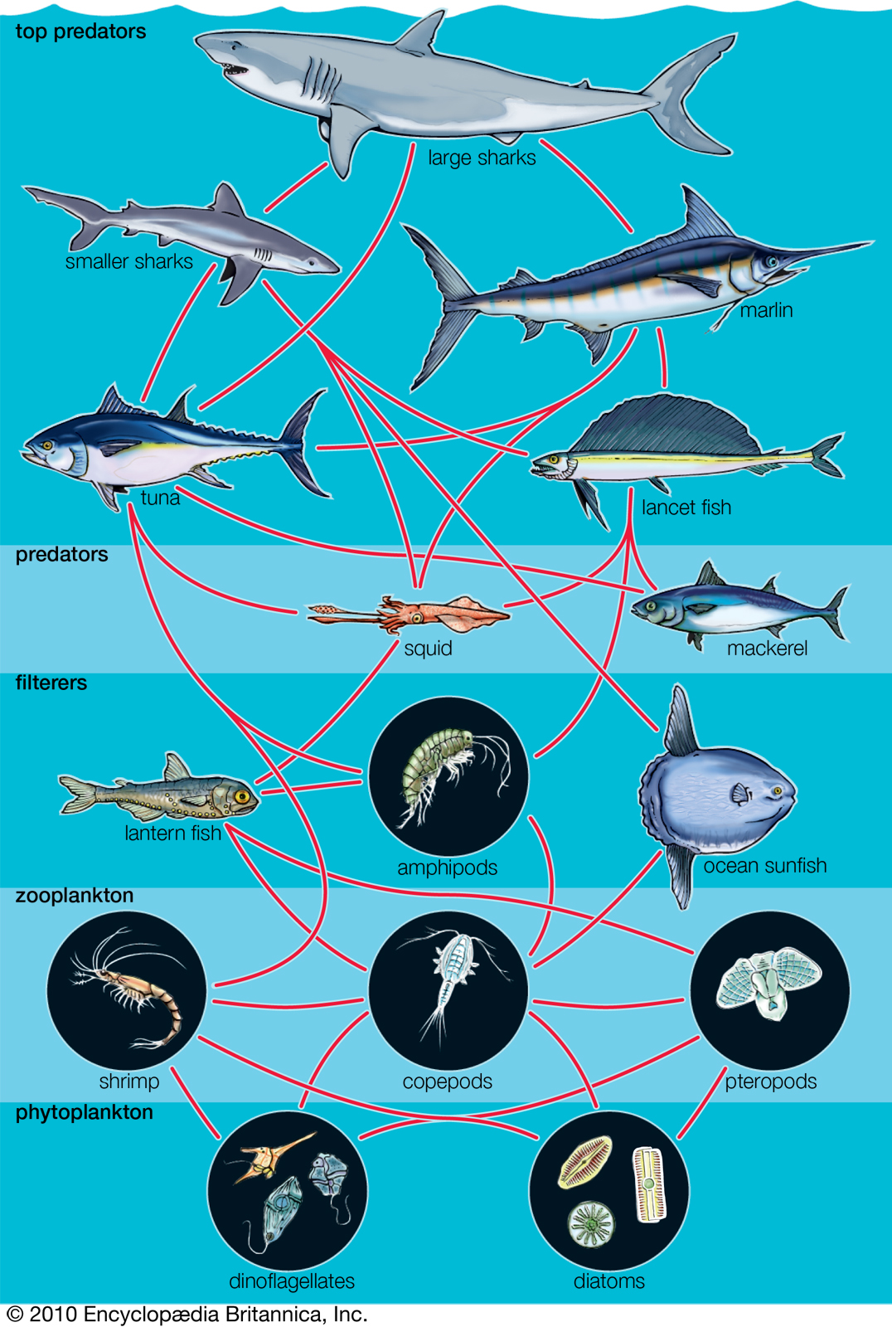
Habitat and niche
The blue marlin is one of the top predators in the open ocean ecosystem. While not widely considered a keystone species, it still serves an important role in regulating the populations of fish at lower trophic levels.
If blue marlins were to be removed from the ecosystem, possible consequences might include increased populations of other large pelagic fish species and subsequent decreases in numbers of organisms at lower trophic levels. Repercussions would most likely extend to lowering biodiversity and therefore the overall health of the pelagic ecosystem.

Slide 10
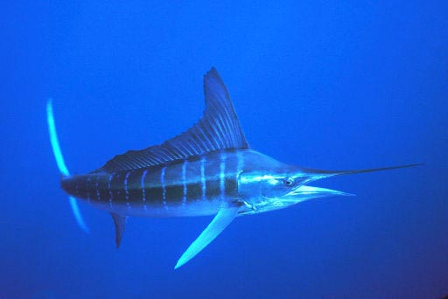
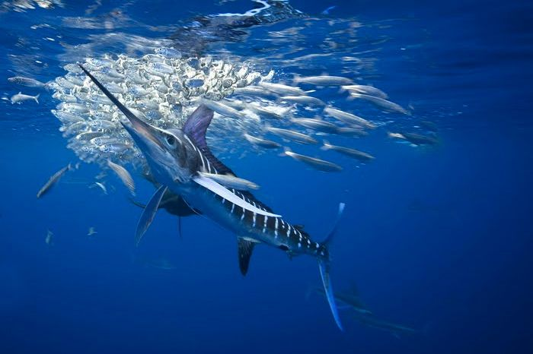
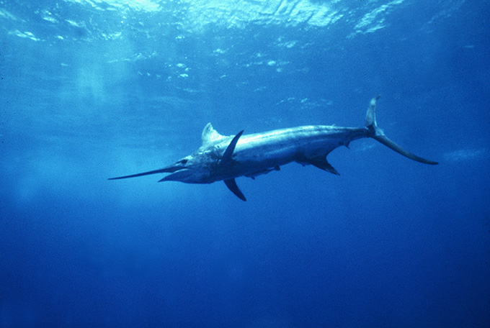
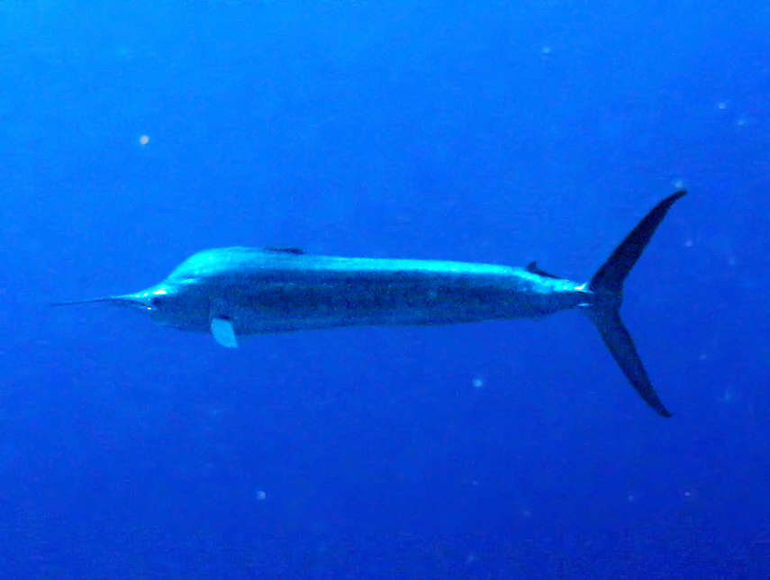
adaptations
The blue coloration on the dorsal side and silver on the ventral side help the blue marlin blend with its environment when viewed from the top or bottom.
One function of the long bill is to slash and stun prey.
Unlike some other billfish species, the blue marlin is not known to travel in schools, but prefers to hunt alone.
Its fins are retractable, making its body more hydrodynamic and maximizing its speed.

Slide 11
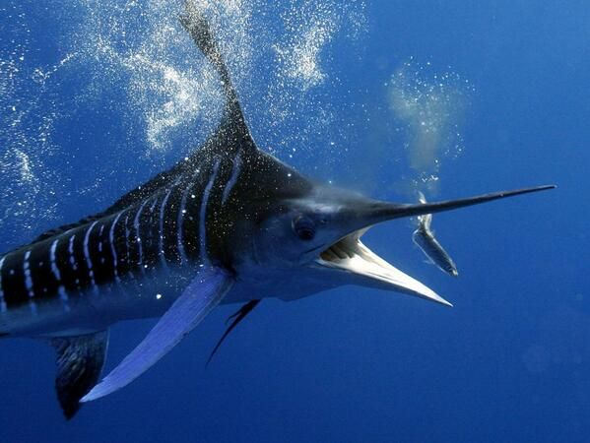
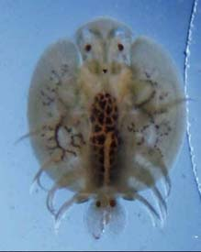
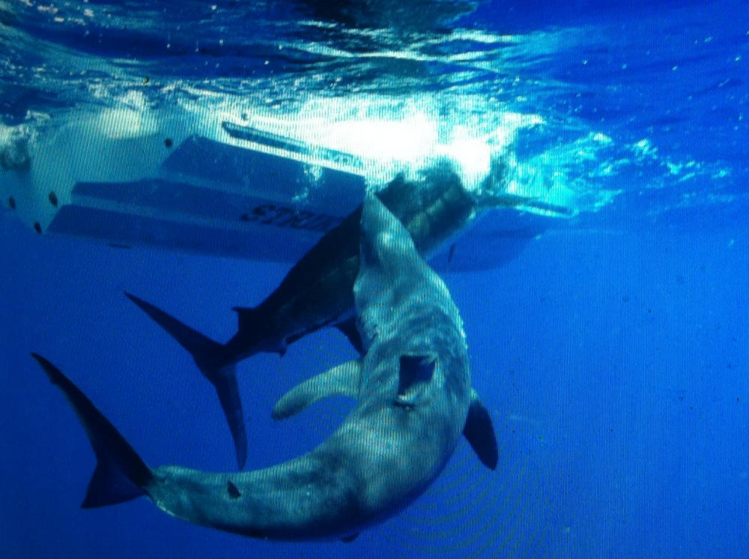
symbiosis
Branchiura, commonly known as sea lice, is an external parasite that can infect the blue marlin’s scales, causing irritation.
The blue marlin can end up on either side of a predator/prey relationship.

Slide 12
Blue marlin on the hunt!
https://www.youtube.com/watch?v=B2kQF7eWkIs
Start video at 1:22
The above clip shows a blue marlin utilizing its bill to pick out a fish from a school and stun and eat it.
Biotic factors evident here include the marlin itself and its living prey.
Abiotic factors include the water and suspended particles within it, affecting visibility and light penetration. The light reflecting off the fish’s scales is also beneficial to help the marlin locate its prey, as its eyesight is well developed.

Slide 13
Works cited
Bannerot2018-04-01T10, S. (n.d.). Blue Marlin Biology. Retrieved from https://www.marlinmag.com/blue-marlin-biology-and-physiology
Blue marlin Facts. (n.d.). Retrieved from http://www.softschools.com/facts/animals/blue_marlin_facts/297/
How-To Catch Blue Marlin. (n.d.). Retrieved from http://www.floridasportsman.com/sportfish/bluemarlin/
Makaira nigricans. (2017, May 09). Retrieved from https://www.floridamuseum.ufl.edu/discover-fish/species-profiles/makaira-nigricans/
Weitzman, S. H., & Parenti, L. R. (2018, June 08). Fish. Retrieved from https://www.britannica.com/animal/fish/Reproduction

