Slide 1
The atomic nucleus, isotopes, and radioactive decay
https://commons.wikimedia.org/wiki/File:Radioactive.svg

Slide 2
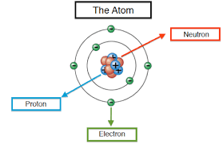
Recall that atoms are composed of 3 subatomic particles: protons, neutrons, and electrons
Protons – (+) charge, mass of 1 amu
Neutrons – no charge, mass of 1 amu
Electrons – (-) charge, no mass (or so small we can ignore it)

Slide 3
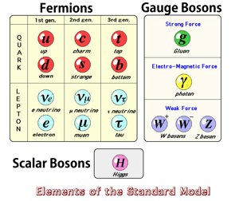
Fyi, there are lots more but you only need to know protons, neutrons, and electrons

Slide 4
The number of protons determines an atom’s identity.
For instance, an atom with 6 protons is always carbon
An atom with 8 protons, is always oxygen
An atom with 74 protons is ALWAYS Tungsten

Slide 5
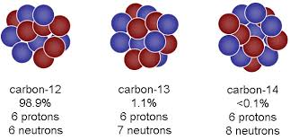
However…
Sometimes we find atoms that have the same number of protons (so they are the same element) but different numbers of neutrons
Ex: 98.9% of carbon on Earth has 6 protons and 6 neutrons, but 1.1% has 6 protons and 7 neutrons, and >0.0001% has 6 protons and 8 neutrons
These are called isotopes.
https://atmos.washington.edu/~dennis/321/321_Lecture_23.pdf

Slide 6
When we write chemical symbols for isotopes,
The atom’s mass number goes in the top left, and the atomic number goes in the bottom left.
${}_{6}^{12}C$, ${}_{6}^{13}C$ , ${}_{6}^{14}C$
We could also represent them this way
C-12, C-13, C-14

Slide 7
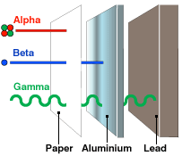
Remember that particles of the nucleus (protons and neutrons) are held together by the strong force.
However, some isotopes are unstable. When that happens, particles can be spontaneously ejected from the nucleus.
We call this radioactive decay.
There are 3 types:
Alpha radiation, Beta radiation, and Gamma radiation

Slide 8
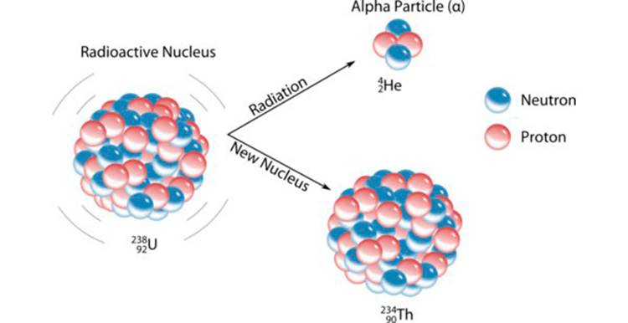
Alpha decay

Slide 9
Beta decay

Slide 10
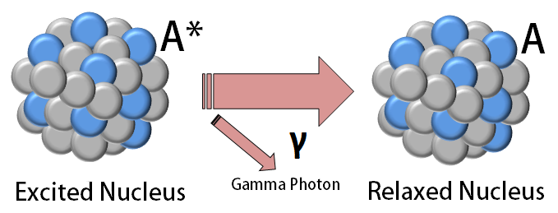
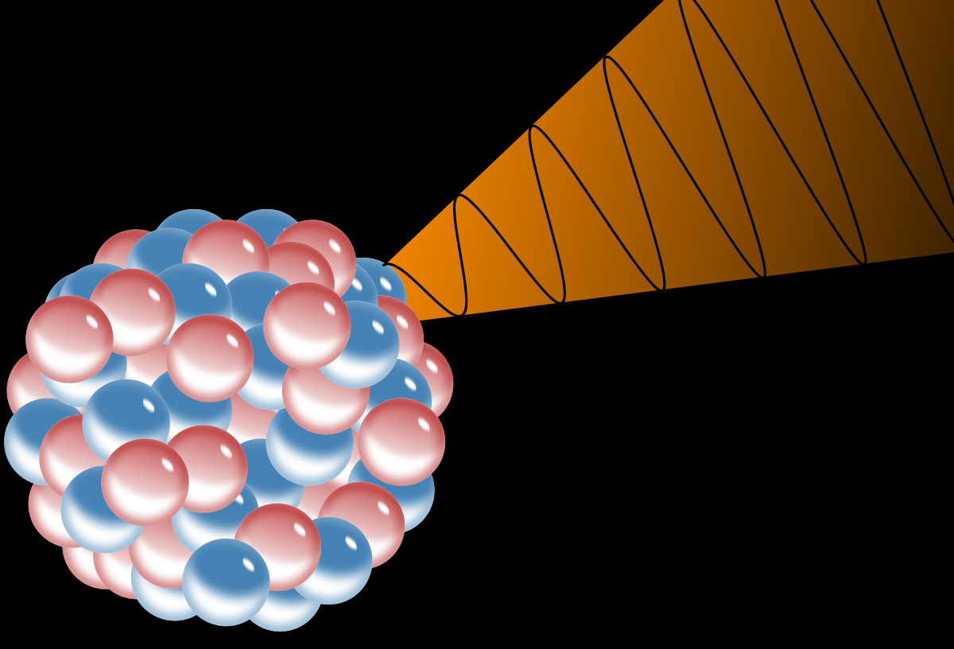
Gamma decay

Slide 11
The time it takes for half of a radioactive substance to decay is known as its half life.
Scientists use this information to estimate the age of rocks and artifacts.

Slide 12
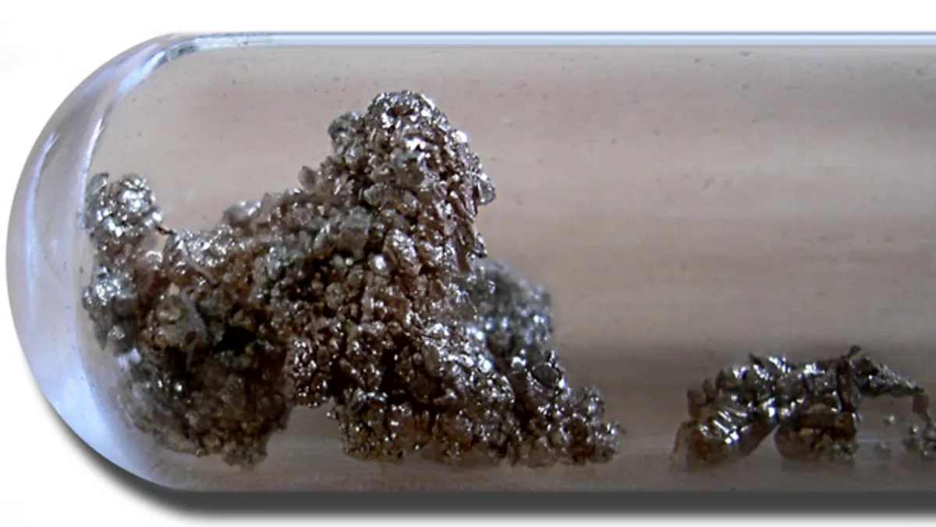
For example, Strontium-90 undergoes Beta decay to become Yttrium-90, with a half life of about 29 years.

