Slide 1
Welcome!
Back to School Night 2015

Slide 2
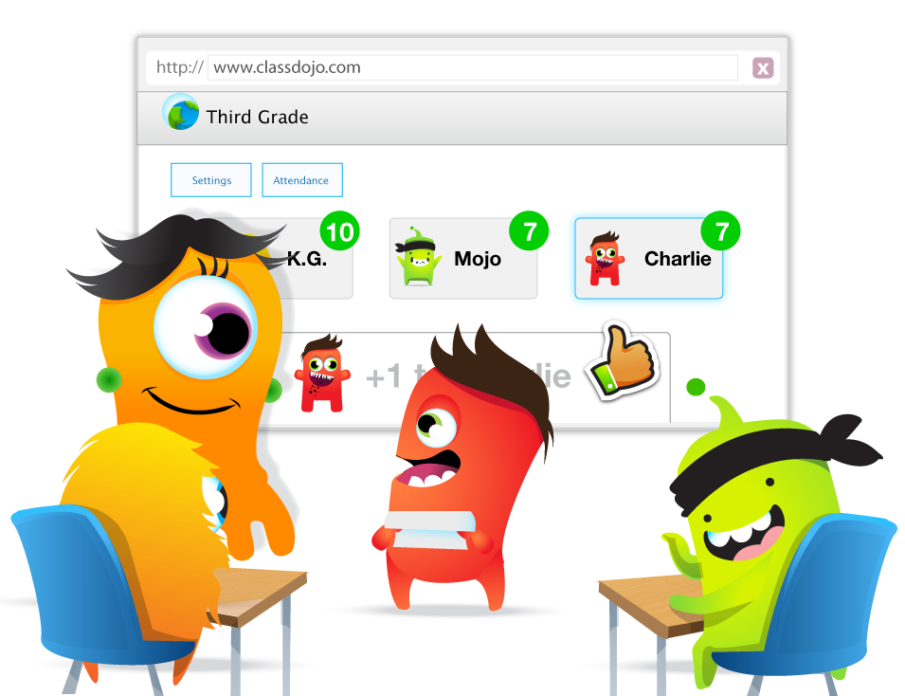
Classroom Expectations
This year we will be focusing on building important life skills such as working hard and participating.
I’ll be using ClassDojo to give students feedback on these skills :)

Slide 3
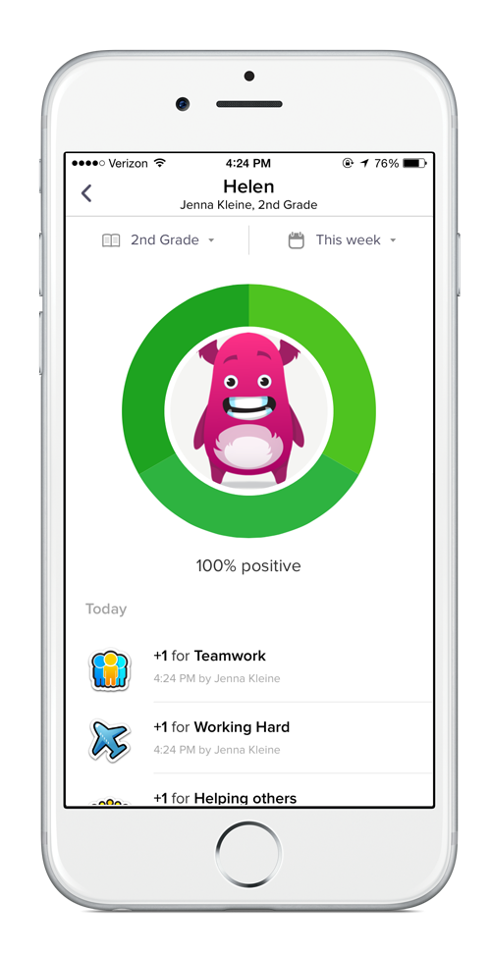
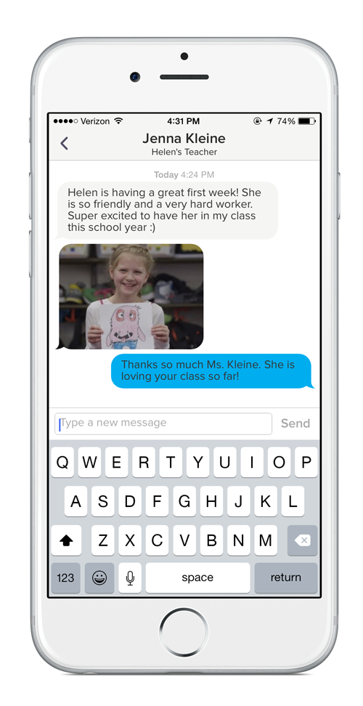
Why use ClassDojo?
ClassDojo is the easiest way to see your child’s progress on these skills.
I’ll be sending classroom updates and photos with you through ClassDojo, too!

Slide 4
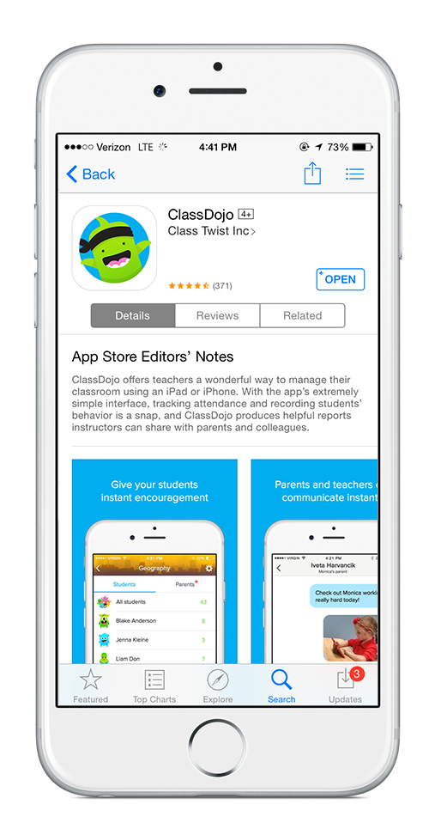
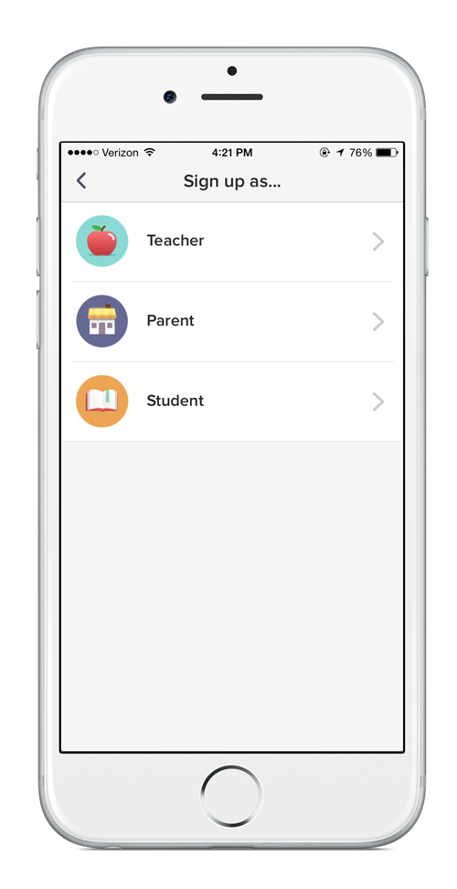
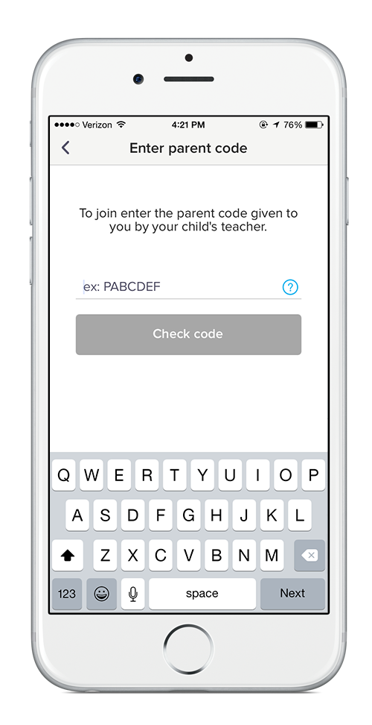
Get out those phones :)
Download the app
Sign up as a parent
Enter your code!

Slide 5
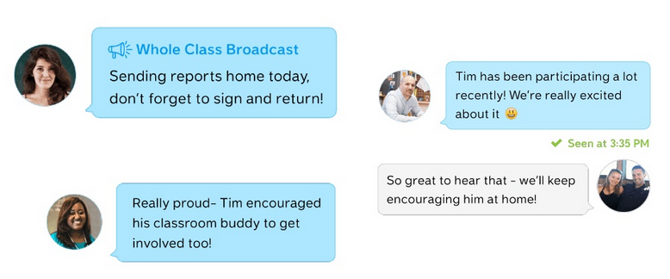
Let’s try it out
I’ll send you a message now!
Go ahead… send one back :)

Slide 6
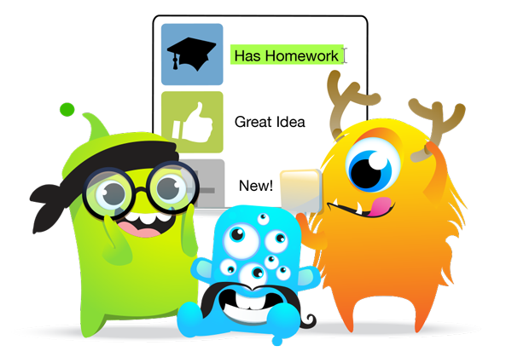
How else can we work together?
Check ClassDojo regularly.
Keep me updated on how your child is doing at home.
Encourage the life skills we are working on in class outside of school.
Celebrate wonderful classroom moments at home :)
Let me know how I can be most helpful!

Slide 7
I’m always here to help if you need anything, as well as the ClassDojo team who can be reached at parents@classdojo.com :)

